Slide 1
Electronic Payment Exemption Request Form
OFMA
March 1, 2012

Slide 2
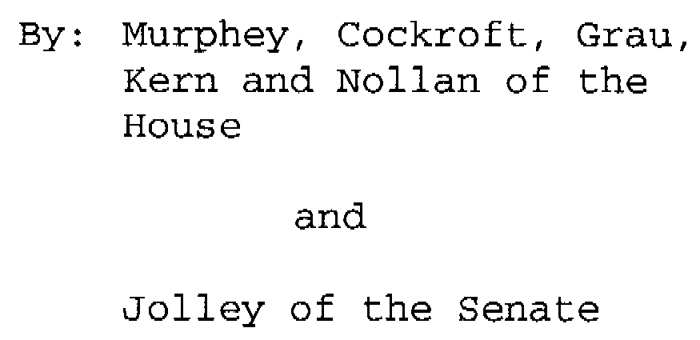
HB 1086

Slide 8
FAQs
Since all of our agency funds are already disbursed by the Treasurer’s Office, do we need to do anything with this Exemption Request Form?
The Treasurer’s Office processes payment records in the manner specified in the record initiated by the agency. State agencies can specify that payments be made with a warrant, or with an ach (a form of electronic funds transfer) or wire transfer. Effective July 1, 2012, the Treasurer’s Office plans to continue to process payment records as they are received. If your agency must continue to process any payments via warrant, for whatever reason, you will need to request an exemption using the form that was distributed.
If we are just making vendor payments through CORE do we need to request an exemption?
Each agency who initiates a disbursement that cannot be processed through an electronic payment mechanism must request an exemption. If your agency will issue a payment to any vendor in CORE that does not have the banking information available to select and utilize to issue an electronic payment, then you will need to request an exemption pursuant to Section B of the Request for Exemption electronic document that has been distributed. Your request does not have to be vendor specific but can address the lack of banking data for certain vendors within the CORE vendor system.
Does HB 1086 apply to 700 funds?
Yes, 700 fund payments are examples of payments required by HB1086 to be disbursed from the State Treasury electronically unless the Treasurer has granted an exemption for cause.

Slide 9
How can our agency get set up to make electronic payments?
If your agency wants to issue an electronic payment to a CORE vendor that does not have the banking information available to select, contact the vendor and encourage them to utilize the CORE vendor portal to register to receive electronic funds transfers. If your agency wants to make electronic payments that do not originate in CORE please contact Diedra O’Neil, diedra.oneil@treasurer.ok.gov, 522-4256 or Carole Bailey, carole.bailey@treasurer.ok.gov, 522-4216 with our Banking Services Division. We are currently dealing with a rush of such requests and expect that it will take some time to work through them.
I am having trouble using the Electronic Exemption Request Form, don’t know what to do with the completed form or have another question about the exemption request process what can I do?
Contact Susan Eubanks, 522-4215, for assistance with the Request Form and submit completed forms and questions to Electronic.Payment.Exemption@treasurer.ok.gov.

