Slide 1
Higher Education Payroll Processing & Reporting Jan 2016
Q & A Session - overview August 5, 2015

Slide 2
Session Overview
Payroll Fund Transfer (PFT)
New file layout, account codes, example
500 Misc File
File layout, example
OMES Processing of PFT & 500 Misc Files
OST Processing of 500 Misc File
Processing of taxes and withholdings
Processing of returned direct deposits
Processing cancellation of paper warrants and direct deposits

Slide 3
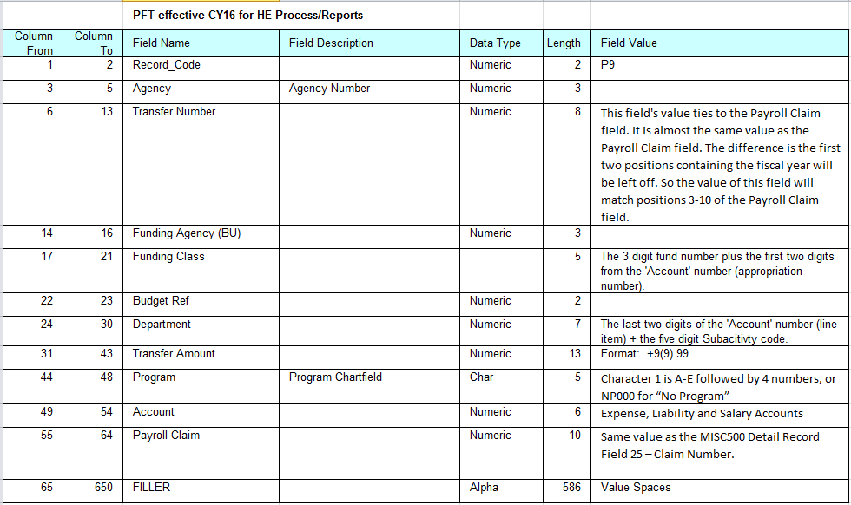
NEW PFT Layout

Slide 4
NEW PFT Account Codes
Account Description |  | New PFT Acct Code |  | New AP Acct Code for Vouchers |  |  | Currrent Account Code to use on PFT from Funding Source
Payroll Payable |  | 485060 |  | 585060 |  |  | na
Federal Income Tax W/H |  | 485110 |  | 585110 |  |  | na
FICA-ER Share |  | 485120 |  | 585120 |  |  | na
FICA-EE Share |  | 485125 |  | 585125 |  |  | na
MQFE-ER Share |  | 485130 |  | 585130 |  |  | na
MQFE-EE Share |  | 485135 |  | 585135 |  |  | na
State Income Tax W/H |  | 485140 |  | 585140 |  |  | na
OPERS-ER Share |  | 485200 |  | 585200 |  |  | na
OPERS-EE Share |  | 485205 |  | 585205 |  |  | na
Def Comp-ER Match |  | 485220 |  | 585220 |  |  | na
Def Comp-EE Share |  | 485225 |  | 585225 |  |  | na
OLERS-ER Share |  | 485230 |  | 585230 |  |  | na
OLERS-EE Share |  | 485235 |  | 585235 |  |  | na
Unemployment Tax - ER Share |  | 485400 |  | 585400 |  |  | na
Unemployment Tax W/H |  | 485405 |  | 585405 |  |  | na

Slide 5
NEW PFT Account Codes
Account Description |  | New PFT Acct Code |  | New AP Acct Code for Vouchers |  |  | Currrent Account Code to use on PFT from Funding Source
Sals-Regular Pay |  | na |  | na |  |  | 511110
Sals-Non-Reg Pay |  | na |  | na |  |  | 511130
Sals-H.Ed Teaching Pay |  | na |  | na |  |  | 511140
Sals-H.Ed Prof.(Non-Teach) Pay |  | na |  | na |  |  | 511150
Sals-H.Ed Non-Prof. Pay |  | na |  | na |  |  | 511160
Sals-H.Ed Other Teach Pay |  | na |  | na |  |  | 511170
Longevity Pay-H.Ed |  | na |  | na |  |  | 511220
Individ.Incent.Pay-Safety Awds |  | na |  | na |  |  | 511230
Ind. Health Incentive Payments |  | na |  | na |  |  | 511260
Overtime Wages |  | na |  | na |  |  | 511270
Holiday Pay - Payroll Only |  | na |  | na |  |  | 511280
Pay Differential |  | na |  | na |  |  | 511290
Education Loan Reimb Incentive |  | na |  | na |  |  | 511300
Terminal Leave |  | na |  | na |  |  | 511310
Cafeteria Plan - Other |  | na |  | na |  |  | 511390
Compensation - Brd-Com Members |  | na |  | na |  |  | 511400
Excess Benefit Allowance |  | na |  | na |  |  | 511420
Employee Exp.Allow-Reportable |  | na |  | na |  |  | 511430
Unemployment Compen.-Payroll |  | na |  | na |  |  | 512210
Employer Share-FICA |  | na |  | na |  |  | 513110
Employer Share-MQFE/FICA |  | na |  | na |  |  | 513120
Employer Share OPERS |  | na |  | na |  |  | 513230
ER Share-Other Auth.Ret.Sys |  | na |  | na |  |  | 513240
ER Match-Ad Fee-State Annuity |  | na |  | na |  |  | 513280
Supplemental Retmt Plans-HEd |  | na |  | na |  |  | 513320
Retirement Pmts-Hed |  | na |  | na |  |  | 514440
Employee Reimb.-Non-Travel |  | na |  | na |  |  | 561130

Slide 6
NEW PFT Account Codes
Account Description |  | New PFT Acct Code |  | New AP Acct Code for Vouchers |  |  | Currrent Account Code to use on PFT from Funding Source
W/H-Other Insurance-2% |  | 485310 |  | 585310 |  |  | na
W/H-Other Insurance-No Fee |  | 485315 |  | 585315 |  |  | na
W/H-Other Retirement-1% |  | 485320 |  | 585320 |  |  | na
W/H-Other Retirement-No Fee |  | 485325 |  | 585325 |  |  | na
W/H-Credit Union and Banks |  | 485330 |  | 585330 |  |  | na
W/H-Empl Tax Shelt Annuity |  | 485340 |  | 585340 |  |  | na
W/H-Cafeteria |  | 485350 |  | 585350 |  |  | na
W/H-457 Tax Def Retirement |  | 485360 |  | 585360 |  |  | na
W/H-403b Tax Def Retirement |  | 485370 |  | 585370 |  |  | na
W/H-401k Tax Def Retirement |  | 485380 |  | 585380 |  |  | na
W/H-401a Tax Def Retirement |  | 485385 |  | 585385 |  |  | na
W/H-Other (Garnish,levies,etc) |  | 485390 |  | 585390 |  |  | na

Slide 7
PFT Example - Excel

Slide 8
PFT Example – Claim Doc

Slide 9
PFT Example – dat file

Slide 10
PFT Example – Report

Slide 11
PFT
Questions???

Slide 12
500 Misc File Layout General Rules
Each file shall only contain records for one payroll claim for one agency.
All fields are required unless stated otherwise.
Alpha fields are left justified. Unused positions are filled with spaces.
Numeric fields are right justified. Unused positions are filled with leading zeros.

Slide 13
500 Misc File Layout Header Record
Header Record
DESCRIPTION | TYPE | POSITION | LEN | VALUE / DESCRIPTION
1. Agency Account Number | Numeric | 1 - 7 | 7 | ‘0000000'
2. Agency Number | Numeric | 8 - 10 | 3 | 3-digit agency number
3. File Creation Date | Numeric | 11 – 18 | 8 | YYYYMMDD
4. File Creation Time | Numeric | 19 - 24 | 6 | HHMMSS
5. File Load Name | Alpha | 25 – 32 | 8 | ‘500MIXXX’ where XXX=3-digit agency number
6. Record Type | Alpha | 33 - 38 | 6 | ‘HEADER’
7. Claim Number | Numeric | 39 - 48 | 10 | Same value as Detail Record Field 25 – Claim Number. *all detail records in the file will have the same claim number.
8. Filler | Alpha | 49 - 500 | 452 | Not used.

Slide 14
500 Misc File Layout Detail Record
Detail Record
DESCRIPTION | TYPE | POSITION | LEN | VALUE / DESCRIPTION
Key OST Account Number (i). Warrant Type (ii). Fund Number (iii). Agency Number b. Effective Date c. Warrant Number (i). Warrant Code (ii). Warrant Seq Nbr | GROUP Numeric Numeric Numeric Numeric GROUP Numeric Numeric | (1 – 7) 1 - 1 2 - 4 5 - 7 8 - 13 (14 – 22) 14 15 - 22 | 7 1 3 3 6 9 1 8 | This is a 7 position group field. It consists of the next 3 fields. Value ‘7’ 3-digit fund number ‘789’ 3-digit agency number YYMMDD (Payment Date of Payroll) This is a 9 position group field. It consists of the next 2 fields. Value ‘2’ (HiEd payroll identifier) Normal warrant number Warrant numbers can not be reused within 120 days
2. Amount | Numeric | 23 - 33 | 11 | Net pay amount 9(9)v99 Must be greater than zero
3. Payee Name | Alpha | 34 – 78 | 45 | Payee Name
4. Payee Address Line 1 | Alpha | 79 – 123 | 45 | Required for Pay Type P, Payee Address Line 1
5. Payee Address Line2 | Alpha | 124 – 168 | 45 | Optional, Payee Address Line 2
6. Payee City | Alpha | 169 – 203 | 35 | Required for Pay Type P, Payee City
7. Payee State | Alpha | 204 – 205 | 2 | Required for Pay Type P, State code
8. Payee Zip | Alpha | 206 – 215 | 10 | Required for Pay Type P, Zip Code format = 99999-9999

Slide 15
500 Misc File Layout Detail Record
Detail Record
DESCRIPTION | TYPE | POSITION | LEN | VALUE / DESCRIPTION
9. Pay Type | Alpha | 216 – 216 | 1 | See Table 1
Table 1 - Pay Type Values
A = EFT item, uses the bank account number sent with the record to create the EFT and add or update database account information for the participant. E = EFT item, does not use the bank account info in the transaction. It ONLY uses the participant’s bank account from the OST database to create EFT. P = Paper Warrant item.

Slide 16
500 Misc File Layout Detail Record
Detail Record
DESCRIPTION | TYPE | POSITION | LEN | VALUE / DESCRIPTION
10. Participant ID/Employee ID | Alpha | 217 – 231 | 15 | Either participant ID or Employee ID
11. Class ID | Alpha | 232 – 234 | 3 | OST assigns a specific Class ID to each agency.
12. Transit Number | Numeric | 235 – 243 | 9 | Required for Pay Type A Else, it is not used
13. Bank Account number | Alpha | 244 – 260 | 17 | Required for Pay Type A Else, it is not used
14. Checking/Savings Flag | Alpha | 261 – 261 | 1 | Required for Pay Type A Else, it is not used ‘C’ For Checking ‘S’ For Savings
15. Originating Agency Number | Numeric | 262 – 264 | 3 | 3-digit agency number
16. Filler | Numeric | 265 – 266 | 2 | ‘00’
17. Record ID | Alpha | 267 – 267 | 1 | ‘1'
18. Invoice ID | Alpha | 268 – 297 | 30 | Same value as Detail Record Field 25 – Claim Number plus a unique sequence number suffix for that claim. Examples: Claim Number_SeqNbr • YYAAASSSSS_000001 • YYAAASSSSS_000002 • Etc. *the sequence number suffix can be any length as long as all values are unique for the same claim number.

Slide 17
500 Misc File Layout Detail Record
Detail Record
DESCRIPTION | TYPE | POSITION | LEN | VALUE / DESCRIPTION
19. Invoice Date | Alpha | 298 – 305 | 8 | YYYYMMDD Payment Date of Payroll
20. Filler | Alpha | 306 - 307 | 2 | Not used.
21. Invoice Amount | Numeric | 308 – 318 | 11 | Net pay amount 9(9)v99 Same value as Field 2 – Amount
22A. INVOICE MESSAGE | GROUP | (319 – 388) | 70 | Optional This is a 70 position group field. It consists of the next 3 fields. They are only used for paper warrants ( i.e. when Pay Type = P)
22. Voucher Desc | Alpha | 319 – 325 | 7 | Optional. Usable when Pay Type = P.
23. Voucher ID | Alpha | 326 – 334 | 9 | Optional. Usable when Pay Type = P.
24 Voucher Description | Alpha | 335 - 388 | 54 | Optional. Usable when Pay Type = P.
25. Claim Number | Numeric | 389 – 398 | 10 | The claim number is a three part value: • YY = 2-digit fiscal year • AAA = 3-digit agency number • SSSSS = 5-digit claim sequence Same value is used in Header Record Field 7 – Claim Number.

Slide 18
500 Misc File Layout Detail Record
Detail Record
DESCRIPTION | TYPE | POSITION | LEN | VALUE / DESCRIPTION
26. Country Code | Alpha | 399 – 401 | 3 | If Pay Type = P, then this is required for non-US addresses.
27. Country Name | Alpha | 402 – 446 | 45 | If Pay Type = P, then this is required for non-US addresses.
28. Location (warrant sequence number) | Alpha | 447 – 456 | 10 | Not used.
29. Class PCD Addenda Number | Alpha | 457 – 472 | 16 | Not used.
30. RTGS Bank Line | Numeric | 473 – 478 | 6 | Not used.
31. Filler | Alpha | 479 – 500 | 22 | Not used.

Slide 19
500 Misc File Layout Trailer Record
Trailer Record
DESCRIPTION | TYPE | POSITION | LEN | VALUE / DESCRIPTION
1. Account Number | Numeric | 1 - 7 | 7 | ‘9999999’
2. Effective Date | Numeric | 8 - 13 | 6 | YYMMDD Same value as Header Record Field 3 – File Creation Date.
3. Total Number Warrants | Numeric | 14 - 22 | 9 | Total number of warrants in the file, not the total number of detail records.
4. Total Dollar Amount | Numeric | 23 - 33 | 11 | Total dollar amount of the warrants in the file. 9(9)V99
5. Filler | Alpha | 34 - 500 | 467 | Not used.

Slide 20
500 Misc
Questions???

Slide 21
OMES Processing
PFT
Validate PFT Funding Report
Payroll Claim Document
500 Misc File

Slide 22
OST Processing
500 Misc File
Issue Record to Financials
Paper Warrants
Remote Print
OST print

Slide 23
OMES/ OST Processing

Slide 24
Processing of Taxes and Withholdings
Federal Tax Payments
ACES Entry
Journal Entry
State Tax Payments
OPERS/OLERS/Deferred Comp Plan Payments
Other Withholdings

Slide 25
Processing of Taxes and Withholdings

Slide 26
Processing Returned Direct Deposits
Miscellaneous returns
Agency to reissue

Slide 27
Processing Cancellations
Paper Warrants
EFTs

Slide 28
Processing Cancellations

Slide 29
Processing Cancellations

Slide 30
Processing Cancellations

Slide 31
Reissue of Stat Cancels

Slide 32
Direct Deposits/Cancellations

Slide 33
Closing
https://public.govdelivery.com/accounts/OKOMES/subscriber/new?preferences=true
http://www.ok.gov/cio/Customer_Portal/Business_Application_Services_Essentials/Financials/Financials_News.html
Melody.Wright@core.state.ok.us OR Linda.Bove@core.state.ok.us
Next Session, August 19:
1. Open Books
2. Direct Deposit

