Slide 1
Higher Education Federal Tax Payments, General Ledger and Accounts Payable Training
November 3, 2015

Slide 2
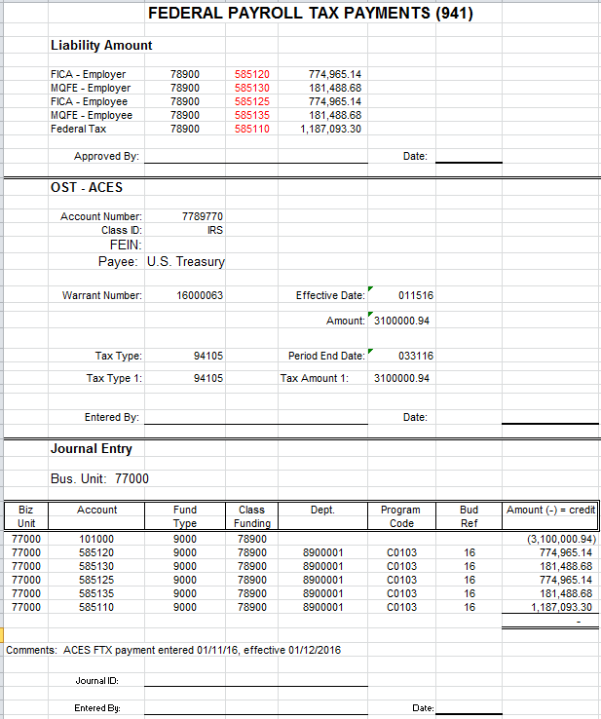
Federal Tax Payment Processing

Slide 3
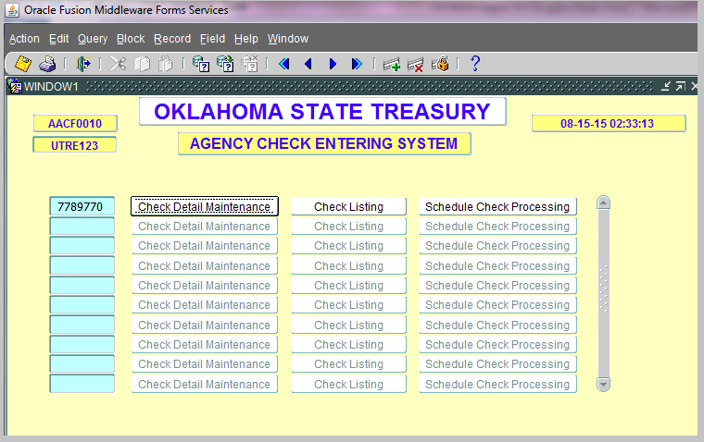
Federal Tax Payment Processing

Slide 4
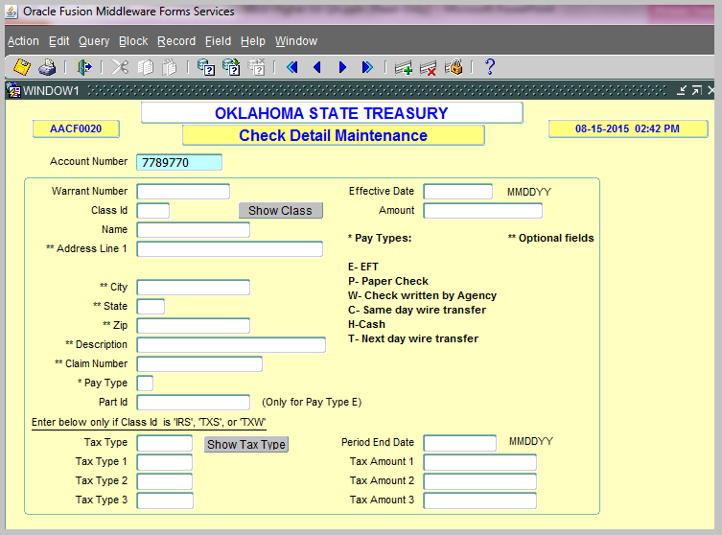
Federal Tax Payment Processing
http://www.irs.gov/pub/irs-pdf/p4990.pdf

Slide 5
Federal Tax Payment Processing
http://www.ok.gov/treasurer/Banking/On-line_Access_and_Banking_Forms/index.html

Slide 6
Federal Tax Payment Processing
Timing –
  Day before payment is due to IRS
  10 am to DCAR Accounting
  10:45 am to OST
  11am OST completes scheduling

Slide 7
Federal Tax Payment Processing
OMES review:
  Proper accounts, class, fund, department, program code, & bud ref
  Matches dollar amount on ACES payment screen shot
Posted and Released to OST?
  Yes: if all info is correct and $ amounts agree
  No: if anything is not correct, agency will be notified
OST Processing
  By 10:45 am daily notified of agencies & amounts posted in GL
  Verify ACES entry amounts match the notification to release payment

Slide 8
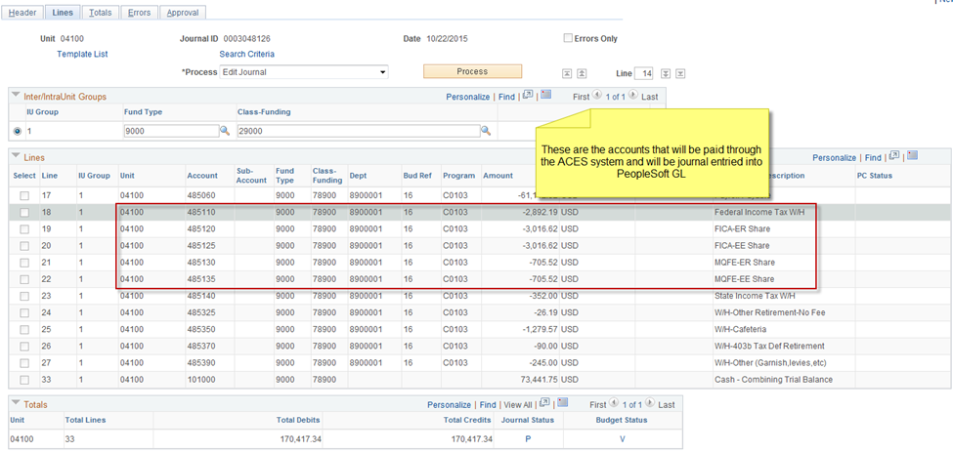
Federal Tax Payment Processing

Slide 9
Federal Tax Payment Processing
UserID ends with JE
Navigation
General Ledger>Journals>Journal Entry>Create/Update Journal Entries
Favorites

Slide 10
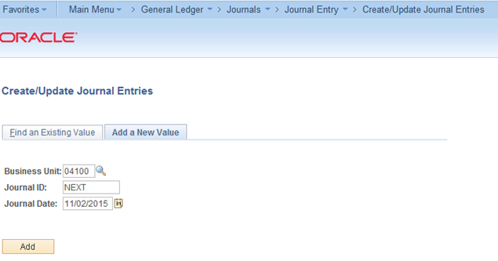
Federal Tax Payment Processing
Add a New Entry

Slide 11
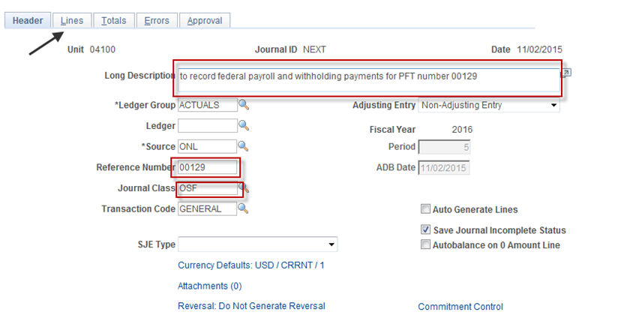
Federal Tax Payment Processing
Complete Journal Header

Slide 12
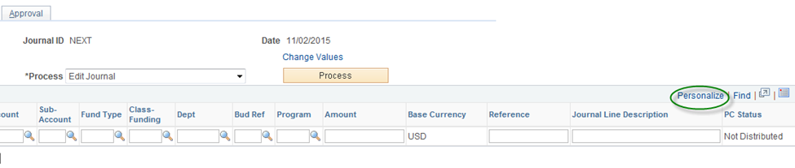
Federal Tax Payment Processing
Personalize View

Slide 13
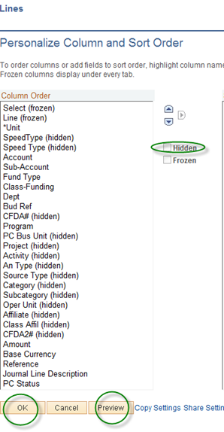
Federal Tax Payment Processing

Slide 14
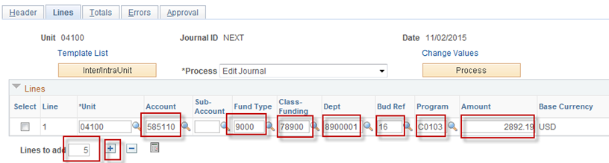
Federal Tax Payment Processing
Journal Lines

Slide 15
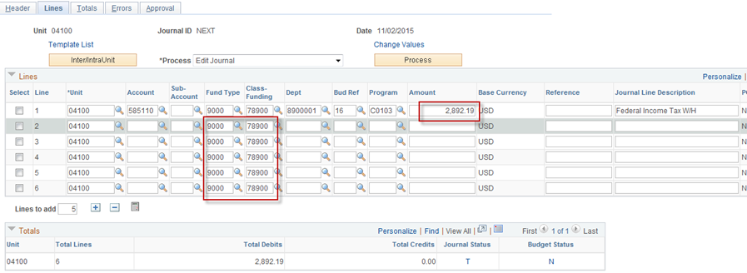
Federal Tax Payment Processing

Slide 16
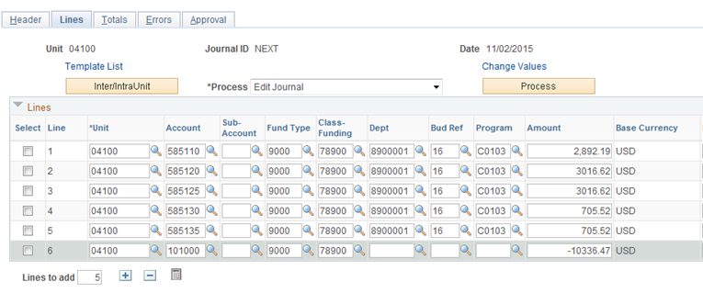
Federal Tax Payment Processing
Complete Entry

Slide 17
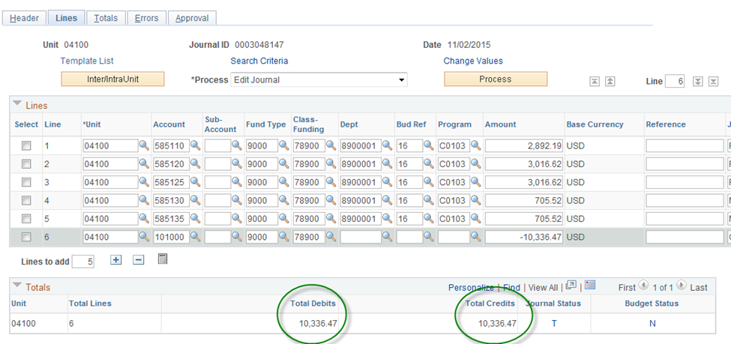
Federal Tax Payment Processing
Save Entry and Verify Totals

Slide 18
Federal Tax Payment Processing
Process Summary
  Calculate the tax deposit by account
  Enter payment in ACES
  Enter journal entry in financial system
  Notify DCAR Accounting for approval
    10am day before payment is due
    E-mail
      Agency number
      Contacts
      Journal ID
      Screen shot

Slide 19
Federal Tax Payment Processing
PS General Ledger Entry Review
  In balance
  Proper header information
  Accounts
  Class funding
  Fund Type
  Department
  Program Code
  Bud Ref
  Amount

Slide 20
Federal Tax Payment Processing
Posted and Released to OST?
  Yes: if all info is correct and $ amounts agree
  No: if anything is not correct, agency will be notified
OST Processing
  By 10:45 am daily notified of agencies & amounts posted in GL
  Verify ACES entry amounts match the notification to release payment

Slide 21
Federal Tax Payment Processing and Journal Entry
Questions???

Slide 22
Accounts Payable
Agenda
Net Payroll Vouchers
Net Payroll EFT Returns
PFT Reversals and Net Payroll Cancelations
Payroll Reversals
Lost or Destroyed Net Payroll Warrants
Stat Canceled Net Payroll Warrants
Other 585XXX Voucher Payments
7XX, 789, 994 Comparisons
Voucher From Remote Agency Changes
Accounts Payable Report Changes

Slide 23
Accounts Payable
Net Payroll Vouchers
Net Payroll vouchers will create as part of the PFT and Misc 500 file uploads
  Vouchers will be available the next business day
  Supplier ID will be 0000001111 – Higher Ed Payroll
  Payee name maintained in PeopleSoft table
  Invoice ID is claim number plus record number
  Voucher accounting date prior to invoice date
  Invoice date and payment date are pay date
  Class Fund is 78900, Department is 8900001, and Account code is 585060
  Warrant number submitted to OST will populate in the voucher

Slide 24
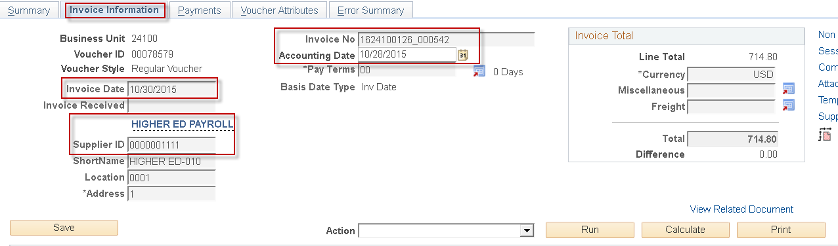
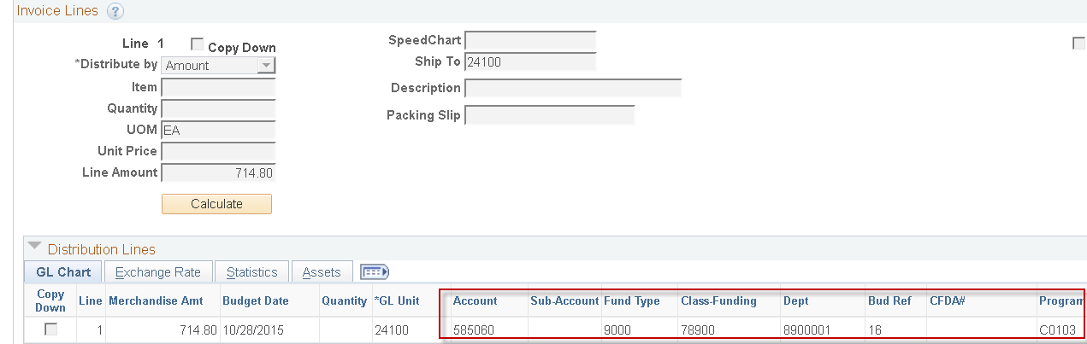
Accounts Payable
Invoice Information Page

Slide 25
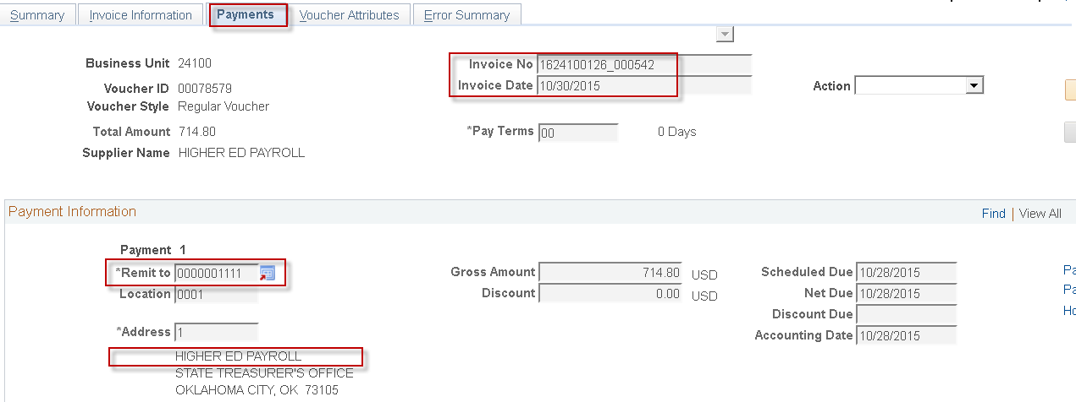
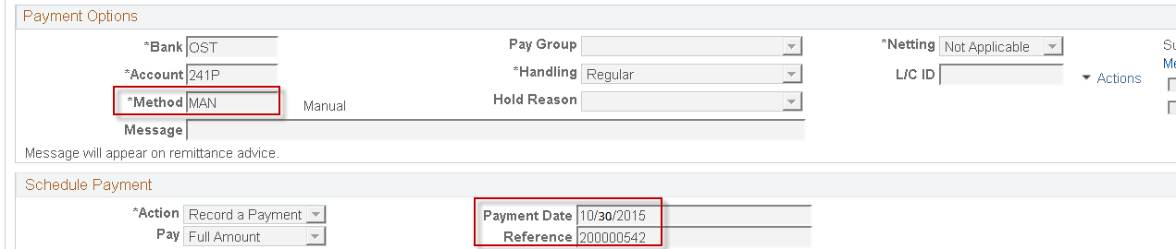
Accounts Payable
Payment Page

Slide 26
Accounts Payable
Net Payroll EFT Returns
EFT Return – Item returned by the Receiving Depository Financial Institution
OMES will no longer issue replacement checks
Funds will be deposited to institution’s clearing account
Transaction Processing will contact institution to issue a refund warrant from the clearing account to the payee
Notes:
58512

Slide 27
Accounts Payable
PFT Reversal & Net Payroll
EFT Payment - submit Form EWC to reverse payment to 7789AGY
  Section 2 – Payees Name will be employee’s name and Vendor ID will be 0000001111
  Submit within five days of the effective date
  Warrant will be canceled five days after OST forwards to JPMC
Warrant - submit the OST Stop Payment and Hard Cancel Form
  Mark as Hard Cancel and attach warrant
  Complete Section 2A with Misc Warrant Type, Voucher Number and Amount, and‘N’ in Replace Warrant column
Notes:
58512

Slide 28
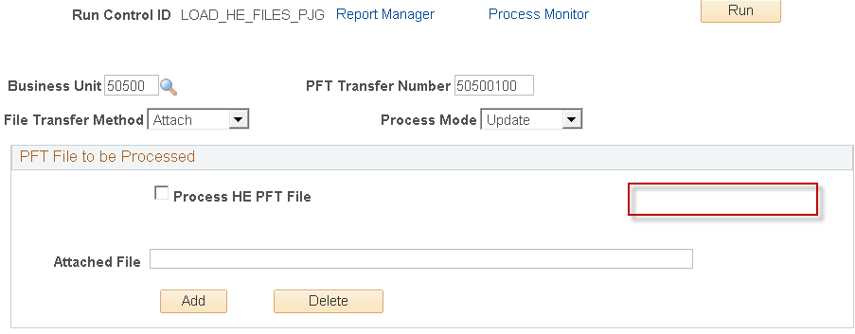
Accounts Payable
PFT Reversals
Submit PFT File to remove funds from class fund 789 to the operating funds
Currently developing PFT Reversal process in Financials
  PFT and 500 Misc file will not tie since there will not be 500 Misc file
Notes:
58512

Slide 29
Accounts Payable
Lost or Destroyed Warrant
Submit the OST Stop Payment and Hard Cancel Form
  Complete Section 1 - Stop Pay (Lost) or Hard Cancel (Damaged). Enter Employee’s Name
  Complete Section 2A with Misc Warrant Type, Voucher # and Amount, and ‘Y’ in Replace Warrant column
  Complete Section 2B to obtain payee’s signature
  Complete Section 2C with Vendor Name, Amount, Vendor ID, and Location
Warrant Replacement will be to Payee
  Replaced from 00000 Vendor File
  Submit Additions/Changes for Employees form
Notes:
58512

Slide 30
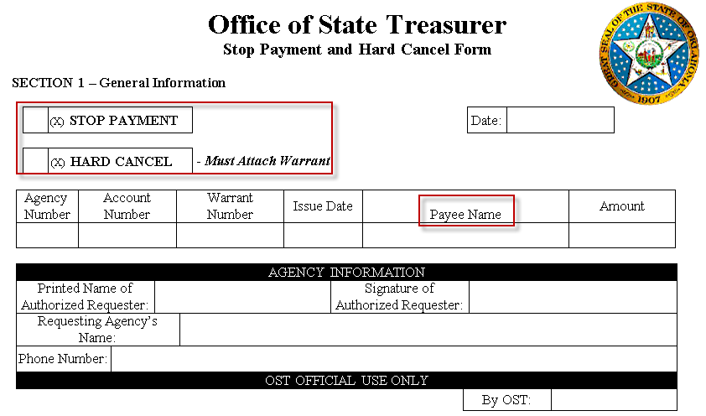
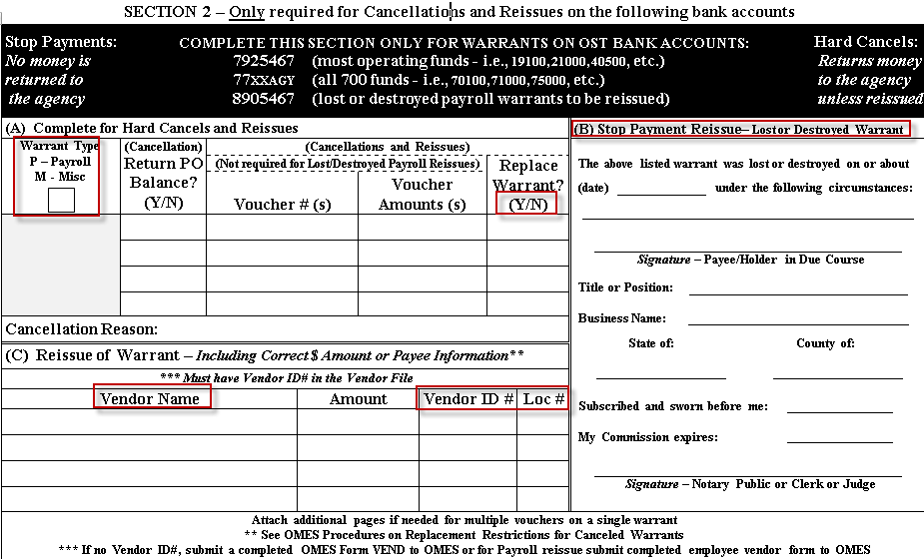
Accounts Payable
OST Stop Pay and HC Form
  http://www.ok.gov/OSF/Forms/Division_of_Central_Accounting_and_Reporting_Forms/
Notes:
58512

Slide 31
Accounts Payable
Stat Cancel Warrants
Submit the Form 20R
  Mark cancel by statute with warrant or without warrant
  Complete Section A to complete warrant information including Misc Type, payee’s name, Vendor ID and Loc
  Complete Section B to obtain affidavit for lost statutory warrant
  Complete Section C, Notary Section for lost statutory warrant
Warrant Replacement will be to Payee
  Replaced from 00000 Vendor File
  Submit Additions/Changes for Employees form
Notes:
58512

Slide 32
Accounts Payable
Other 585XXX Vouchers
Transmitted in VFRA
Class 789 vouchers
No central payments
No class 994 vouchers
Account codes
correspond to 485XXX
Account Description | AP Acct Codes | Prior Acct
State Income Tax W/H | 585140 | 202140
OPERS-ER Share | 585200 | 202200
OPERS-EE Share | 585205 | 202205
Def Comp-ER Match | 585220 | 202220
Def Comp-EE Share | 585225 | 202225
OLERS-ER Share | 585230 | 202230
OLERS-EE Share | 585235 | 202235
Unemployment Tax - ER Share | 585400 | 202400
Unemployment Tax W/H | 585405 | na
W/H-Other Insurance-2% | 585310 | 633110
W/H-Other Insurance-No Fee | 585315 | 633115
W/H-Other Retirement-1% | 585320 | 633120
W/H-Other Retirement-No Fee | 585325 | 633125
W/H-Credit Union and Banks | 585330 | 633130
W/H-Empl Tax Shelt Annuity | 585340 | 633140
W/H-Cafeteria | 585350 | 633150
W/H-457 Tax Def Retirement | 585360 | 633160
W/H-403b Tax Def Retirement | 585370 | 633170
W/H-401k Tax Def Retirement | 585380 | 633180
W/H-401a Tax Def Retirement | 585385 | 633185
W/H-Other (Garnish,levies,etc) | 585390 | 633190

Slide 33
Accounts Payable
7XX, 789, 994 Comparisons
7XX vouchers are expenditures
  789 vouchers are not expenditures
7XX vouchers do not stat cancel
  789 vouchers will stat cancel back to the agency
  Institutions are responsible for reissuing or sending funds to unclaimed property
994 budget check without department ID
  789 subject to more stringent budget checking
994 class fund can go negative
  789 class fund will not allow a deficit

Slide 34
Accounts Payable
Vouchers from Remote
Column 1 for all records should be ‘A’ since the class fund begins with a ‘7’
Header column 64 should be ‘W’
Vouchers must populate with department ID
Payee column 208 should populate ‘P,’ ‘I,’ ‘E’
VFRA code will allow the 789 class to interface with account codes beginning with 585 except for 585060, 585110, 585120, 585125, 585130, and 585135
VFRA code will disallow the 633XXX accounts to interface with class fund other than 994
Notes:
58512

Slide 35
Accounts Payable
Report Changes
Certain Accounts Payable reports will sum or exclude net payroll vouchers
  Six Digit Expenditure Detail by Journal Date Report
  Successful Voucher Report
  OMES Form 15A Voucher Jacket
  Miscellaneous Warrant Report
  Reconciled Miscellaneous Warrant Report
  Fiscal YTD AP Transactions Report
  OCP_Alltrans_AP Query
  OCP_Expenditures_Vouchers_SRD Query
Will remove Regents Expenditure queries
Notes:
58512

Slide 36
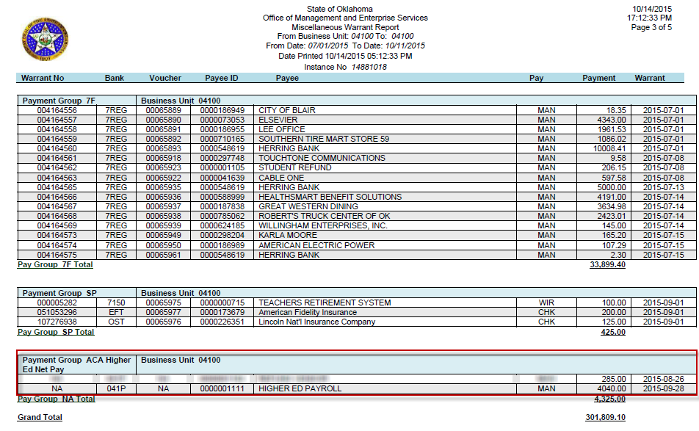
Accounts Payable
Example Report
Notes:
58512

Slide 37
Accounts Payable
Questions???

