Slide 1
Amazing Library Race
A modular introduction to the resources of the TCC Libraries

Slide 2
Introduction: Amazing Race
The Amazing Library Race is designed to introduce first-time college students to the basic resources of the Library while building basic information literacy skills.
The Amazing Library Race works best when each "pit stop" (learning unit) is tied to an actual assignment or task. This outline offers suggested assignments and tasks for each pit stop.

Slide 3
Why The Amazing Library Race?
A 2009 Faculty request for a “scavenger hunt” activity which could be used for extra credit or paired with an assignment.
Name ‘The Amazing Library Race’ to erase the stigma (at least within our organization) surrounding scavenger hunt activities.
Became an integral part of TCC’s Achieving the Dream, Strategies for Academic success (aka Academic Strategies) course.
Academic Strategies focus on life skills, such as planning & time-management. In our view, library skills are fundamental life skills for successful, high-functioning individuals.

Slide 4
Reality Show Tie-In Rationale
Many students were familiar with the Amazing Race reality show.
This type of activity could’ve been tied to many themes; The Amazing Race seemed somewhat timely and a bit more sophisticated than other reality show alternatives:
  Keeping up the Librarians
  Here Comes Honey Boo Boo, the Librarian
  Big Brother: Library Edition
  The Real World Library
  The Real Librarians of Tulsa, OK
The Amazing Library Race seemed more dignified.

Slide 5
Modular Approach
The Amazing Library Race, concept first attributed to the University of Arizona Libraries, evolved from a basic library orientation, a more scalable activity which could be tied to a variety of assignments in many gateway courses.
The Amazing Library Race most readily pairs with Comp Courses and Strategies for Academic success, with varying degrees of difficulty assigned.
The framework is designed to be customized by librarians, faculty, and recruitment staff as appropriate.

Slide 6
Guiding Design Principles
Make Amazing Library Race modular and include capability to build into a variety of courses.
Consider Distance Learning for fully online courses and to assist with blended courses.
Make students who have not been exposed to libraries and library services proficient library users.
Instill a sense of life-long learning via the Library.
Avoid creation of barriers/challenges for students.

Slide 7
LibGuide Structure
To keep the activity basic and easily customizable, activities are broken into pit-stops, each containing specific activities:
  Library Basics
    When is the library open?
    Who works in the library?
    Do I have to go to the library to get help?
  Find Books
    Find something fun to read.
    Give a basic explanation of LC classification.
  Find E-Books
    Locate online biographical information.
    Define what an idiom is using an linked dictionary.
  Find Articles
    List four different EBSCOHost Databases.
    Find an article on bacteriology.
    What does “Peer Reviewed” mean?

Slide 8
LibGuide Structure
Plagiarism Row
  How do you properly cite sources?
  What is “accidental plagiarism”? How to avoid it.
Super Student
  View time management tutorial.
  View tutorial on reducing test anxiety.
  Plan the appropriate amount of time for your assignments.
Customizations to the tasks often include:
  Checking a book out and presenting it to the class.
  Reviewing an article and presenting it to the class.
  Demonstrating a virtual reference session for the class.

Slide 9
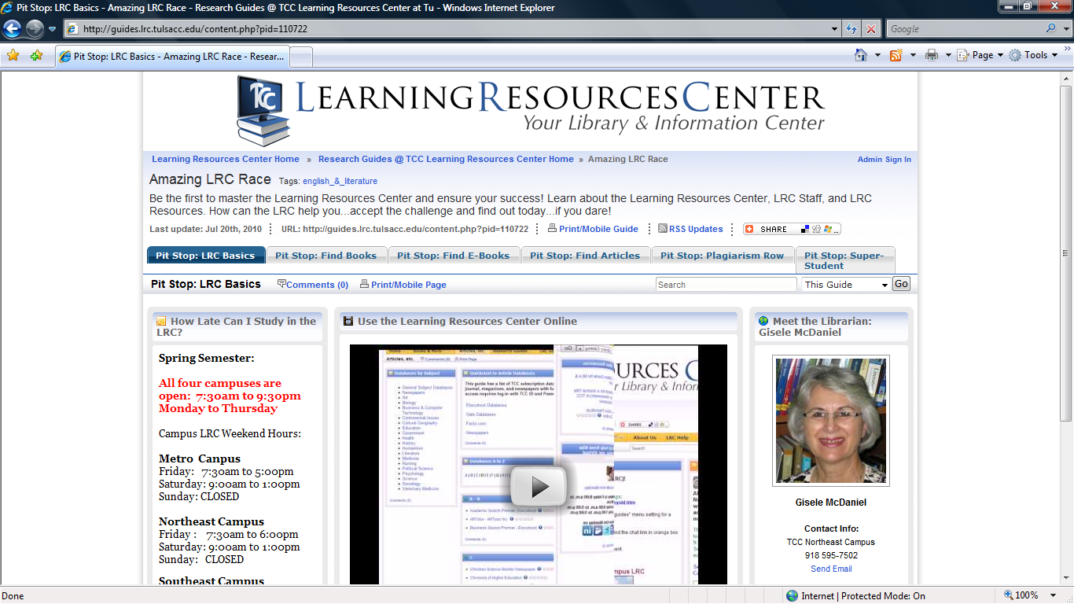
Pit Stop: Library Basics

Slide 10
Ideas for Library Basics Pit Stop
Learn what resources the library offers, when the library is open, and who works in the
library on your campus:
What can you find in Books & More?
2. What can you find in Articles, etc.?
3. How do you navigate the library website (how is it organized)?
4. When is the library on your campus open?
5. What is the name of a librarian in your campus library?
These tasks may be completed online without visiting the library.

Slide 11
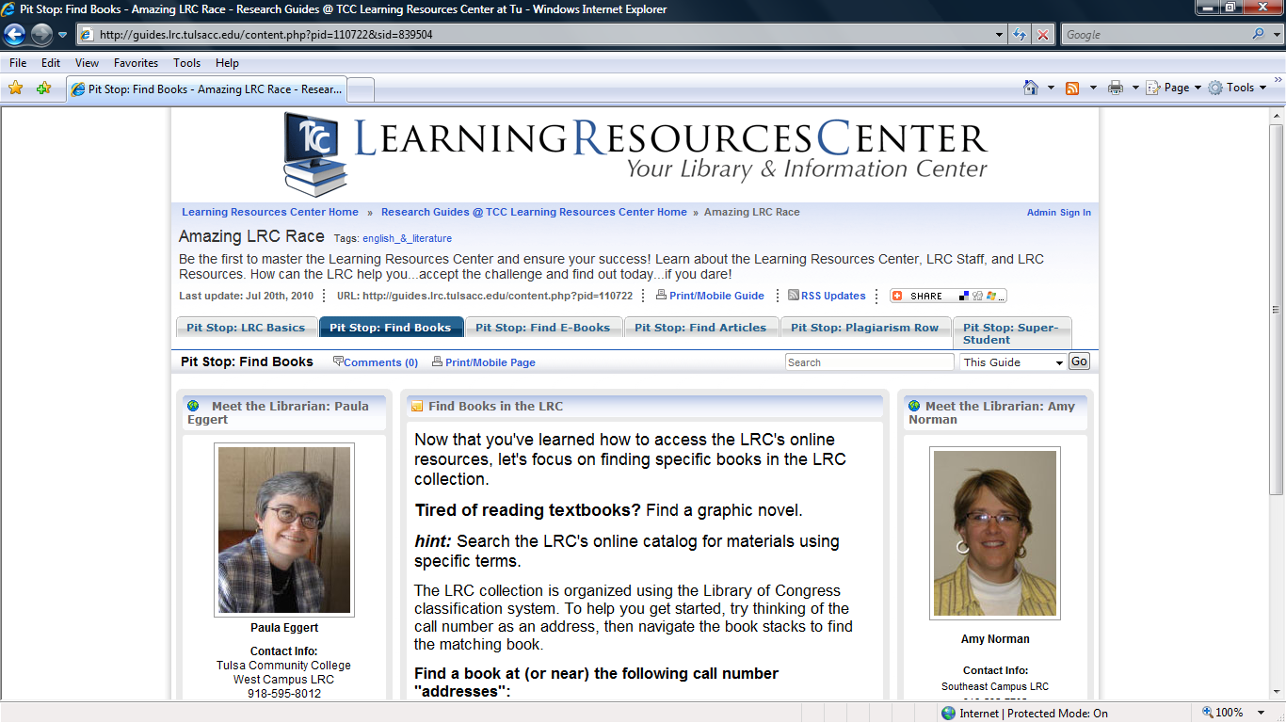
Pit Stop: Find Books

Slide 12
Using the Find Books Pit Stop
Learn how to locate books and e-books in the library. Students will need to visit a library to complete some of these tasks (specifically task 1) but should not require the intervention of library staff (unless the student wishes).
Find a book (and possibly check one out) @ PS374.S5V6, E876.S29, or E842.9M275. This is an opportunity to explain that the library is not organized like a bookstore (or even a public library). Library of Congress classification is used in academic libraries. Student should report on books found in those areas or check out an example from each area.
To introduce students to the subject-specific organization of the Library of Congress classification system, ask students to identify the subject areas for 'E' & 'PS' (all libraries have this information posted on the end-panels of the book shelves).
Find a book that is considered to be a "graphic novel". Students should understand what a graphic novel is and how to locate one using the online catalog. Optionally, students may check out a graphic novel and report on it.
Optional:
Ask the students to report back on how they checked the book out, how long they
get to keep the book, and any other library information they learned in the process of
checking-out a book.
These tasks require students to visit the library.

Slide 13
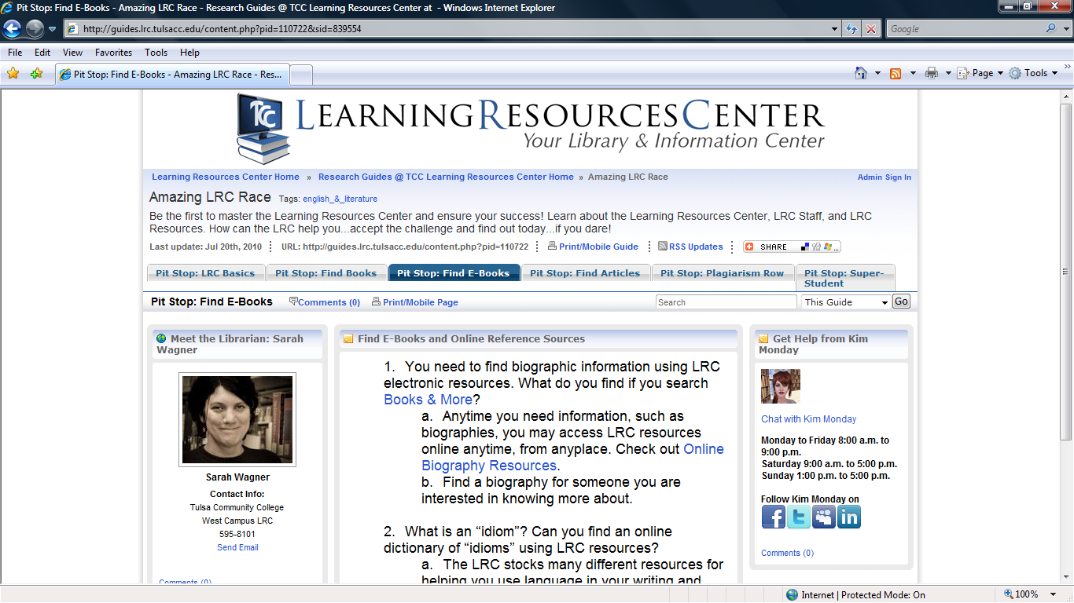
Pit Stop: Find E-Books

Slide 14
Using the Find E-Books Pit Stop
In addition to print collections, the library offers thousands of books electronically,
via the library websites. These titles are selected in accordance with the standards
established for print materials and are often excellent sources for assignments
and research.
What area of the library website can be used to search for e-books?
Many of the library's online research tools feature journal article content. Authoritative sources exist in aggregated tools, too. Ask students to find biographic information using online resources, specifically, Gale's Biography in Context. The information they locate could support an assignment or be just personal interest. Bonus: Ask students to present a citation.
First-time college students often need to become better acquainted with different types of words and the way they are used in language. Ask students to define what an idiom is and provide specific examples. The library's OneLook Dictionary is a good starting point which allows you to direct students to dictionary sources you recommend (such as OED or American Heritage).
These tasks may be completed online without visiting the library.

Slide 15
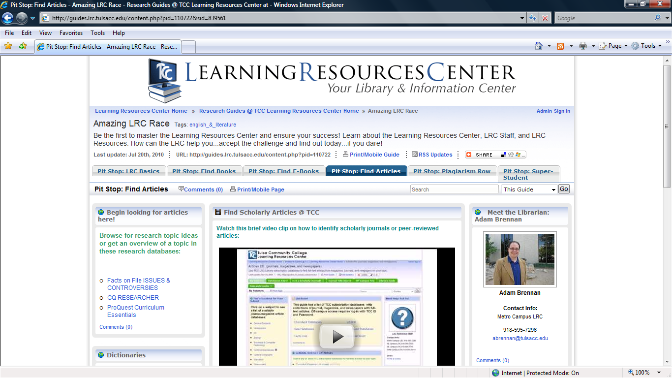
Pit Stop: Find Articles

Slide 16
Using the Find Articles Pit Stop
The Articles, etc. page contains a wealth of newspaper, periodical, and journal resources. Major aggregators represented here include EBSCO, ProQuest, and Gale. Library staff have worked to streamline discipline specific information into single-vendor interfaces to the greatest extent possible - this is an ongoing effort. For the purposes of these assignment ideas, each of these major aggregators will be the focus of each task.
EBSCOHost features of wealth of business and general studies publications. Ask students to locate the EBSCOHost interface, select a specific EBSCOHost database to search, and submit an article from a publication contained within that database. Examples include searching Business Source Premier to find an article about outsourcing or using Points of View Reference Center to find an article on a controversial topic.
ProQuest features a concentration of Nursing & Allied Health information, but also includes the inter-disciplinary resource Curriculum Essentials. Ask students to search Curriculum Essentials for on article on gender and leadership or racial identity.
  Optional:
  Ask the students to describe how they may distinguish between scholarly and non-
  scholarly articles in their searches.
These tasks may be completed online without visiting the library.

Slide 17
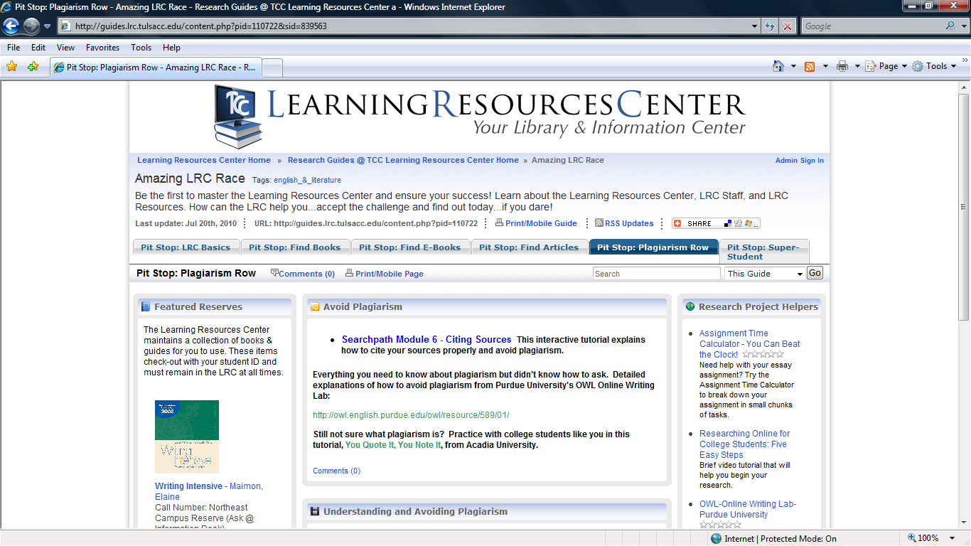
Pit Stop: Plagiarism Row

Slide 18
Using the Plagiarism Row Pit Stop
Plagiarism presents a video tutorial explaining what plagiarism is. It also features online tutorials
for avoiding plagiarism and properly citing and giving credit for others’ ideas.
After exploring the resources in the center of the page for understanding what plagiarism is and how to avoid it, ask students to define the two primary types of plagiarism. What makes them different? How are they similar.
Ask students to describe what a citation is and how to properly cite sources in their own work.
  Optional:
  Ask students to find a source (article) and present the citation.
These tasks may be completed online without visiting the library.

Slide 19
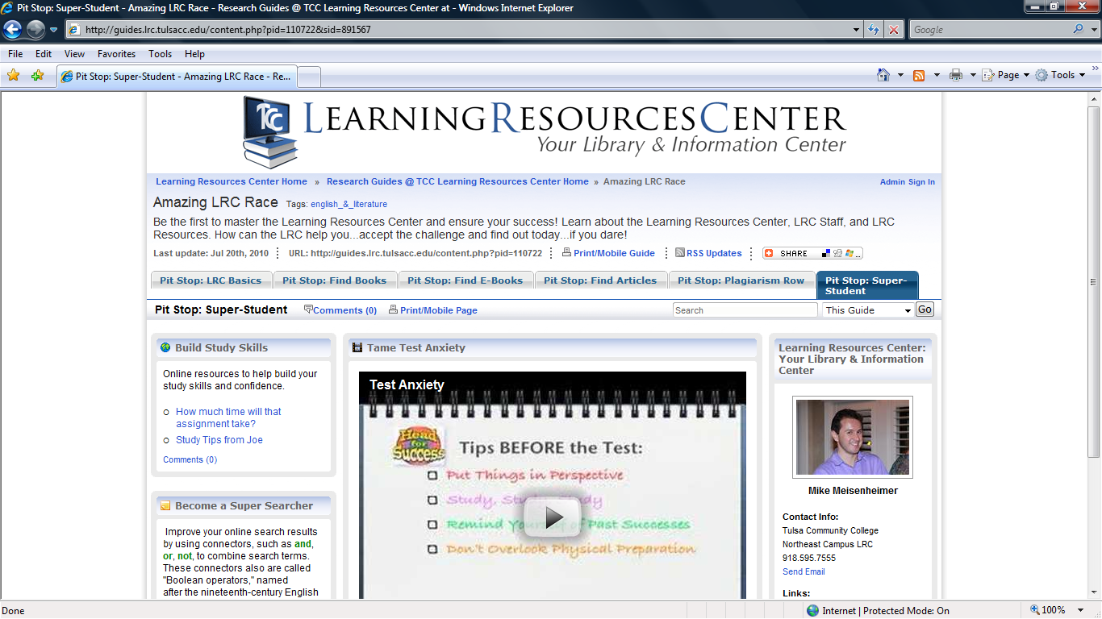
Pit Stop: Super Student

Slide 20
Using the Super Student Pit Stop
This pit stop contains additional resources for students to learn more about building study-
skills and reducing test anxiety. The assignment calculator is featured again here, plus a video
on preparing for exams and reducing test anxiety.
Ask students to find information on planning their daily schedule with study time built-in (Study Tips from Joe).
Ask students to calculate how much time it would take them to write a research paper. The Assignment Time Calculator will adjust the schedule based upon the due date entered by the student…assigning daily tasks.
Ask students to view the Test Anxiety video and report what they learned about ways to improve their task taking skills.
These tasks may be completed online without visiting the library.

Slide 21
Other Ways We Engage
Piggy-backing on Student Activity events, especially beginning and end-of-semester events, with refreshments in the library.
360-degree embedding, comprised of:
  Embedding in Blackboard course sites,
  Embedding a librarian in each division office to work with ADs,
  Creating custom Research Guides for specific courses,
  Involving faculty in collection development and programming.
Representing the library with our campus leadership.
Identifying and branding the library as the hub of the campus.

Slide 22
More Ideas We Use
Blind-book date (modeled on NSU event) for Valentine’s Day.
Librarian super-hero trading cards.
Women’s history month trading cards.
Partnering with Honors courses to create dedicated Research Guides, library programming, and enhanced collection support.

Slide 23
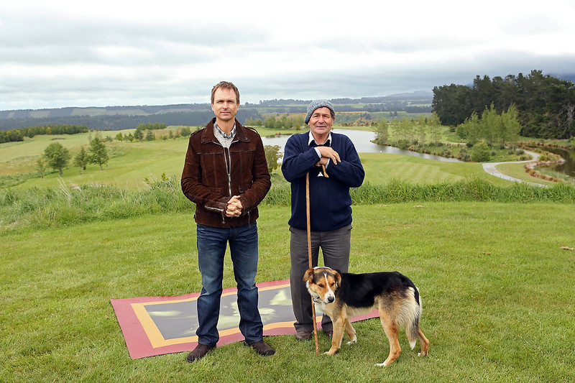
Congratulations!
You’ve Completed the Race!
Copyright: Robert Voets/CBS via http://bangphotos.smugmug.com/photos/i-vzKdjbC/0/L/i-vzKdjbC-L.jpg

Slide 24
Contact Information
Mike Meisenheimer
michael.meisenheimer@tulsacc.edu
Managing Librarian
Tulsa Community College
Northeast Campus
3727 East Apache
Tulsa OK 74115
918-595-7555
918-595-7568

