Slide 1
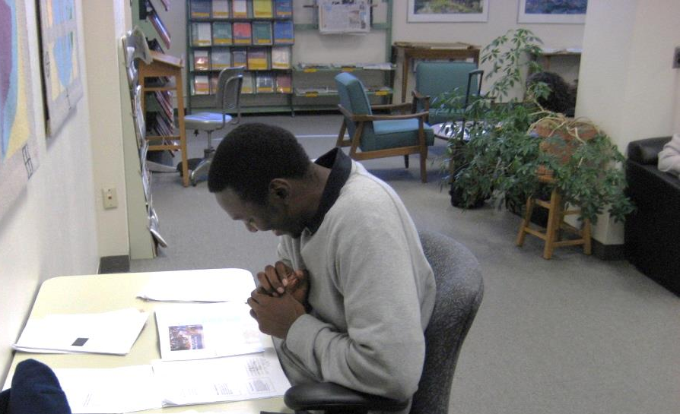
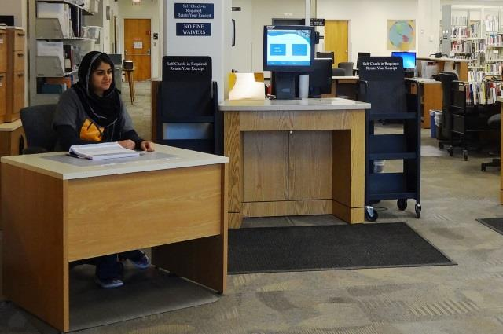
Assessment of the One-Shot

Slide 2
Introduction & Disclaimer
Mandi Smith – Technical and Electronic Services Librarian
Jason Smith – Reference, Archives, and Interlibrary Loan Librarian

Slide 3
Overview
Student learning outcomes
Aligning outcomes
Creating and aligning measures
Distributing measures
Scoring measures
Presenting results to the institution

Slide 4
Student Learning Outcomes
What is a student learning outcome
“Student learning outcomes or SLOs are statements that specify what students will know, be able to do or be able to demonstrate when they have completed or participated in a program/activity/course/project. Outcomes are usually expressed as knowledge, skills, attitudes or values.”
(A Guide to Developing Measurable Student Learning Outcomes, Cañada College – Office of Planning, Research, and Student Services)

Slide 5
Student Learning Outcomes
Student focused
Focus on what students are learning, not what librarians are doing.

Slide 6
Student Learning Outcomes
NOT student focused: The librarian will teach search strategies that will improve students’ search results.
Student focused: The student will identify search strategies to improve their search results.

Slide 7
Student Learning Outcomes
Characteristics of Student Learning Outcomes
“Describe what students should be able to demonstrate, represent, or produce based on their learning”
“Rely on active verbs that identify what students should be able to demonstrate, represent or produce”
(Tips for Writing Student Learning Outcomes, Indiana University-Purdue University Indianapolis – The Center for Teaching and Learning)

Slide 8
Student Learning Outcomes
Phrasing matters!
Action verbs are more relatable and can be measured
Bloom’s taxonomy
Create
Evaluate
Analyze
Apply
Understand
Remember
Higher Order Thinking

Slide 9
Student Learning Outcomes
Remembering
Recognize
List
Identify
Describe
Retrieve
Name
Locate
Find
Applying
Implement
Carry out
Use
Execute
Operate
Edit
Understanding
Interpret
Summarize
Infer
Paraphrase
Classify
Compare
Explain
Exemplify
Bloom’s Revised Taxonomy

Slide 10
Student Learning Outcomes
Analyzing
Compare
Organize
Deconstruct
Attribute
Outline
Find
Structure
Integrate
Creating
Implement
Carry out
Use
Execute
Operate
Edit
Evaluating
Hypothesize
Critique
Experiment
Judge
Test
Detect
Monitor
Bloom’s Revised Taxonomy

Slide 11
Student Learning Outcomes

Slide 12
Student Learning Outcomes
Cameron’s Student Learning Outcomes
The student will locate library resources by searching the library catalog or databases.
The student will identify search strategies to improve their search results.
The student will recognize the proper use of citation to avoid plagiarism.
The student will identify the factors making up the authority of a source.

Slide 13
Aligning Outcomes
Cameron’s outcomes were made before the new ACRL Framework was released.
Aligned with what we teach and what we expect our students to learn
Aligned with ACRL Information Literacy Competency Standards for Higher Education
Aligned with the institution’s mission

Slide 14
Aligning Outcomes
Aligning with the ACTUAL instruction
Example
Previous: The student will verbalize positive outcomes associated with using information properly.
Current: The student will recognize the proper use of citation to avoid plagiarism.
Periodically review outcomes to make sure they still align with instruction.

Slide 15
Aligning Outcomes

Slide 16
Aligning Outcomes
Aligning with the new ACRL Framework
Can use the knowledge practices and dispositions as foundation of student learning outcomes

Slide 17
Aligning Outcomes
Knowledge Practices
Use different searching language types (e.g., controlled vocabulary, keywords, natural language)
Give credit to the original ideas of others through proper attribution and citation
Use various research methods, based on need, circumstance, and type of inquiry
Dispositions can also be used to generate ideas even though they are more abstract and harder to measure
Value the process of matching an information need with an appropriate product

Slide 18
Aligning Outcomes
“Neither the knowledge practices nor the dispositions that support each concept are intended to prescribe what local institutions should do in using the Framework; each library and its partners on campus will need to deploy these frames to best fit their own situation, including designing learning outcomes. For the same reason, these lists should also not be considered exhaustive.”
(ACRL Board of Directors Action Form, January 16, 2015)

Slide 19
Aligning Outcomes
Cameron’s outcome: The student will identify search strategies to improve their search results.
ACRL Frame: Searching as Strategic Exploration - Searching for information is often nonlinear and iterative, requiring the evaluation of a range of information sources and the mental flexibility to pursue alternate avenues as new understanding develops.

Slide 20
Creating & Aligning Measures
What is a measure?
Anything that measures the outcome. It can be as long as a portfolio or as short as a single multiple choice question.
Since we are assessing the one-shot we focused on short measures.
Additionally we only used one or two measures per outcome.

Slide 21
Creating & Aligning Measures
Example
Outcome: The student will identify the factors making up the authority of a source.

Slide 22
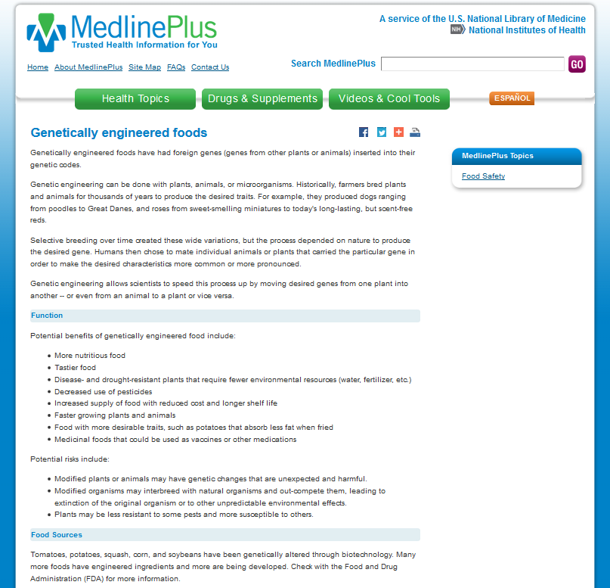
Website
Authority
Question 1: Please list three factors that make a source authoritative.
Question 2: Please circle two items on the provided website that make it authoritative, and explain why they do so.

Slide 23
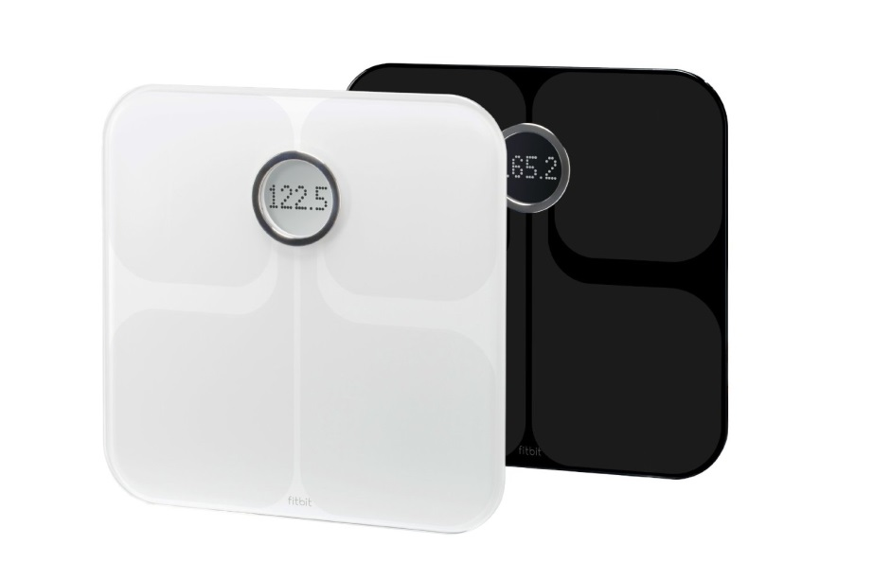
Creating & Aligning Measures
Important that the outcomes are valid and reliable.
Valid - measuring accurately
Reliable – measuring consistently
HARDEST PART!!

Slide 24
Creating & Aligning Measures
Tips
Don’t lose sight of what you are measuring.
When possible use the same phrasing as the outcome.
Ask a knowledgeable outsider to verify that the measure aligns with the outcome; this will help to establish face validity
Test and, if need be, modify the measures

Slide 25
Creating & Aligning Measures
Example
Outcome: The student will identify search strategies to improve their search results.
Measure: Please list two search strategies that can improve your results.

Slide 26
Creating & Aligning Measures
√
Use advanced search
√
Filter your results using dates and formats
√
Use a narrower or broader term
√
Use multiple keywords
Expectations
Notes:
Final Impressions from every angle and perspective.

Slide 27
Creating & Aligning Measures
√
Academic Search Premier
√
EBSCO
√
Google
√
Catalog
Reality
Notes:
Final Impressions from every angle and perspective.

Slide 28
Creating & Aligning Measures
The fix:
Previous Measure: Please list two search strategies that can improve your results.
Current Measure: Please list two search strategies that can improve your results when searching in the CU catalog and/or databases.

Slide 29
Distributing Measures
History
Previously pre-test and post-test
Cameron went to a 4-day class schedule
Only get to teach a one-shot information literacy session as opposed to the two sessions we taught in the past
Used surveys asking students how much they improved, but IAC asked for direct measures
So…

Slide 30
Distributing Measures
One-shot Measures
Made a conscious decision to not spend more than 5 minutes on assessment during each one-shot session
DO NOT attempt to measure every outcome during each session
Focused on program assessment versus a single class session
Each session measure one or at most two outcomes
Focus on the lower end of Bloom’s taxonomy

Slide 31
Scoring Measures
Grading
Two librarians graded each set of questions separately
When needed, a third librarian was the tiebreaker

Slide 32
Scoring Measures
Rubrics
Pass/fail and multiple choice (get 2 or more answers right)
Discussed beforehand what would be acceptable answers to improve inter-rater reliability
Liberal but somewhat strict in what we accepted as correct answers (ex. Google Scholar was ok but not Google as a search strategy)

Slide 33
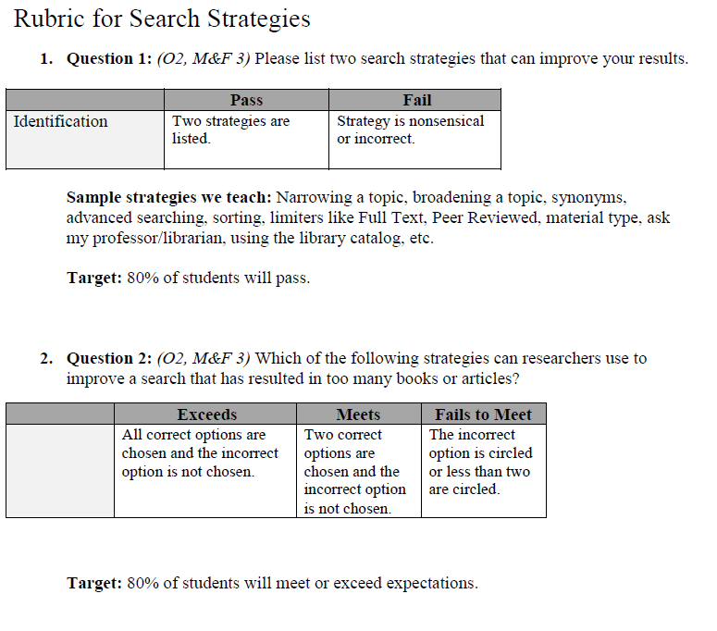
Scoring Measures

Slide 34
Scoring Measures
 |  | Barbara
 |  | Pass | Fail | Total
 | Pass | 22 | 12 | =C3+D3
Jason | Fail | 4 | 19 | =C4+D4
 | Total | =C3+C4 | =D3+D4 | =E3+E4
Proportion of observed agreement: | =(C3+D4)/E5 | 0.719298245614035
Expected proportion of agreement: | =((C5*E3)+(D5*E4))/(E5*E5) | 0.491535857186827
Kappa: | =(B8-B9)/(1-B9) | 0.447941888619855
PABAK: | =(2*B8)-1 | 0.43859649122807
Prevalence index: | =(C3-D4)/E5 | 0.0526315789473684
Bias index: | =(D3-C4)/E5 | 0.140350877192982
Proportion of positive agreement: | =(2*C3)/(E5+C3-D4) | 0.733333333333333
Proportion of negative agreement: | =(2*D4)/(E5-C3+D4) | 0.703703703703704

Slide 35
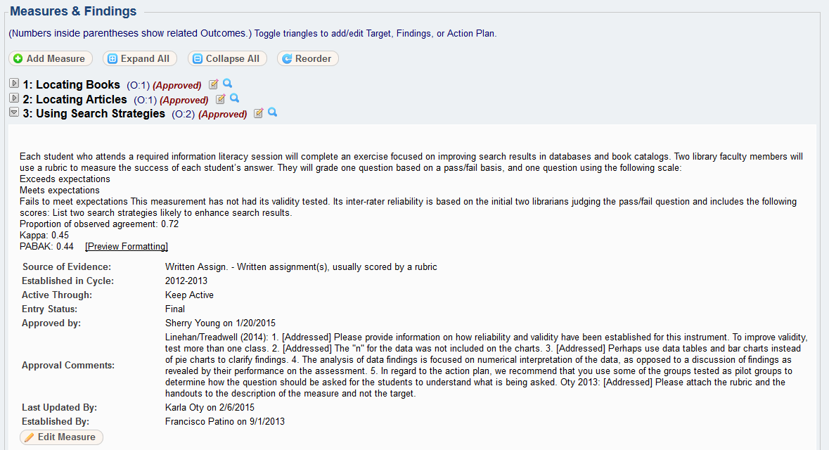
Presenting the Results

Slide 36
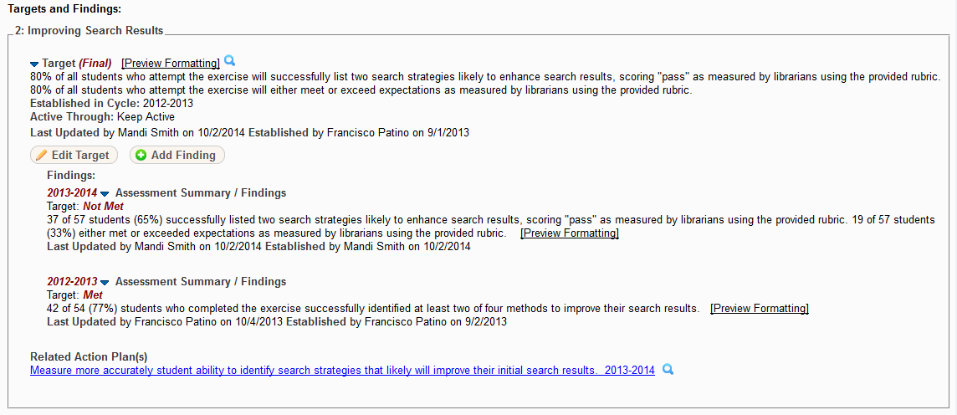
Presenting the Results

Slide 37
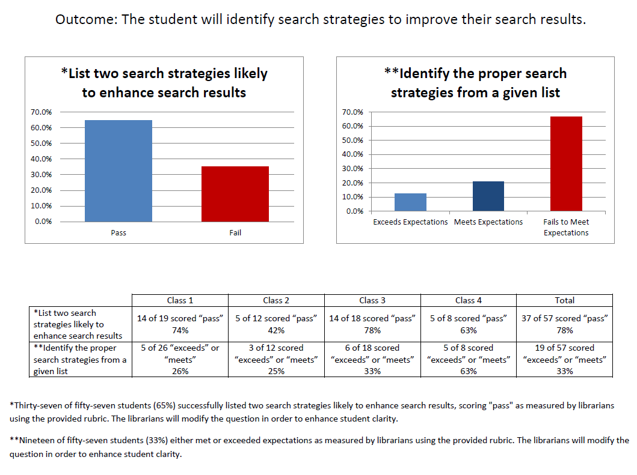
Presenting the Results

Slide 38
Questions
?
?
?
Notes:
Questions?

Slide 39
Reference Links
http://www.niu.edu/facdev/programs/handouts/blooms.shtml
https://www.canadacollege.edu/inside/research/slos/documents/STUDENT%20SERVICES%20SLO%20GUIDE%20BOOK.pdf
http://ctl.iupui.edu/Resources/Planning-the-Learning-Experience/Writing-Student-Learning-Outcomes

