Slide 1

Building a Privacy Program

Slide 2
No one shall be subjected to arbitrary interference with his privacy, family, home or correspondence, nor to attacks upon his honour and reputation. Everyone has the right to the protection of the law against such interference or attacks.

Slide 3
No one shall be subjected to arbitrary interference with his privacy, family, home or correspondence, nor to attacks upon his honour and reputation. Everyone has the right to the protection of the law against such interference or attacks.
-United Nations, Declaration of Human Rights, December 10, 1948

Slide 4
Jonathan Kimmitt
Chief Information Security Officer, The University of Tulsa
Certified Information Systems Security Professional (CISSP)
Fellow of Information Privacy, (FIP)
Certified Data Privacy Solutions Engineer (CDPSE)
Certified Information Privacy Professional – Europe (CIPP/E)
Certified Information Privacy Manager (CIPM)
Certified Information Privacy Technologist (CIPT)
Payment Card Industry Professional (PCIP)
Law of Data Security and Investigations (GLEG)
GIAC Systems and Network Auditor (GSNA)
GIAC Penetration Tester (GPEN)
Certified Ethical Hacker (CEH)
Privacy Field Manual - Summer 2021 (Author)
JKimmitt Consulting, Privacy and Cyber Security Assessments

Slide 5
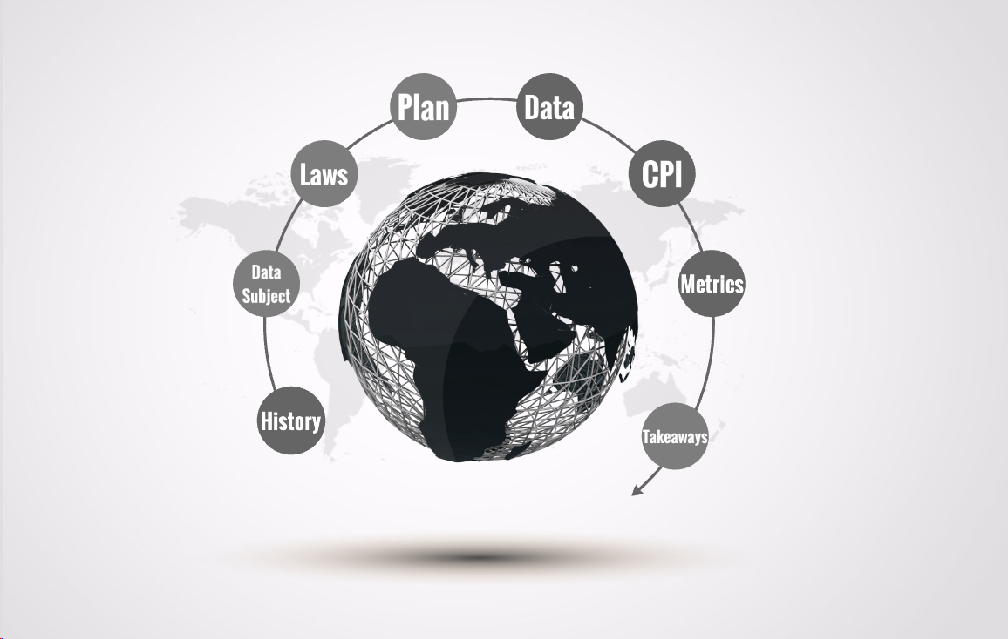

Slide 6
History of Privacy
Post Office Act 1710 Section XL
John Adams Note 1770
"Right to Privacy" 1890 Harvard Law Review
1948 Declaration of Human Rights
1995 Data Protection Directive
2018 GDPR
2020 CCPA
2023 CPRA

Slide 7
Article 4, GDPR, Definitions
‘personal data’ means any information relating to an identified or identifiable natural person (‘data subject’); an identifiable natural person is one who can be identified, directly or indirectly.
https://gdpr-info.eu/art-4-gdpr/

Slide 8
Article 4, GDPR, Definitions
‘controller’ means the natural or legal person, public authority, agency or other body which, alone or jointly with others, determines the purposes and means of the processing of personal data;
https://gdpr-info.eu/art-4-gdpr/

Slide 9
Article 4, GDPR, Definitions
‘processor’ means a natural or legal person, public authority, agency or other body which processes personal data on behalf of the controller;
https://gdpr-info.eu/art-4-gdpr/

Slide 10
Rights of the Data Subject
Transparency
Access to Data
Rectification of Data
Right to Erasure
Right to Portability
Right to Object
https://gdpr-info.eu/chapter-3/

Slide 11
Rights of the Data Subject
Transparency
Access to Data
Rectification of Data
Right to Erasure
Right to Portability
Right to Object
https://gdpr-info.eu/chapter-3/

Slide 12
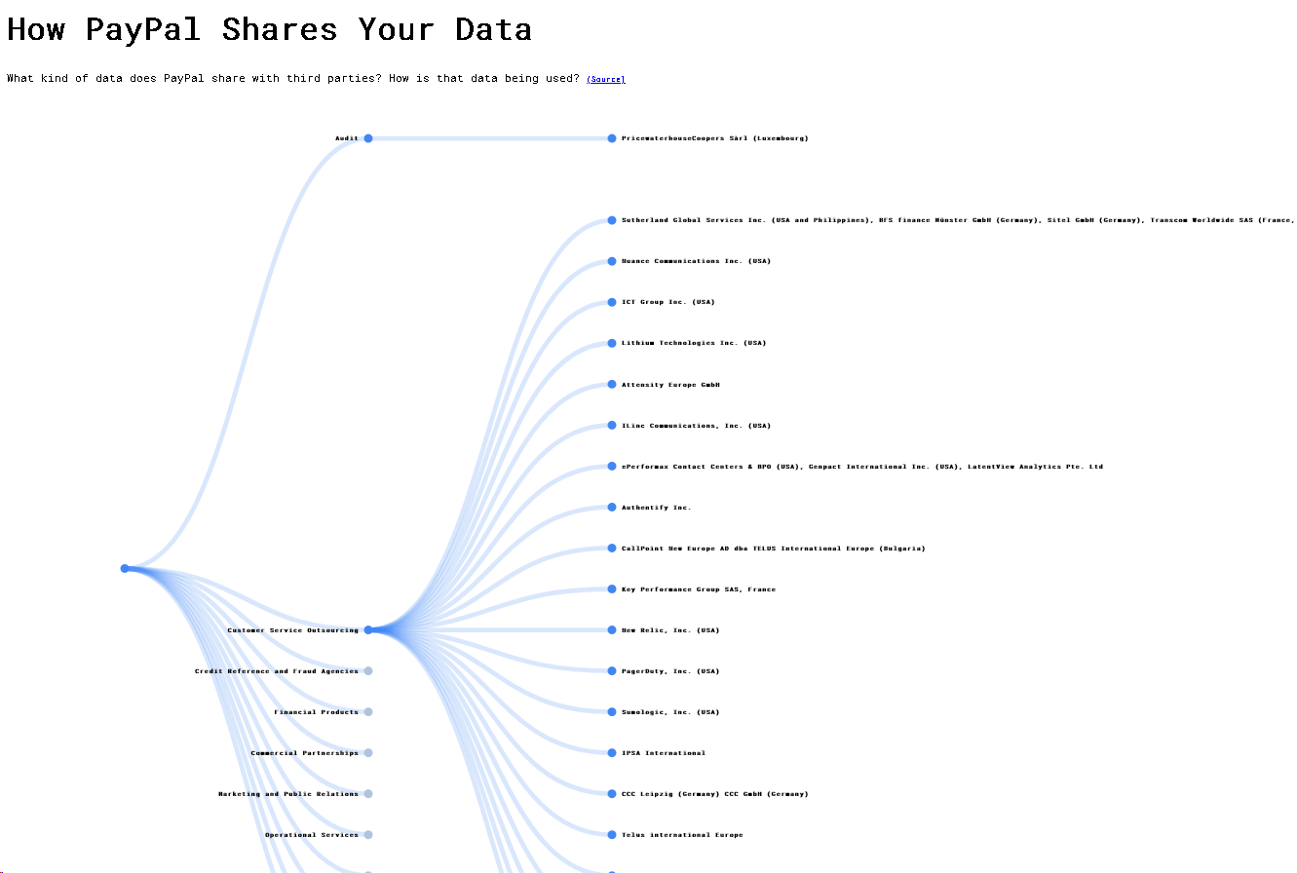
https://rebecca-ricks.com/paypal-data/

Slide 13
Rights of the Data Subject
Transparency
Access to Data
Rectification of Data
Right to Erasure
Right to Portability
Right to Object
https://gdpr-info.eu/chapter-3/

Slide 14
Article 21, GDPR, Right to Object
Where personal data are processed for direct marketing purposes, the data subject shall have the right to object at any time to processing of personal data concerning him or her for such marketing, which includes profiling to the extent that it is related to such direct marketing.
https://gdpr-info.eu/art-21-gdpr/

Slide 16
Privacy Laws
GLBA
FERPA
HIPAA
GDPR
DMCA
PCI-DSS
State Laws
Contracts/Cyber Insurance

Slide 17
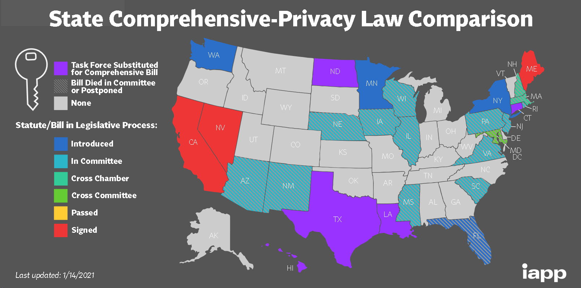

Slide 19
Assessment of a Privacy Program
Who is responsible for your Privacy Program?
Does your Data Protection officer receive professional training?
What metrics does your Data Protection officer report to the board?
Show me your data inventory.
Show me the data life cycle for “X” data field.
Show me all the places “X” data subject’s record resides.
Show me all contracts/vendors that relate to “X” data subject.
Provide me a copy of your Data Privacy Awareness Training.
Show me your Privacy Impact Assessment process.
Show me your Data Security Policies and procedures.
Show me your “Right to Erasure” process and verification.

Slide 21
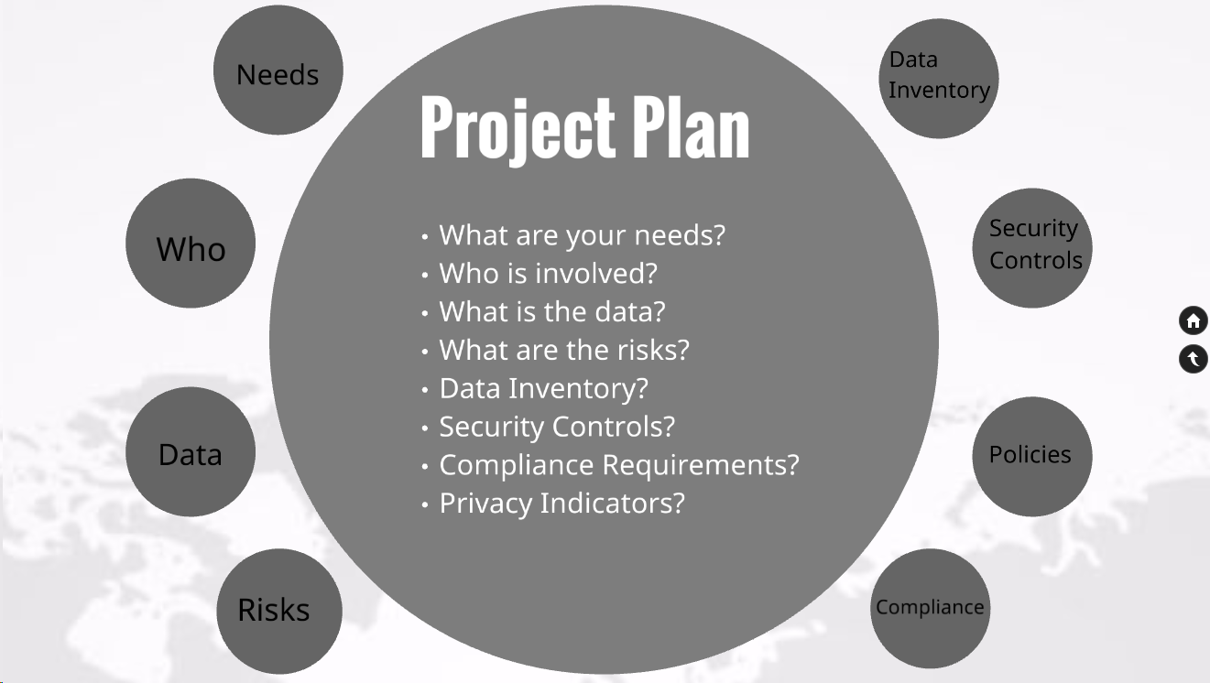

Slide 22
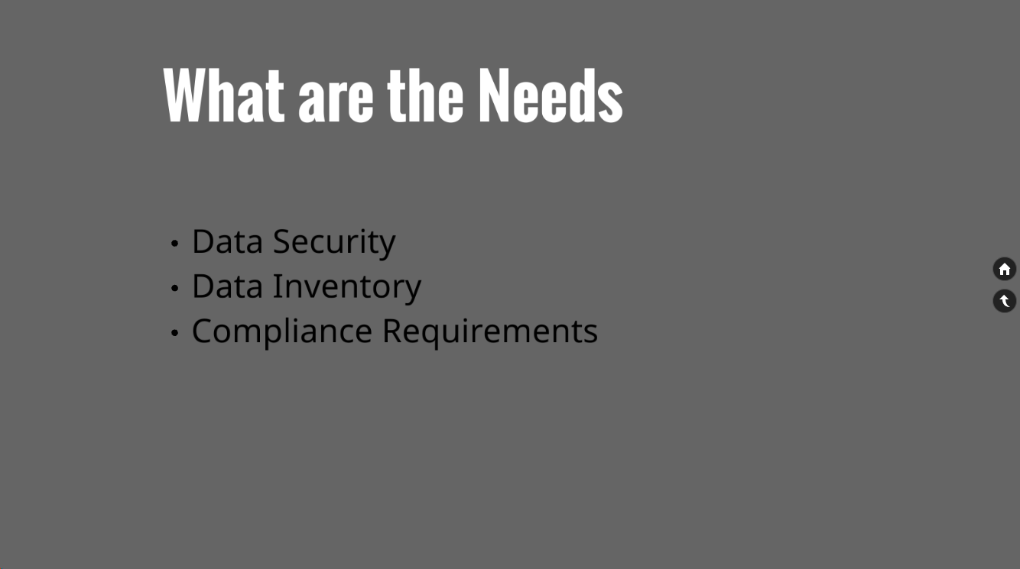

Slide 23
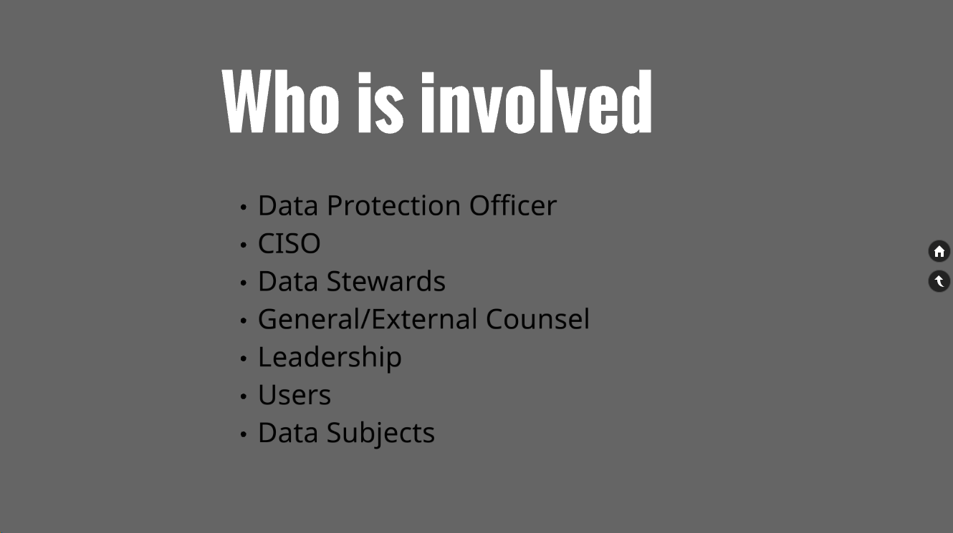

Slide 24
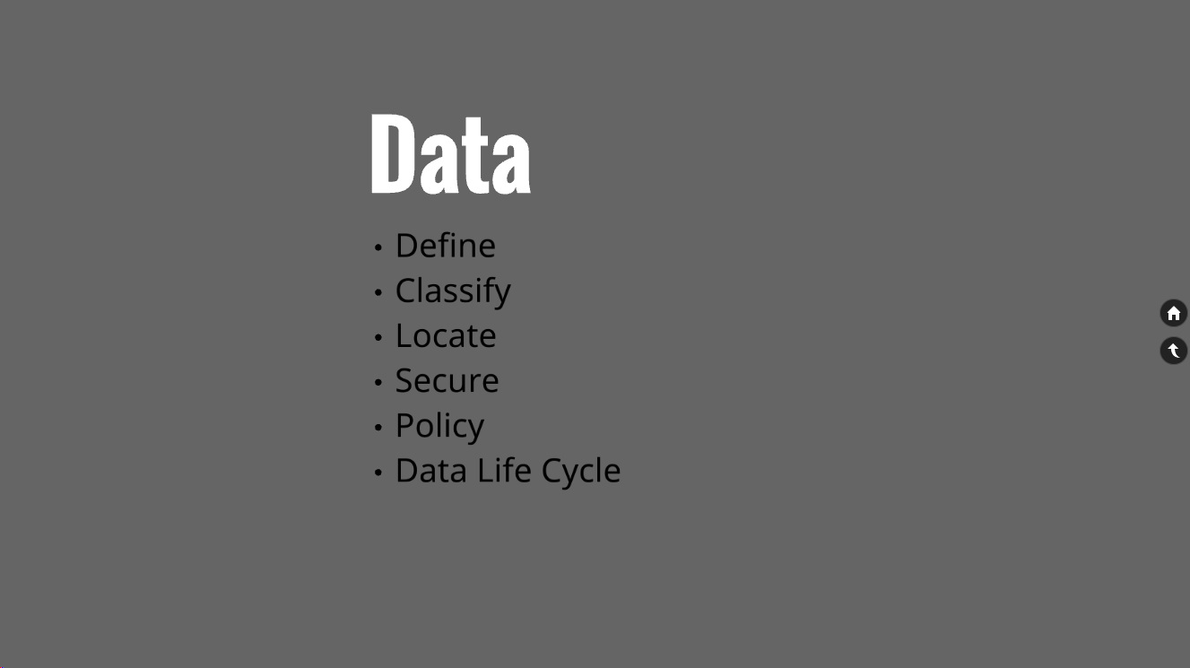

Slide 25
Data Security Life Cycle
How do we get data?
How do we store data?
How do we use data?
How do we destroy data?

Slide 26
Data Security Life Cycle
How do we get data?
How do we store data?
How do we use data?
How do we destroy data?

Slide 27
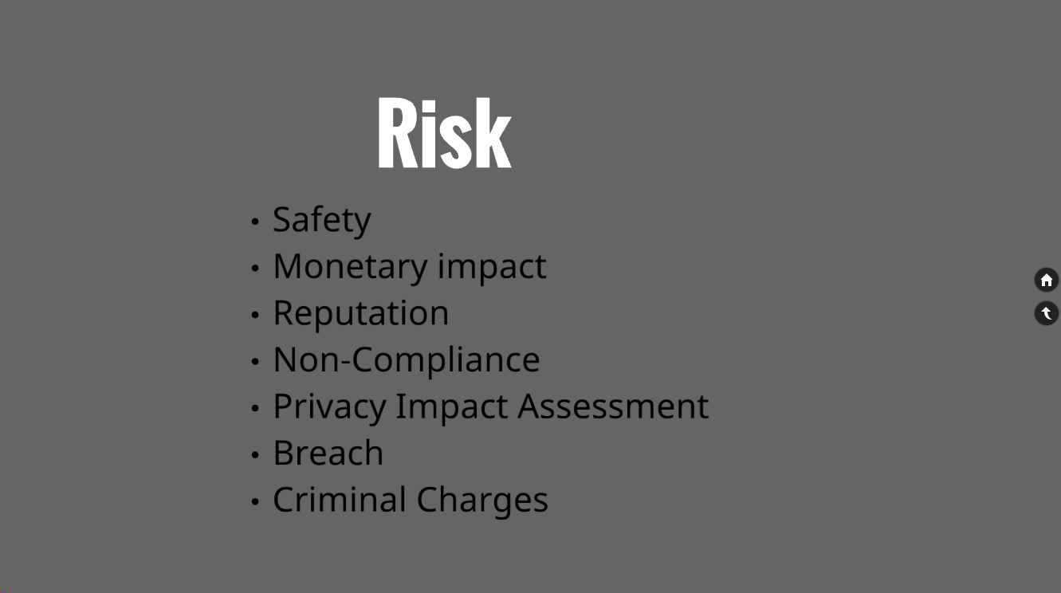

Slide 28
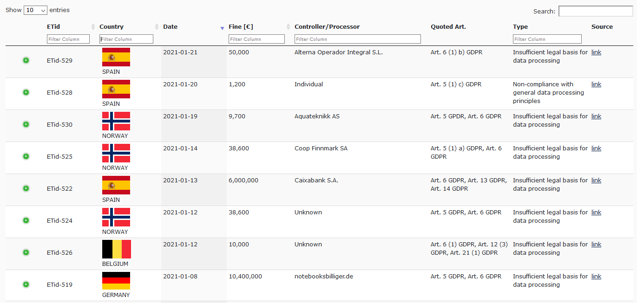
https://www.enforcementtracker.com/

Slide 29
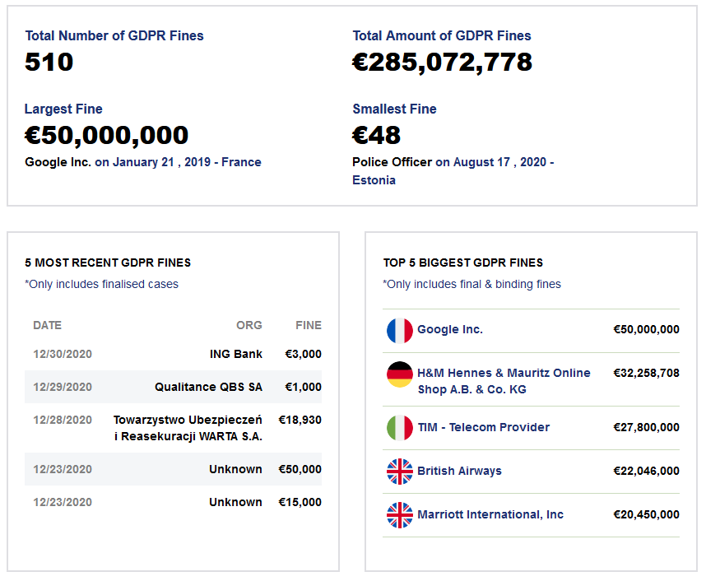
https://www.privacyaffairs.com/gdpr-fines/

Slide 30
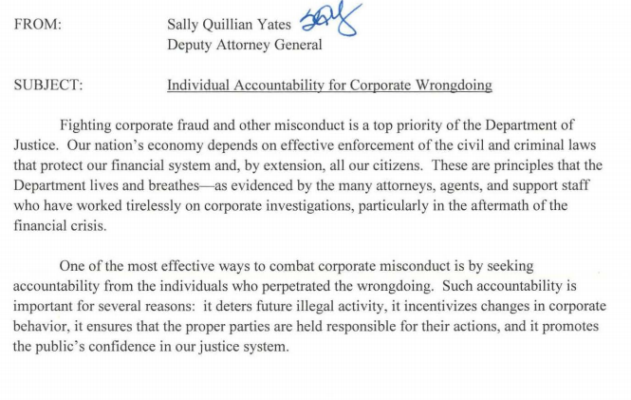

Slide 31
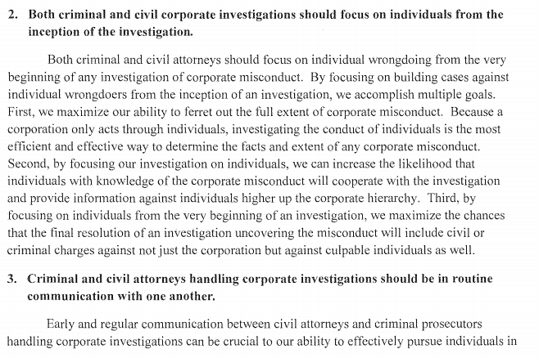

Slide 33
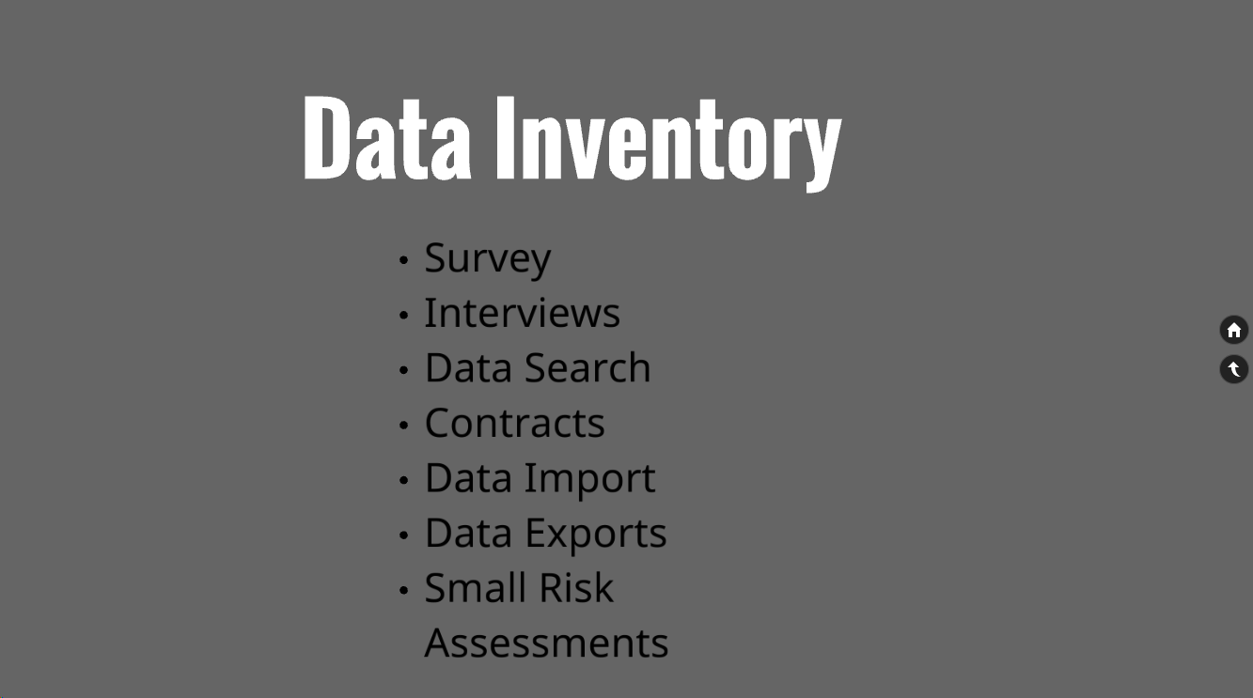

Slide 34
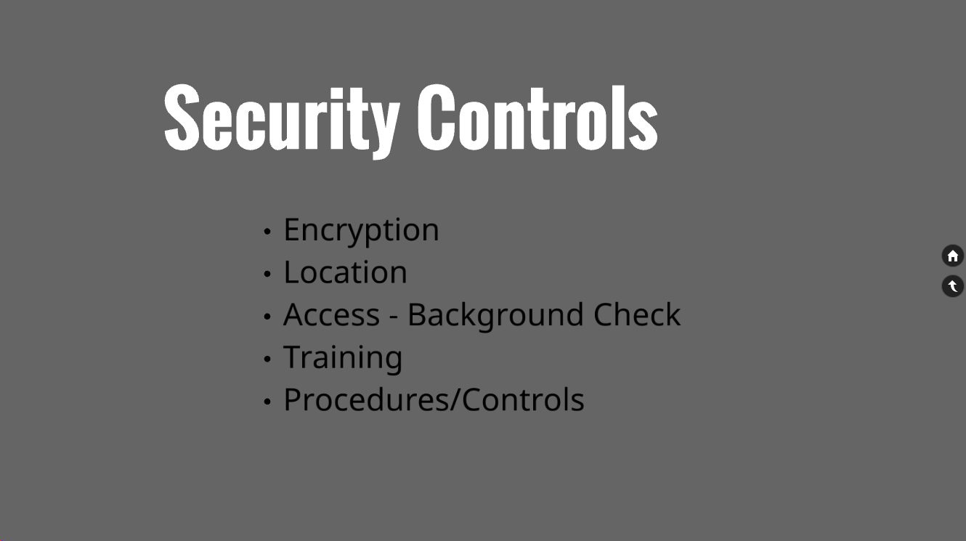

Slide 35
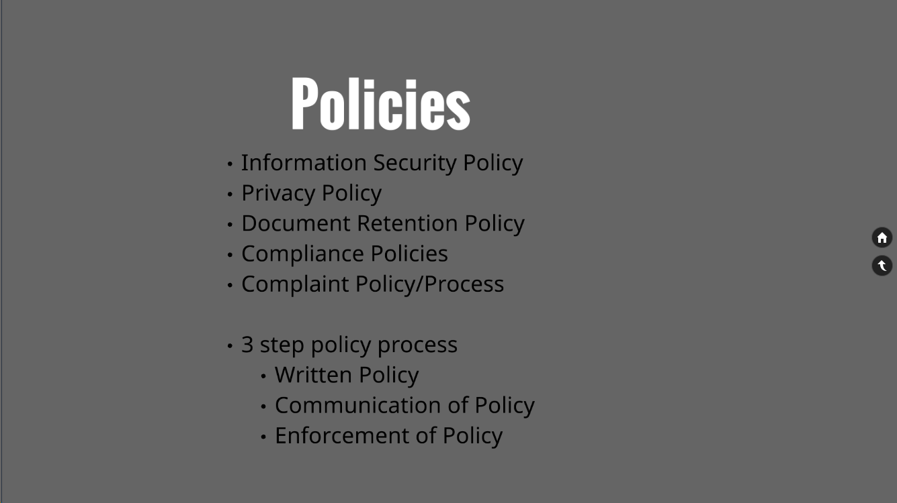

Slide 36
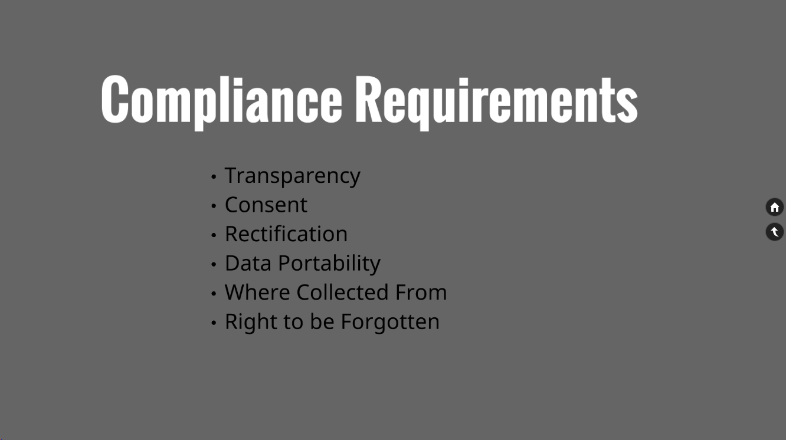

Slide 38
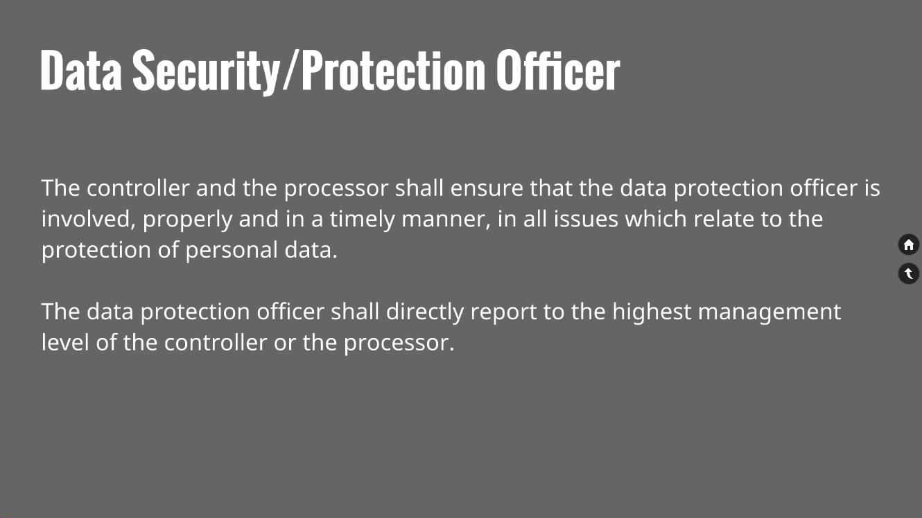

Slide 41
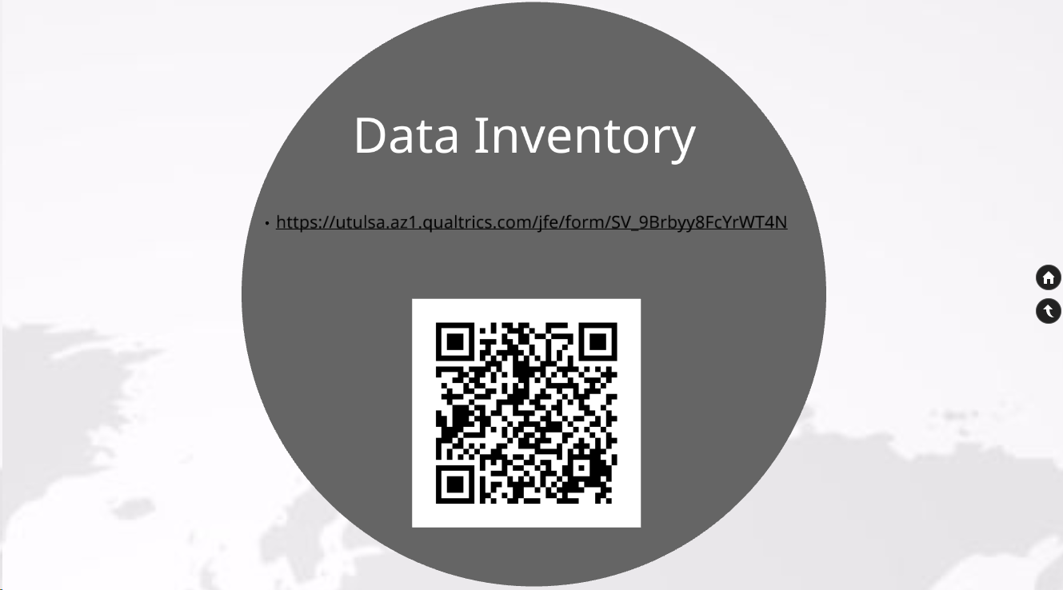

Slide 42
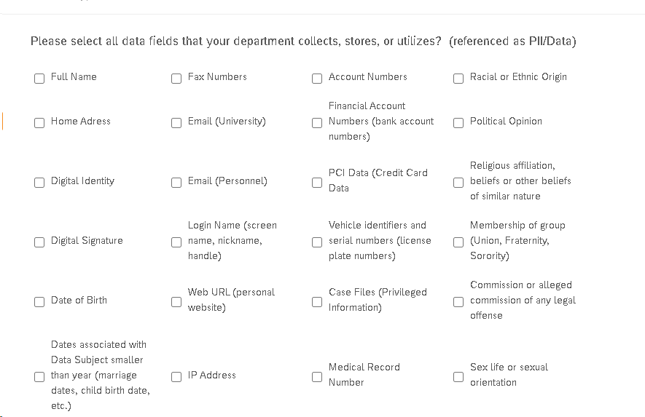

Slide 43
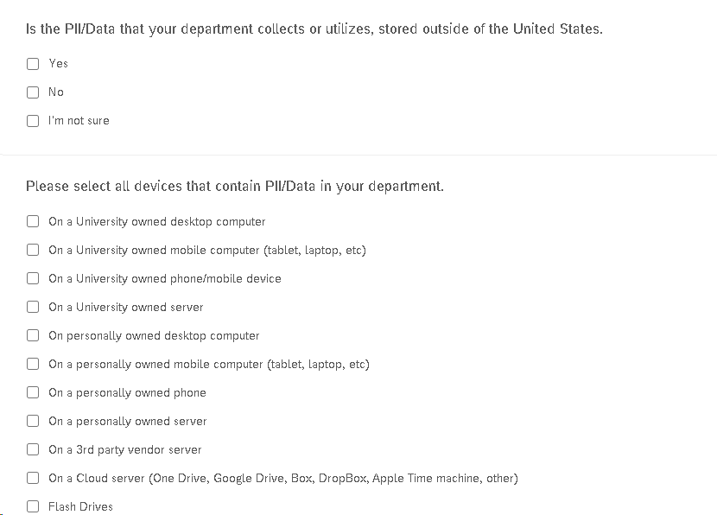

Slide 44
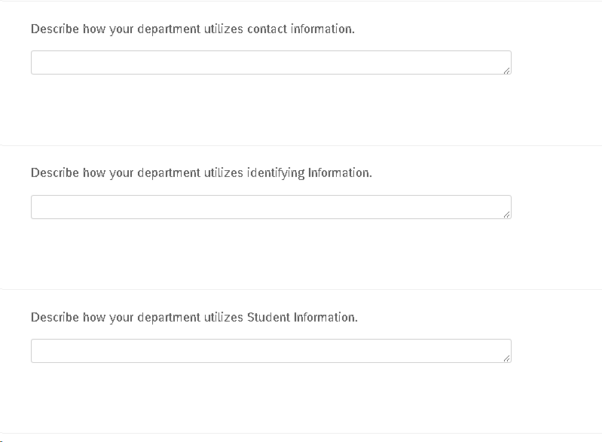

Slide 45
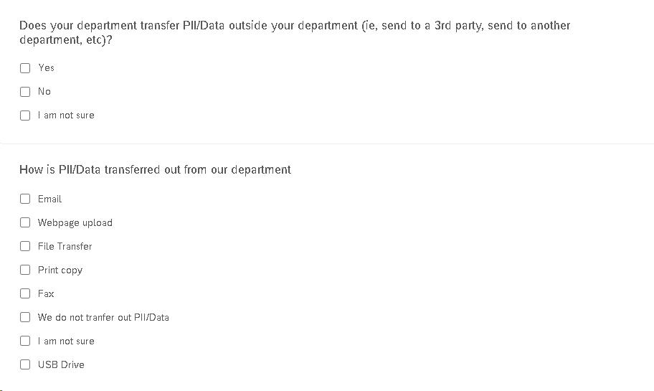

Slide 47
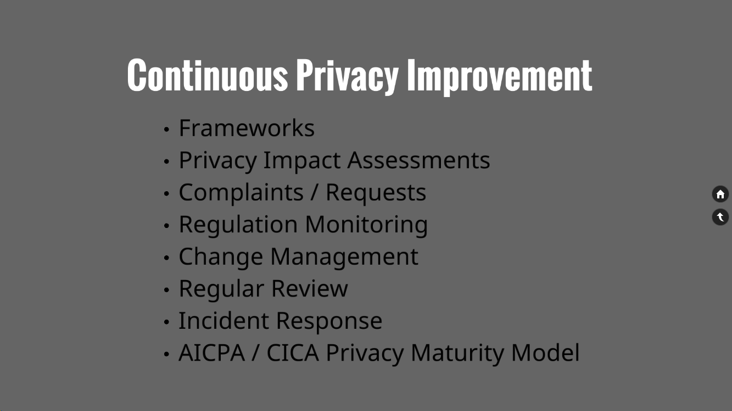

Slide 48
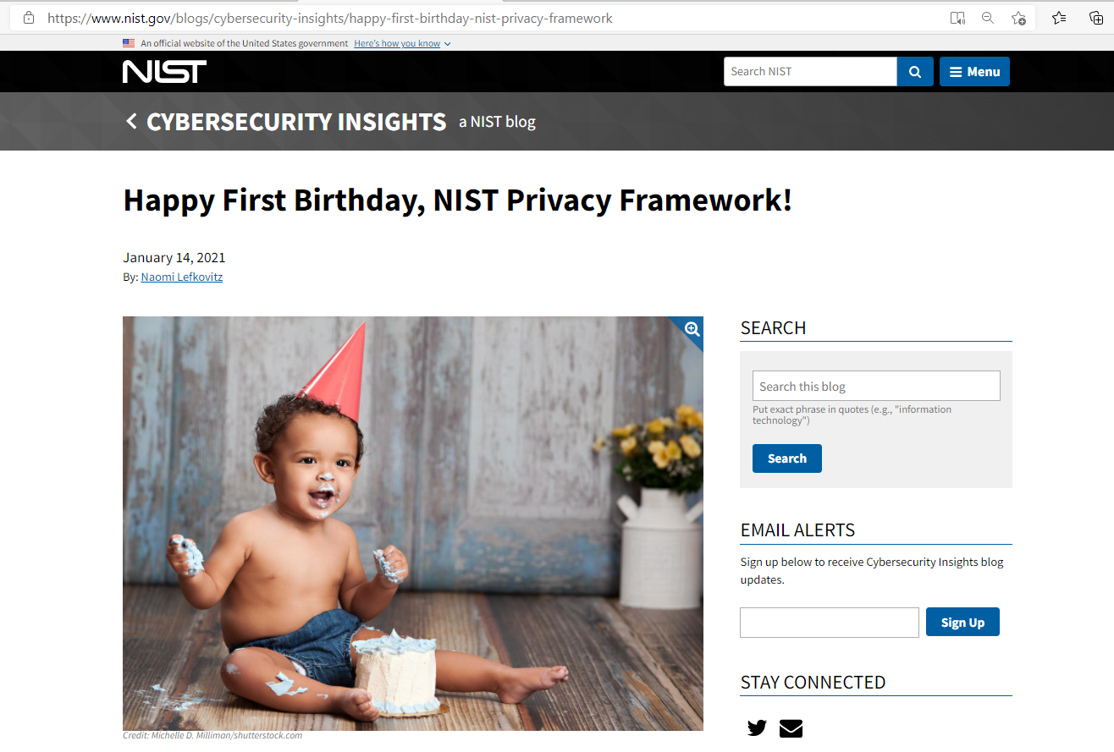

Slide 50
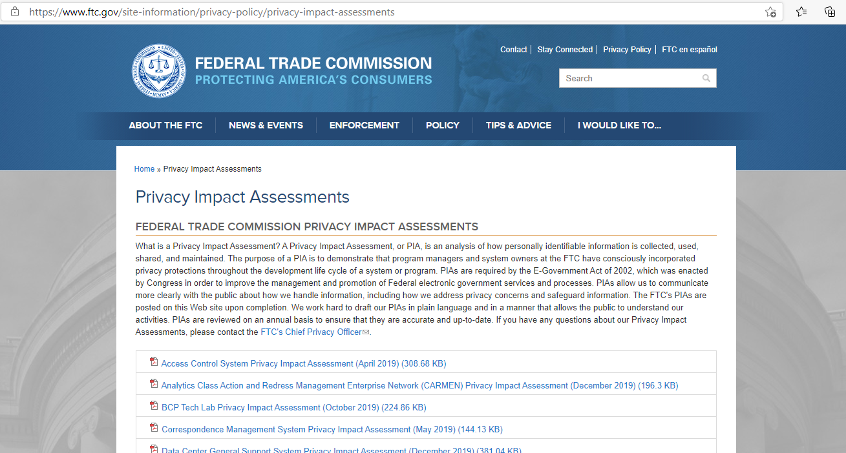

Slide 53
Metrics of a Privacy Program
How many records inbound
How many records destroyed
How many records were accessed
Who has access
How many PIA's performed
How many incidents
How many DLP triggers
What kinds of data elements in incident
What kind of incident (access, disclosure, loss)
Root cause of incident
Controller or Processor incident
External Testing Results
How many notifications

Slide 54
Assessment of a Privacy Program
Who is responsible for your Privacy Program?
Does your Data Protection officer receive professional training?
What metrics does your Data Protection officer report to the board?
Show me your data inventory.
Show me the data life cycle for “X” data field.
Show me all the places “X” data subject’s record resides.
Show me all contracts/vendors that relate to “X” data subject.
Provide me a copy of your Data Privacy Awareness Training.
Show me your Privacy Impact Assessment process.
Show me your Data Security Policies and procedures.
Show me your “Right to Erasure” process and verification.

Slide 55
Takeaway Links
https://gdpr-info.eu
https://www.ftc.gov/site-information/privacy-policy/privacy-impact-assessments
https://iapp.org/resources/article/state-comparison-table/
https://www.bakerlaw.com/BreachNotificationLawMap
https://www.radarfirst.com/blog/the-why-what-and-how-of-benchmarking-your-privacy-program/

