Slide 1
InformatiOn Technology Services

Slide 2
Accounts
You have three accounts created automatically
Email account
Canvas account
My SWOSU Portal account

Slide 3
Email
Passwords expire every 180 days
Password requirements for your email password.
The password is case sensitive. Because of the security requirements of our email system, the passwords will expire every 180 days.
The password must be at least 8 characters long.
Must NOT contain your first name or last name
Must NOT contain your ID number
Consist of a combination of at least 3 of the following: 1) Uppercase letters, 2) Lowercase letters, 3) Numbers, 4) Symbols. (ie: Happy1234, h%ppy1234, haPpy????)
Make use of Passphrases

Slide 4
Email
SWOSU Email Passwords to avoid
Any personal information about you or our family (ie birthdates, anniversary dates, family names)
Don’t use Pets names
Do not use any words which are associated with Southwestern. (i.e. SWOSU, bulldogs, bulldawgs, Duke)
Any type of information that is typically posted on social media like Facebook

Slide 5
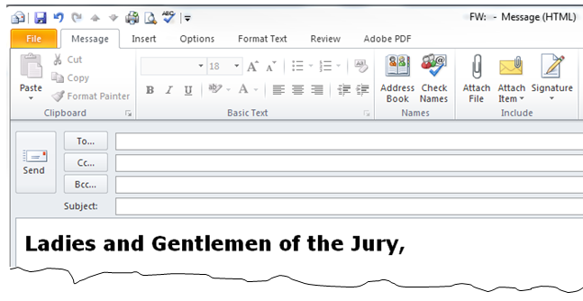
Email
All emails sent and received are archived. We encourage you to use a Non-SWOSU email for your personal correspondence.
Emails are not secure – watch what you send and NEVER send any personal information in an email.

Slide 6
Email
Security issues
Phishing Scams –NEVER answer emails requesting any personal information , usernames or passwords or links to click on to verify accounts.
Identity Theft
Your account is compromised and used to send out thousands of email requesting others for their personal emails
Disrupts SWOSU outgoing and incoming email correspondence due to being on a blacklist
Never open up email from people you do not know especially if you are not expecting an email.

Slide 7
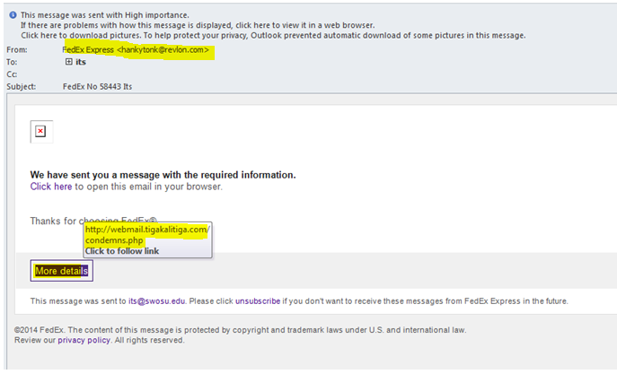
Phishing emails examples Red Flags

Slide 8
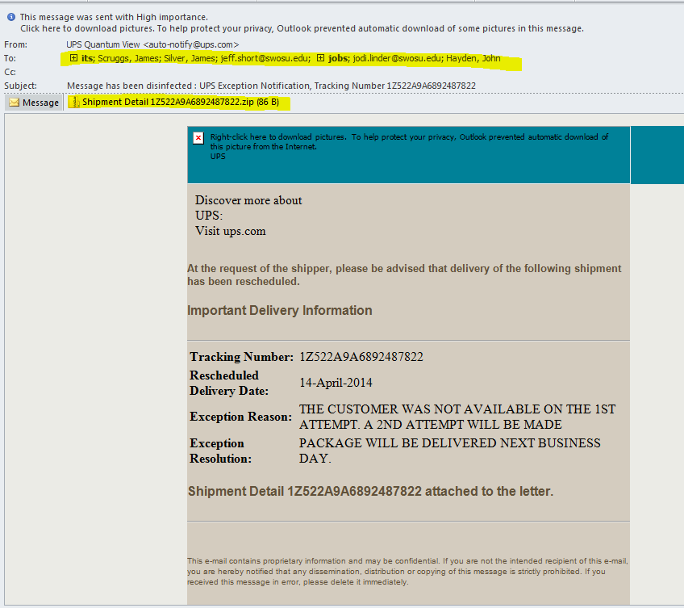
Phishing Emails Examples

Slide 9
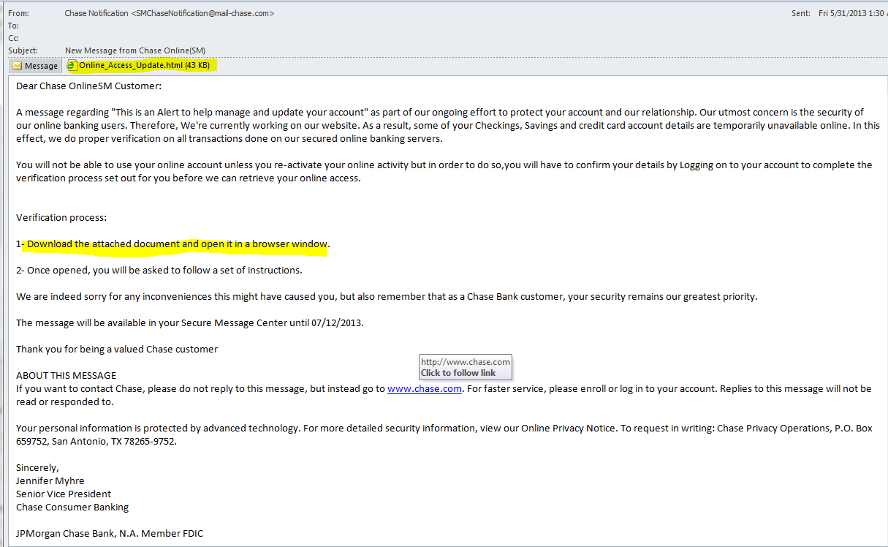

Slide 10
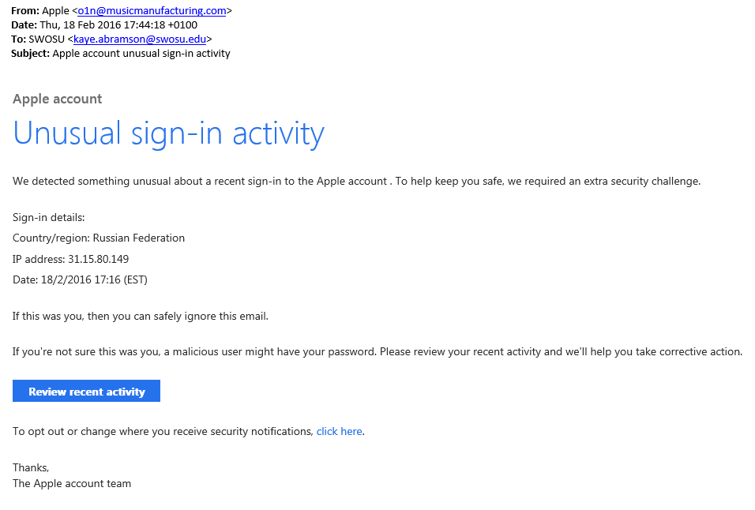

Slide 12
Web Surfing
HTTPS: Make sure you are on a secure sight when doing anything financial. (i.e. banking or ordering).
Never save password
Change passwords regularly on personal accounts. The rule of thumb is the sensitive the information being assessed with the account the more frequent it needs to be change
Keep your browser up today
Be sure when download files they are from a trusted site.
When surfing the web, look at the URLs to see if they look like reputable sites.

Slide 13
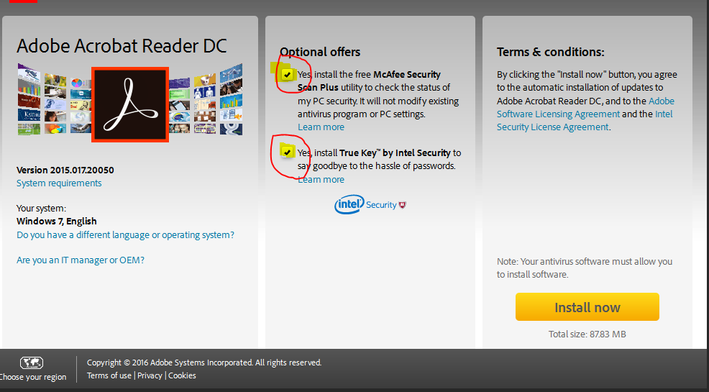
Web Surfing
Beware of bloatware – extra software installed during an installation
Advertisements on the sides of pages frequently will be compromised with malware

