Slide 1
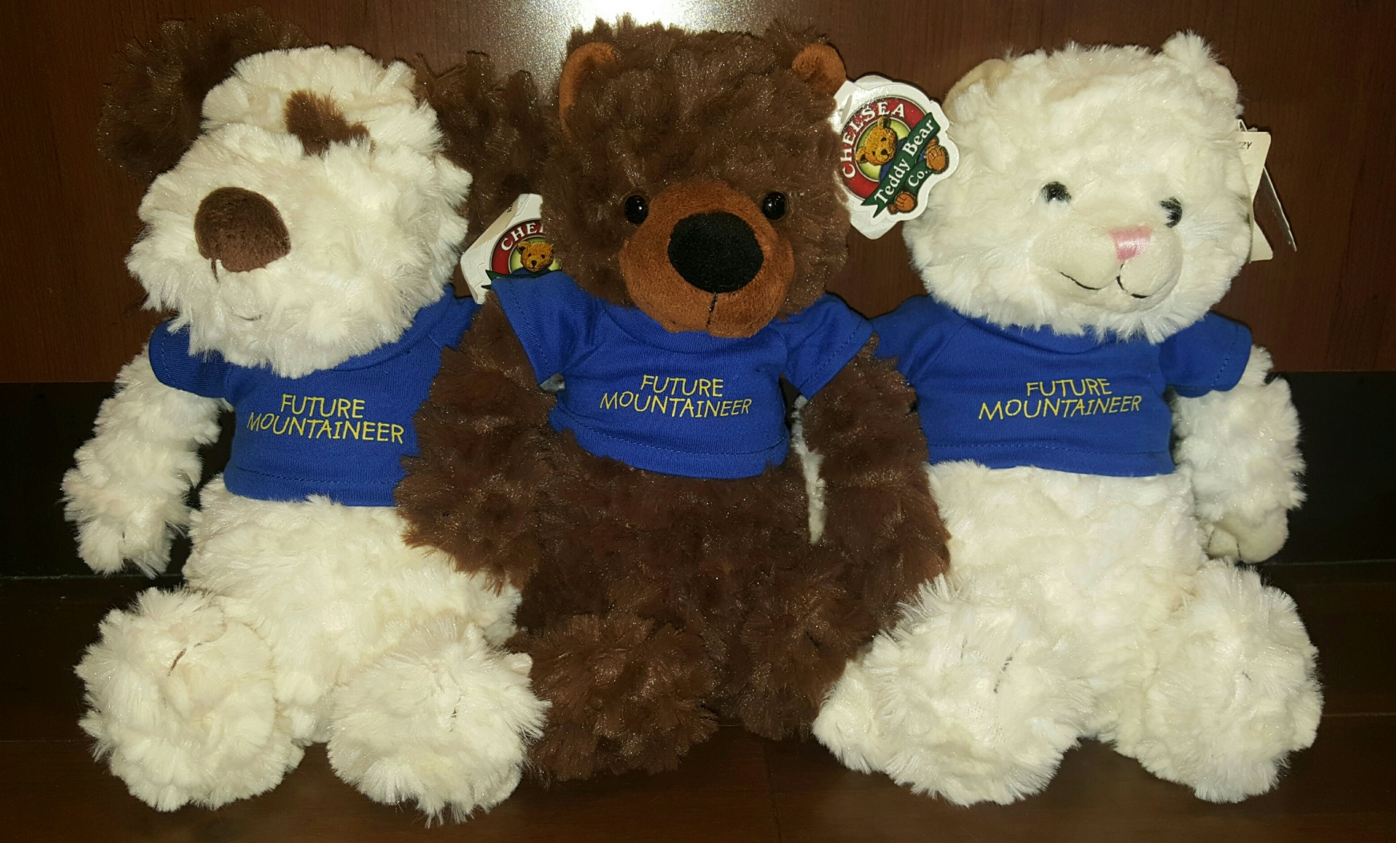
July Featured Item Regular price-$12.99 Sale price-$11.04
Future Mountaineer dog/bear/kitten
Come in to the Bookstore and get yours at 15% off before they’re all gone.

