Slide 1
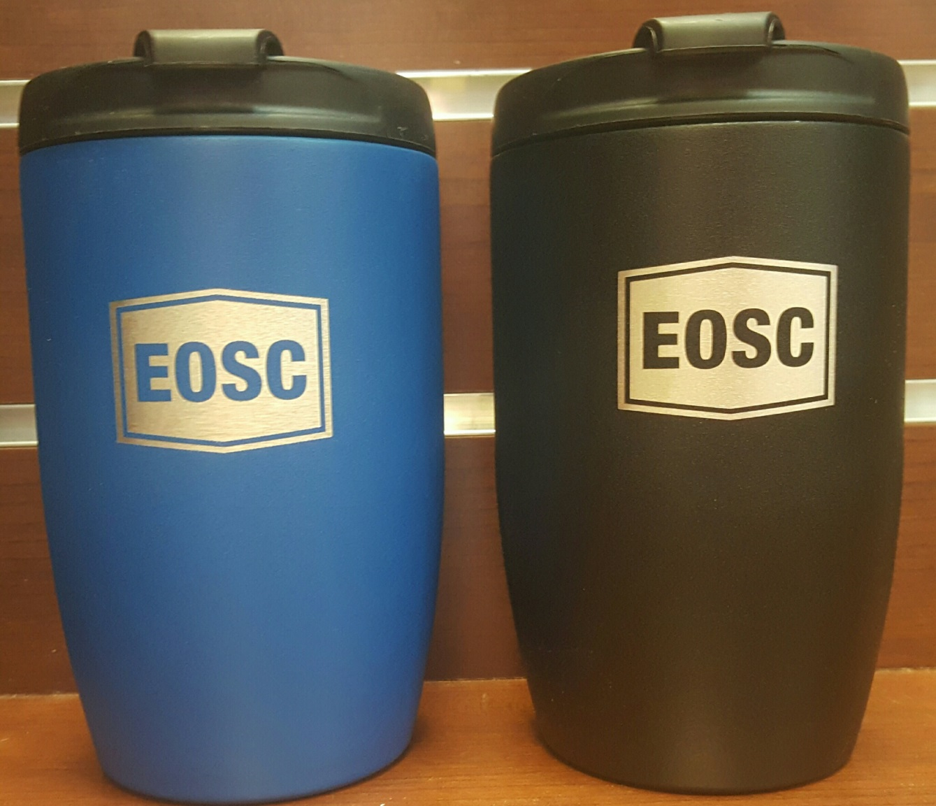
AUGUST Featured Item Regular price-$17.99 Sale price-$15.39
K-cup like that fits on your Keurig and then just take with you.
Come in to the Bookstore and get yours at 15% off before they’re all gone.

