Slide 1
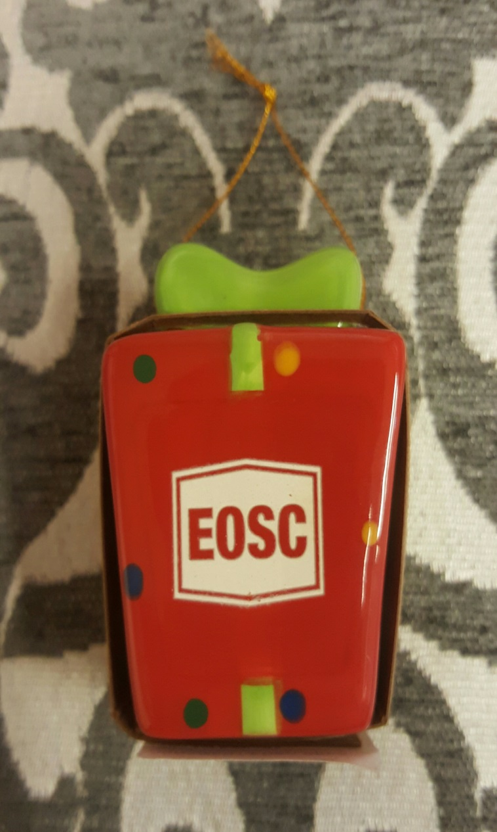
DECEMBER Featured Item Christmas Ornaments-2 choices On sale now @ 10% off Regular price-$10.99 Sale price-$9.89 +employee discount of 10%
Come in before they’re all gone.
This is a wonderful item to add to your Christmas/Alumni collection.
Hope to see you all soon!!!
Merry Christmas from all of us here in the Bookstore:
Ali, Tiara & Destini

