Slide 1
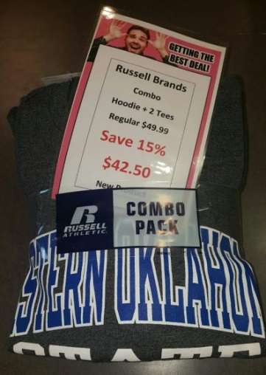
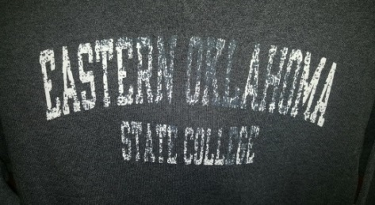
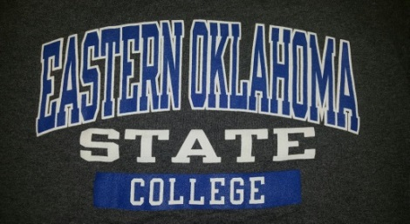
EOSC Bookstore
FEBRUARY Featured Item 3 pc Hoodie Combo 1 Hoodie & 2 t-shirts All for $42.50 Come in & get yours before they’re gone.

