Slide 1
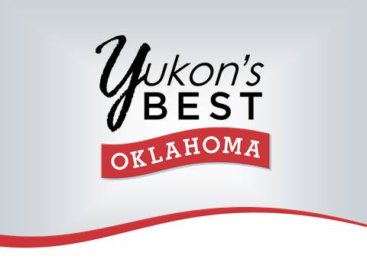

Slide 2
Planning for Recovery

Slide 3
A Pathway Forward
Downtowns won’t recover from the economic impacts of COVID-19 simply by way of government proclamations and marketing campaigns to bring customers back to Main Street.
A return to bricks and mortar shopping and
other downtown activities,
~ like getting a haircut, participating in a fitness class, eating in a restaurant, and attending a special event ~
will all be greatly dependent on having an
informed and strategic recovery plan.

Slide 4
A Pathway Forward
A Recovery Work Plan
will position YBMS & Y66MSA
with a road map,
With a leadership role in the recovery,
and an opportunity to secure implementation resources through advocacy.

Slide 5
Getting Started
What is the timeline between reopening and a more settled “new normal”?
There is no clear timeline and it will differ for every Main Street community based on it’s
size,
location,
downtown worker environments,
and consumer trends.

Slide 6
Getting Started
Main Street America recommendations:
Develop a 90-day Recovery Workplan for the Main Street District.
Workplan should include all 4-Points of the Main Street Approach®
Re-evaluate (after 90 days)
Remaining needs
Fresh look at recovery inputs

Slide 7
Step-By-Step
Inputs
Recovery Workplan
The Outcomes

Slide 8
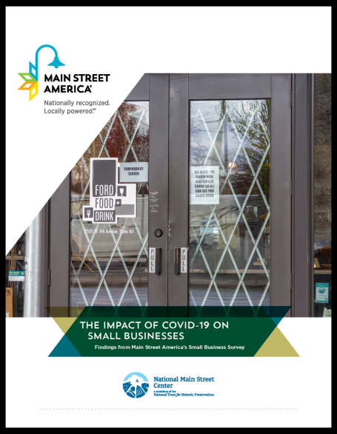
The Inputs – National Trends
For full report: www.mainstreet.org
Key Findings:
Millions of small businesses will be at great risk
of closing permanently if the crisis continues
for several months.
Of the nation’s approximately 30 million small businesses,
nearly 7.5 million small businesses may be at risk of
closing permanently over the coming five months,
and 3.5 million are at risk of closure in the next two months.
COVID-19 has had a devastating impact on small businesses’ revenue, and millions of Americans employed by our nation’s smallest businesses are at risk of unemployment as a result.
Approximately 35.7 million Americans employed by small businesses are at risk of unemployment as result of the COVID-19 crisis.
Our survey finds that business owners primarily need financial assistance and penalty-free extensions on expenses.

Slide 9
Step 2 – Recovery Work Planning
Webinar 1 –Board and staff to review the survey / interview findings.
Analyze how it relates to national trends, and local reopening guidelines.
Webinar 2 –Board and staff to evaluate current workplan for activities that should remain short-term to address COVID-19 recovery.
Develop key goals for each Point – 90 day recovery workplan.
Review any known activities by partner organizations. (1 hour)
Webinar 3 – Facilitated meeting with Organization group
Webinar 4 – Promotion group
Webinar 5 –Design group Webinar 6 - Economic Vitality group
Review activities relevant to COVID-19 recovery and decide on any new activities to accomplish recovery workplan goals. (1 hour each)
Webinar 7 –Meeting with Board, staff and Committee/Task Force Chairs to review finished “Recovery Dashboard” and discuss advocacy messaging and metrics. (1 hour)

Slide 10
Step 3 – Outcomes
The products that result from this workplan provide the critical framework of the next 90 days of your work, serve as an advocacy tool for the resources needed to implement your plan, and provide metrics for you to measure what success looks like for your district over this phase of recovery.

Slide 11
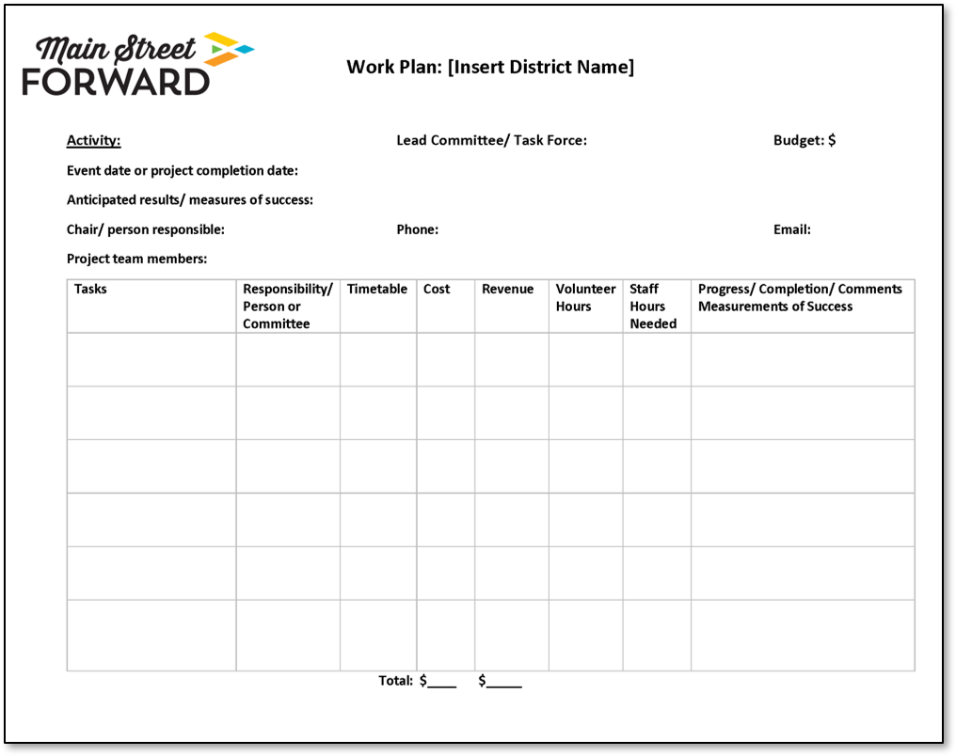

Slide 13
Main Street Advocacy
Main Street Community Recovery and Revitalization Efforts:
Push for federal funding injected into Main Street programming and Main Street businesses in COVID -19 recovery efforts.
Oklahoma Advocacy -
letter to legislators (Senator Langford)
Asking OK Main Street programs to agree to “sign-on” to the letter
Specific requests [draft form]:
Support for Main Street Coordinating Program ($75 million)
Federal match 1:1 up to $1.5m per state
State programming and direct grants to local programs.
Direct Support of Main Street Businesses ($25 million)
To revitalize companies
Facilitate local Main Street programs
Small businesses addressing COVID needs including
online/e-commerce; retailing, marketing, and
implementing social distancing guidelines.

Slide 14
Quote of the Week ~
“Recovery and growth will necessitate creativity, experimentation, and collective thinking as requisites to addressing both immediate needs and those unanticipated in the future.”
– Patrice Frey, President & CEO, NMSC

