Slide 1
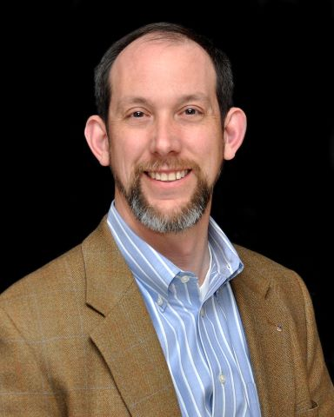
Business Incubators 101
Hosted by SBA Oklahoma District Office
What is a Business Incubator
Incubator vs. an Accelerator
Different Types of Accelerators
Is your Business a Good Fit for an Incubator?
Brad Rickelman
Asst. Director, Business & Entrepreneurial Service
Meridian Technology
August 22, 2023 11am-12noon CST
REGISTER

