Slide 1
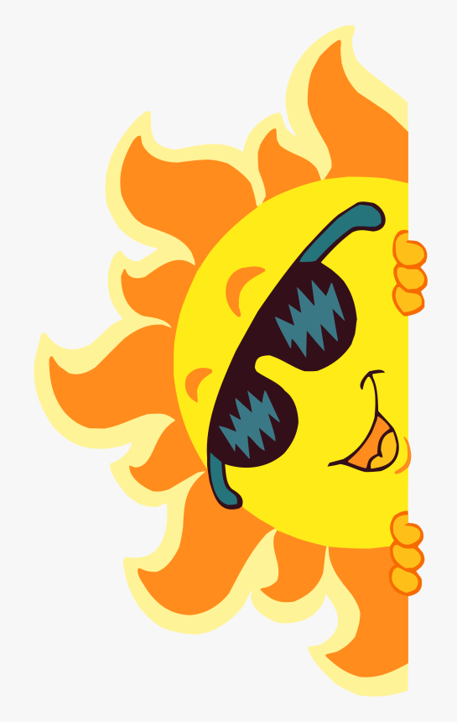
Main Street Director Training
Aug. 8-10, 2023
Guymon, OK
Tuesday, August 8
1:30 – 2:00 Welcome and Ice Breaker
2:00 – 2:15 All about Guymon, Melyn Johnson
2:15 – 3:15 STANDARD I: Broad Based Community Commitment to Revitalization, Lisa Thompson
Partnerships & Collaborations, District and Community Outreach, Communication & Public Relations
3:15 – 3:30 Break
3:30 – 4:30 Partnering… Working Smarter, Melyn Johnson - Being a good partner with other organizations (Chamber, media, and others) helps you be more productive and adds popularity points.
4:30 – 5:00 Rural Renewal Initiative, Dr. Audrey King
6:00 – 7:00 Reception at The Ag Center (Guymon High School Alma Folklorica Dancers performing)
Wednesday, August 9
8:00 – 8:30 Coffee and Conversation
8:30 – 9:30 Dr. Audrey King
9:30 – 10:30 STANDARD II: Inclusive Leadership and Organizational Capacity, Lisa Thompson
Inclusive Organizational Culture & Diverse Volunteer Engagement, Active Board Leadership & Supporting Volunteer Base, Professional Staff Management, Effective Operational Structure
10:30 – 10:45 Break
10:45 – 11:45 STANDARD III: Diversified Funding and Sustainable Program Operations, Lisa Thompson
Balanced Funding Structure, Strategic Revenue Development and Fundraising, Budget and Workplan Alignment, Financial Management and Best Practices
11:45 – 1:15 Lunch on Your Own - Progressive Lunch Downtown (more information later)
1:15 – 2:00 AI Technology, Dakota Mullins - Using AI technology to create fundraising letters, content, etc.
2:00 – 5:00 True Colors (Break Included) – Dr. Renea Skelton, PhD
Continued on back

Slide 2
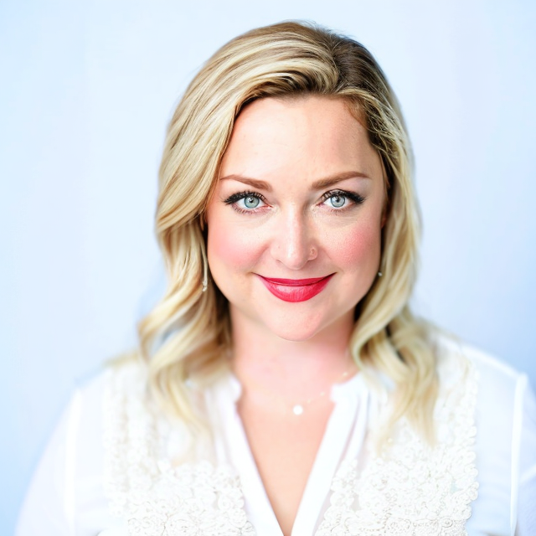
Main Street Director Training
Aug. 8-10, 2023
Guymon, OK
6:30-9:30 Bob’s Block Party at Bob’s Cowboy Bar, 132 N. Ellison St., where there will be Cornhole Tournament, Jinga, food truck with cowboy’s chicken fried steak special, live music being Ken Stonecipher unplugged. Next door at Fisch and Hitch, 123 N. Main, will be an Evening Market with vendors from our Saturday Morning Local Farmers Market selling wares and other fun things.
Thursday, August 10
8:00 – 8:30 Coffee and Conversation
8:30 – 10:00 Reach Customers Online with Google, Jarrod Foster - Learn how your business can be found online with Google. This workshop explains how Google Search works and how you can improve a website’s visibility with Search Engine Optimization (SEO). The session also introduces products like Google Business Profile, Google Trends, Search Console, Google Ads, and more.
10:00 – 10:15 Break
10:15 – 11:00 Local Economic Development, Sheila Martin
11:00 – 12:00 Director Round Table
12:00 Training Adjourn
Dr. Renea Skelton, PhD, is a Certified Life and Communication Coach, True Colors Master Trainer, Speaker, and Author. With over 20 years of experience in leadership and emotional intelligence development, she successfully helped countless individuals and teams drive performance and impact within their organizations, and within themselves. As a Master Trainer, she delivers energetic, engaging, and life-changing workshops centered on leveraging effective communication, increasing emotional intelligence, and reducing conflict. Dr. Renea delivered the True Colors methodology to over 9K individuals in the educational, corporate, government, healthcare, and military industries. She is a retired Air Force combat veteran of 22 years, and her superpower is serving others with a hyper-focus on self-awareness and how we authentically communicate. Dr. Renea is the author of an award-winning Emotional Intelligence children's book series: "The Adventures of Henry the Hedgehog" and her greatest joy is found with her husband of 25 years & her three amazingly resilient children.

