Slide 1
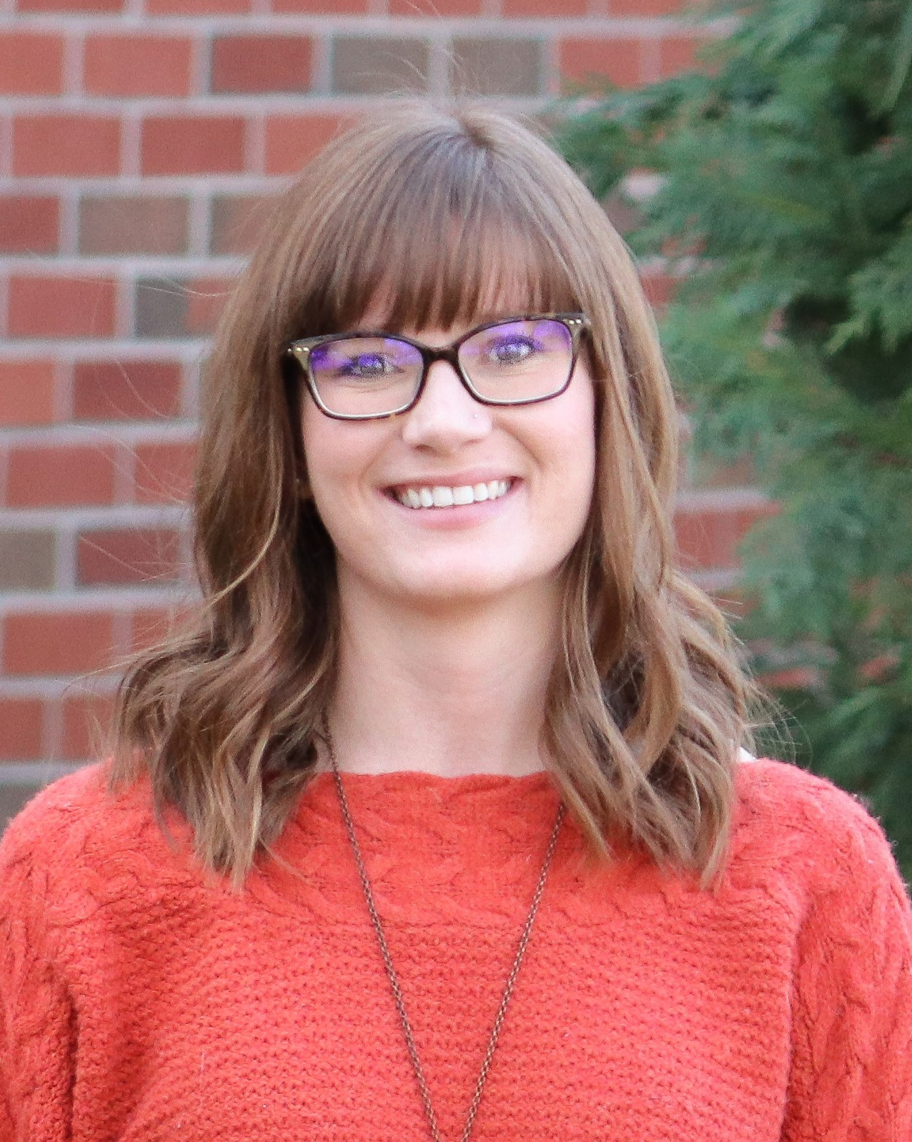
Is Your Small Business Website
ADA Compliant?
Hosted by SBA Oklahoma District Office
Lyssa Prince will present guidance on what is legally required to have an ADA Compliant website, show the impact to people with a disability, and demonstrate a tool to assist small business owners. SBA will also provide some resources to assist your business evaluate your compliance.
Lyssa Prince
Digital Accessibility Program Manager
Oklahoma ABLE Tech
Oklahoma State University Department of Wellness
October 10, 2023 11am-12noon CST
REGISTER

