Slide 1
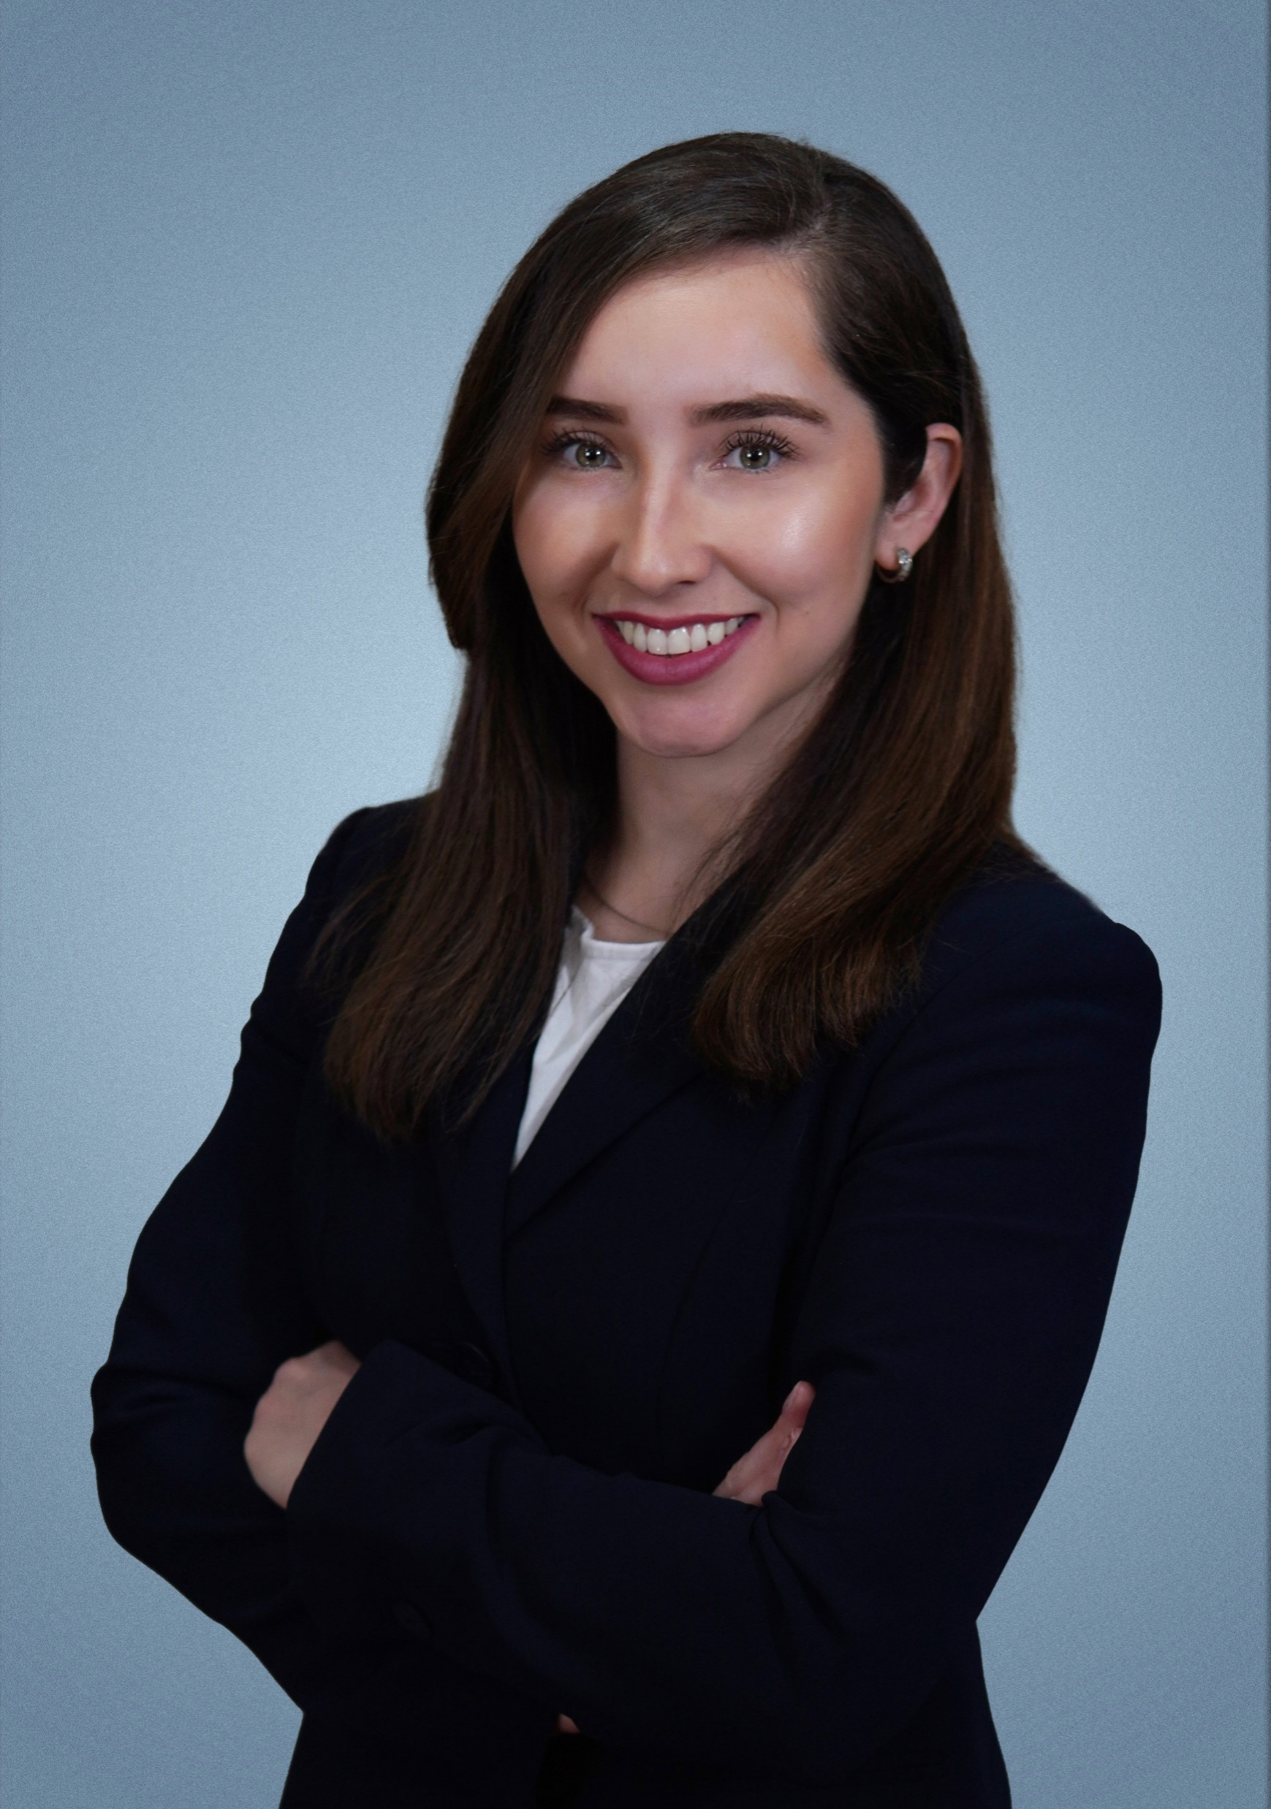
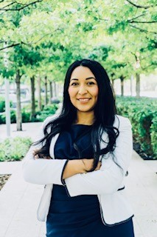
Hispanic Heritage Month
Hosted by SBA Oklahoma District Office
Join Us to Learn about Services and Loan Programs Available for
Hispanic Owned Small Businesses
October 4, 2023 11am-12noon CST
Steffi Silvera
Business Center Director
Greater OKC Hispanic
Chamber of Commerce
Jessica Sifuentes
Minority Business Coordinator
REI Oklahoma
REGISTER

