Slide 1

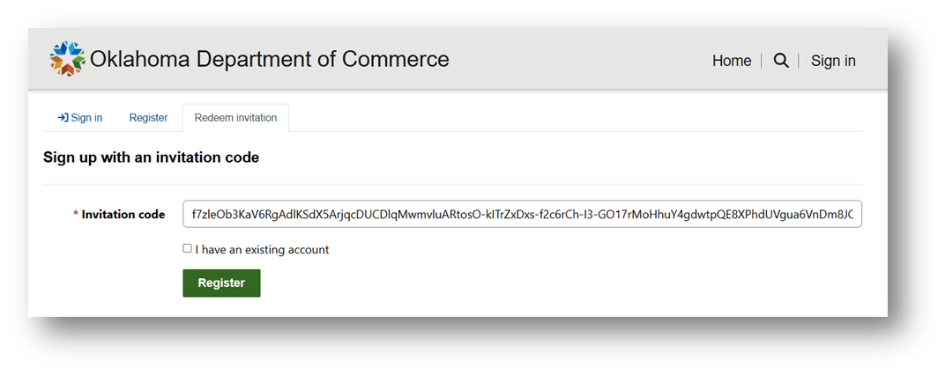
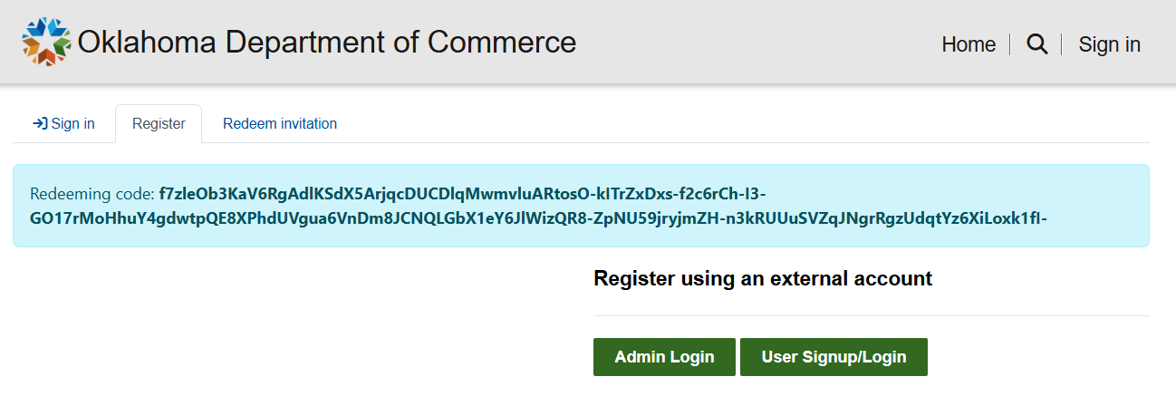
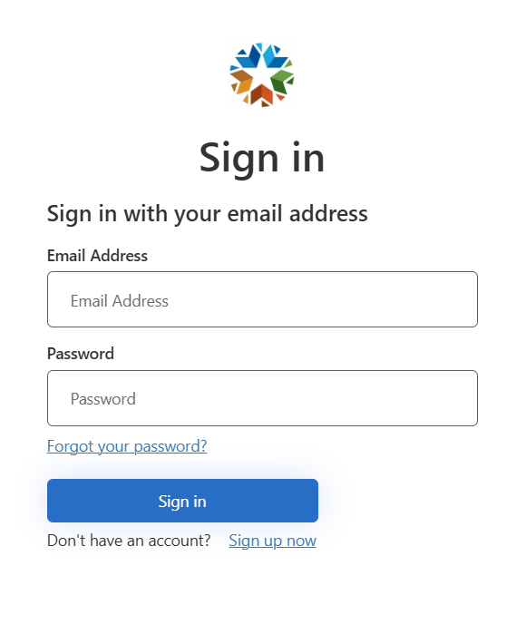
NEW Oklahoma Commerce Portal Registration Instructions
Clicking on portal registration link you received in your email (Check Spam) will open the following in your web browser.
Email will come from SVC_D365-ODOC@agency.ok.gov
2. Leave the “I have an existing account” unchecked- Click Register
3. Click User Signup/Login
4. Select “Sign up now”

Slide 2
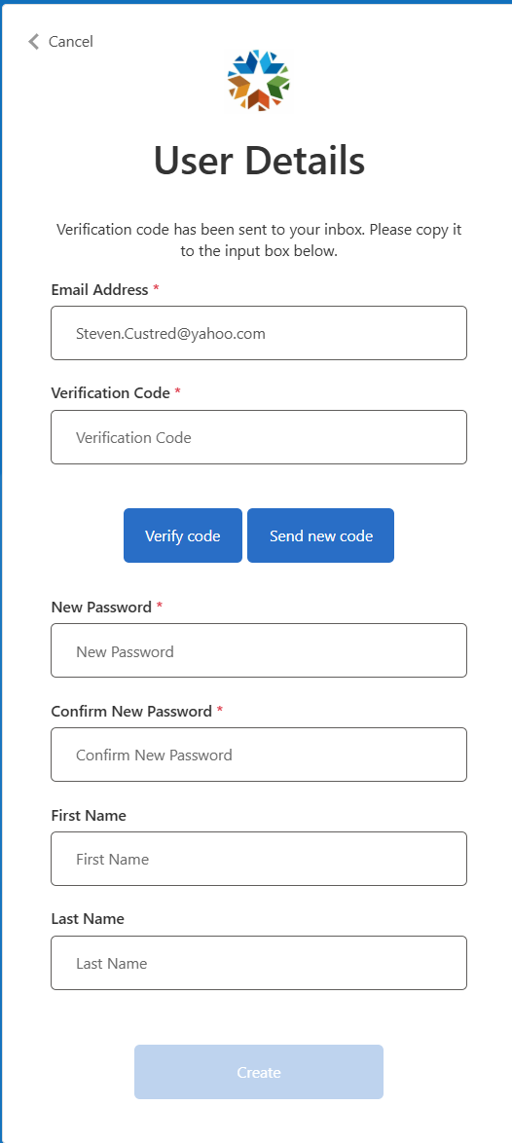
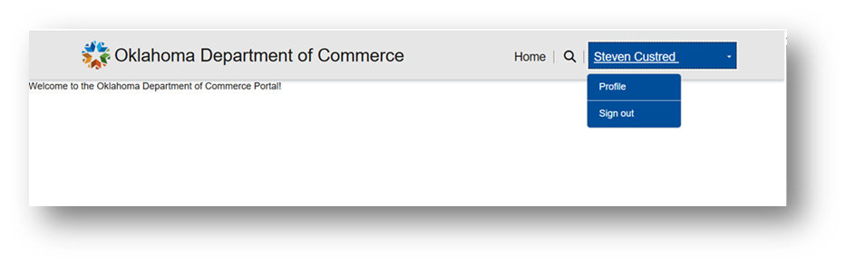
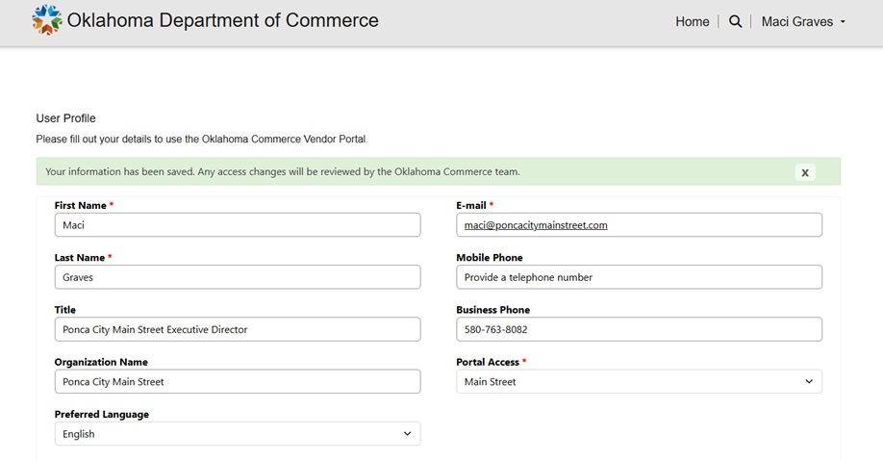
6. Retrieve and enter the Validation Code from the email you provided. Once you select Verify Code, complete the remainder of the form with password information and First/Last Name and select Create. This will take you to the Profile page to complete the registration process
5. Enter Email Address and select Send Validation
7. Select your Name at the top right corner and select Profile.
8. Complete the User Profile page (Select Main Street) and select Submit.
9. A message will display that your information has been saved and is being reviewed. You will receive an email once approved allowing access to the portal.
If your request is denied, you will receive an email with an explanation and/or further instructions.

