Slide 1
To be successful, cities need destinations. They need destinations that give an identity and image to their communities and that help attract new residents, businesses and investment, but they also need strong community destinations for people to go to. A destination might be a downtown square, a main street, a waterfront, a park, or a museum. Cities of all sizes should have at least ten destinations where people want to be. What makes each destination successful is that it has places within it. For example, a square needs at least ten places: a café, a children’s play area, a place to read the paper or drink a cup of coffee, a place to sit, somewhere to meet friends, etc. Within each of the places, there should be at least ten things to do. Cumulatively, these activities, places and destinations are what make a great city. This is a big idea that PPS calls the “Power of 10”.
Notes:
1

Slide 2
EXAMPLE: POWER OF 10, Great Falls, MT
List 5 best places. For each place provide 3-5 reasons why it is the best.
Great Falls Civic Center – terminating vista of Central, events location
Arvon Block – center of block, preservation of building, opens to street
300 block – human scale, few vacant storefronts, historic architecture
Mighty Mo Brew Co (business) – brings people downtown after work
Sip N Dip (business) – brings people downtown from out of town
List 5 places with the most potential. For each place provide 3-5 reasons why it has potential.
Rocky Mountain Building – large, vacant (com & res), architectural features
700 Block – streetscape improvements scheduled for 2016, unique businesses
Davidson Plaza – Charlie Russell statue, buildings frame space, D.A. Davidson
500 Block – vacant upper stories for nearly entire block, end anchor businesses
Private parking lots – blank slate between two healthy blocks; Baum-Trinastisch
Notes:
Example, List of best and potential places, Downtown Great Falls, MT

Slide 3
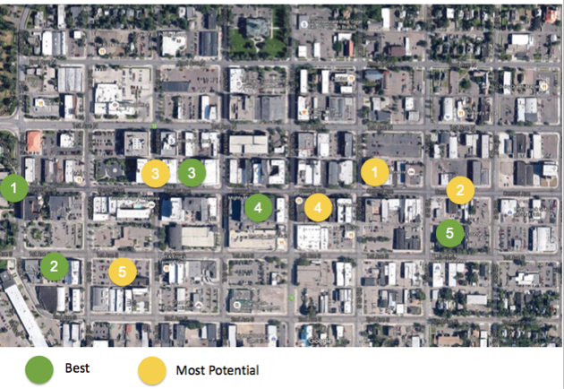
EXAMPLE: POWER OF 10, Great Falls, MT
Notes:
Example, Location of of 5 best and 5 potential places identified, Great Falls, MT

Slide 4
Choose 1 of your five best places. List 5 things you can do or experience in this place that make it great. Place: Great Falls Civic Center
POWER OF 10, Great Falls, MT
1. Public Parks – Margaret Park and Whitter Park; mature trees = enclosure
2. Outside events, e.g. Farmer’s Market, great place to meet people
3. Inside events, Convention Center, Mansfield Theater, ballroom
4. Terminus of the the street is a public, prominent historic structure
5. Front steps as a public forum
Choose 1 of your five places with the most potential. First, list 2 things you can do in this place, and then list 3 additional things you would like to do or experience that would improve it. Place: Davidson Plaza
1. Street wall provides sense of enclosure and defined space; Russell statue
2. Numerous benches with shade trees for passive relaxation
----------------------------
1. Potential as a lunch destination (movable seating, tables)
2. Removal of pine trees for easier pedestrian traffic flow, true plaza feel
3. Activate with small events, music; booths or tables along Central
Notes:
Example, List of activities that make one of the five best places great and two things that make one of the five places with most potential good and three things that would make it better, Great Falls, MT

Slide 5
List 5 best places. For each place provide 3-5 reasons why it is the best.
POWER OF 10, [NAME OF MAIN STREET, CITY]
List 5 places with the most potential.
Notes:
Here we ask you to select a Main Street that you know well and identify 5 of the best places and 5 places with the most potential. Places can be anything from an open space to a business to an entire street. Use this template to list the places and provide reasons for the best places.

Slide 6
1
4
2
5
3
Place image of aerial here and drag the dots at left onto the map.
1
2
3
4
5
Best
Most Potential
Notes:
Place an aerial image of your chosen Main Street on the slide and drag the dots over to identify 5 of the best places and 5 with the most potential.
The process of classifying these places helps local residents think through the importance of creating substantive physical and social connections between existing spaces, the strategic creation of new places, and the energy that can be generated through creating a network of destinations.

Slide 7
Choose 1 of your five best places. List 5 things you can do or experience in this place that make it great. [PLACE: ----]
POWER OF 10, [NAME OF MAIN STREET, CITY]
1.
2.
3.
4.
5.
Choose 1 of your five places with the most potential. List 2 things you can do in this place, and 3 additional things to do or experience that would improve it. [PLACE: ----]
1.
2.
____________________________________________________
1.
2.
3.
Notes:
Here we ask you to select one of the best places you identified and list 5 of the things you can do, participate in, or experience that make this place great. Then choose one of the places you identified with the most potential and list two things you can currently do here, and three things you could do, participate in, or experience that would make it more successful.

