Slide 1
Osrhe policy workshop
July 30, 2026

Slide 2

welcome
Dr. Julie Dinger
Vice Chancellor for Academic and Student Affairs

Slide 3
housekeeping
Format of Workshop and Questions
Presenters Email
  Stephanie Beauchamp sbeauchamp@osrhe.edu
  Anna Dunn adunn@osrhe.edu
  Angel Icenhour aicenhour@osrhe.edu
  Heather Peck hpeck@osrhe.edu
  Goldie Thompson gthompson@osrhe.edu
  Elizabeth Walker ewalker@osrhe.edu
  Jenny Wood jwood@osrhe.edu

Slide 4

About the Oklahoma state regents for higher education
Legislatively established in 1941
  Legal structure for providing public education at the collegiate level
Coordinating board for 25 colleges and universities
  2 research institutions
  10 regional universities
  1 public liberal arts university
  12 community colleges
  11 constituent agencies
  1 higher education center
Institutions have their own governing board

Slide 5
Governing boards
OU
  University of Oklahoma
  Cameron University
  Rogers State University
RUSO
  East Central University
  Northeastern State University
  Northwestern Oklahoma State University
  Southeastern Oklahoma State University
  Southwestern Oklahoma State University
  University of Central Oklahoma
INDEPENDENT BOARDS
  University of Science and Arts of Oklahoma
  Carl Albert State College
  Eastern Oklahoma State College
  Murray State College
  Northern Oklahoma College
  Oklahoma City Community College
  Redlands Community College
  Rose State College
  Seminole State College
  Tulsa Community College
  Western Oklahoma State College
OSU A&M
  Oklahoma State University
  Langston University
  Oklahoma Panhandle State University
  Northeastern Oklahoma A&M College
  Connors State College

Slide 6
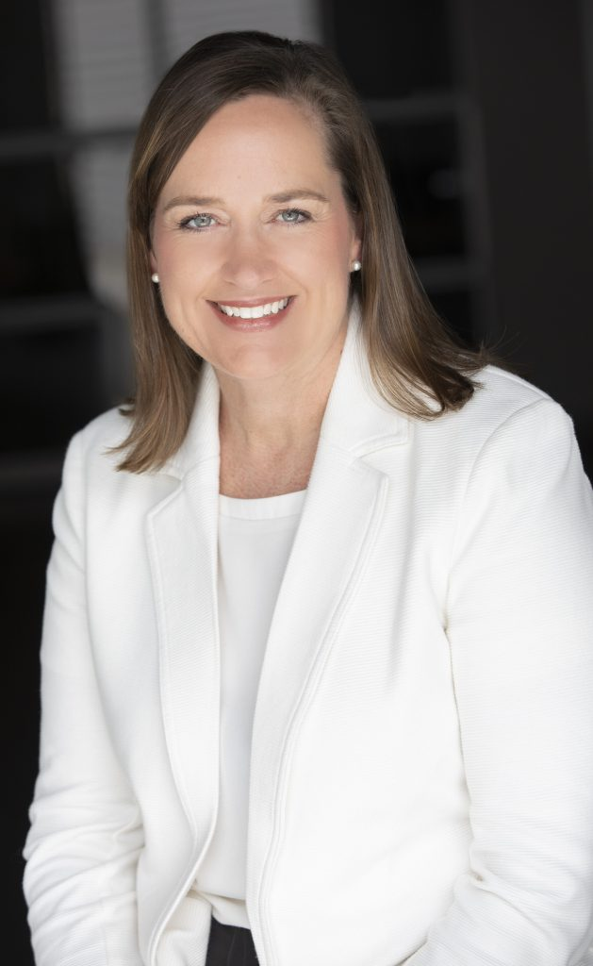
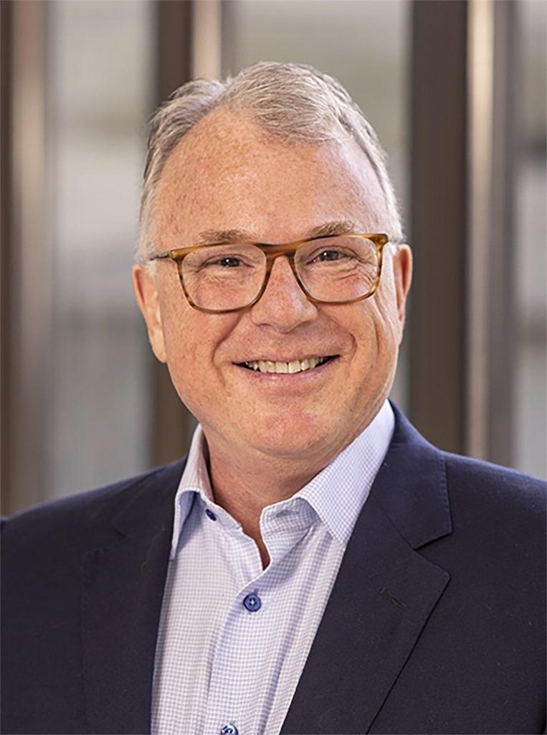
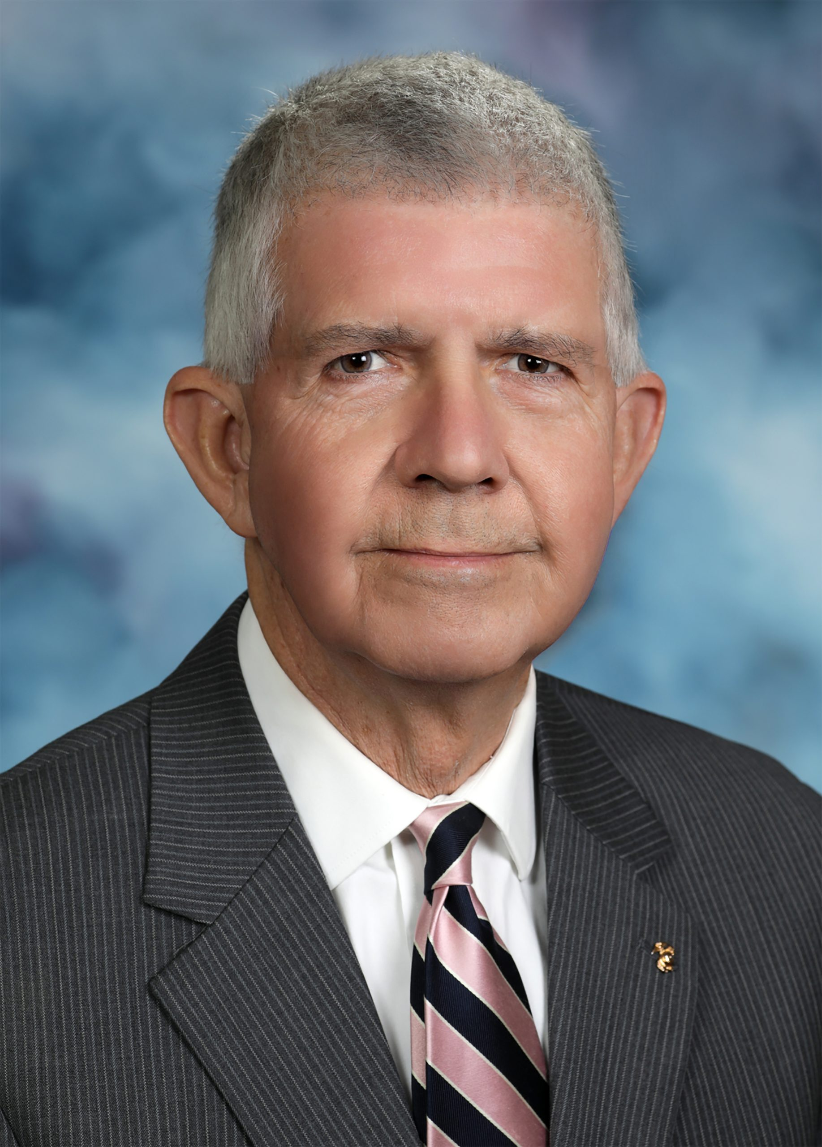

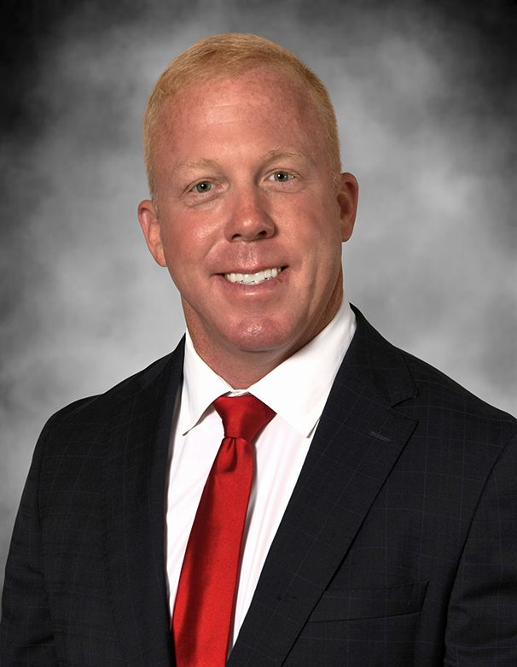
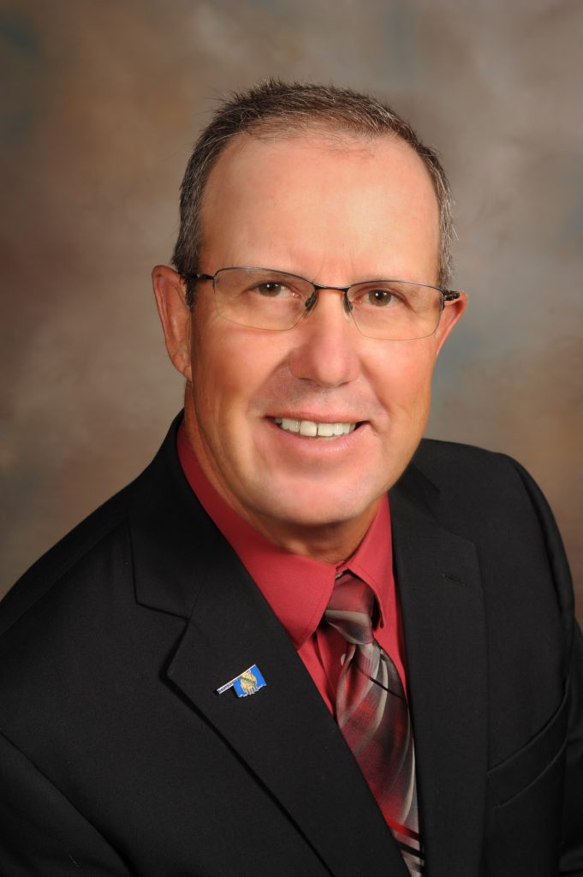
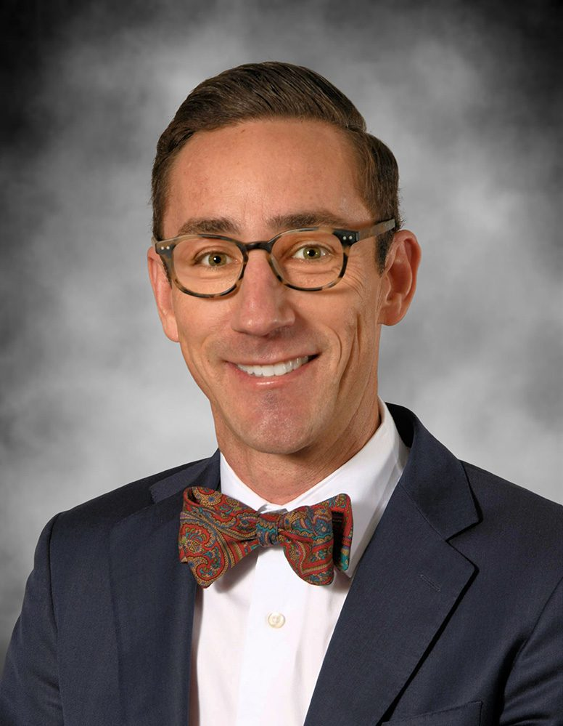
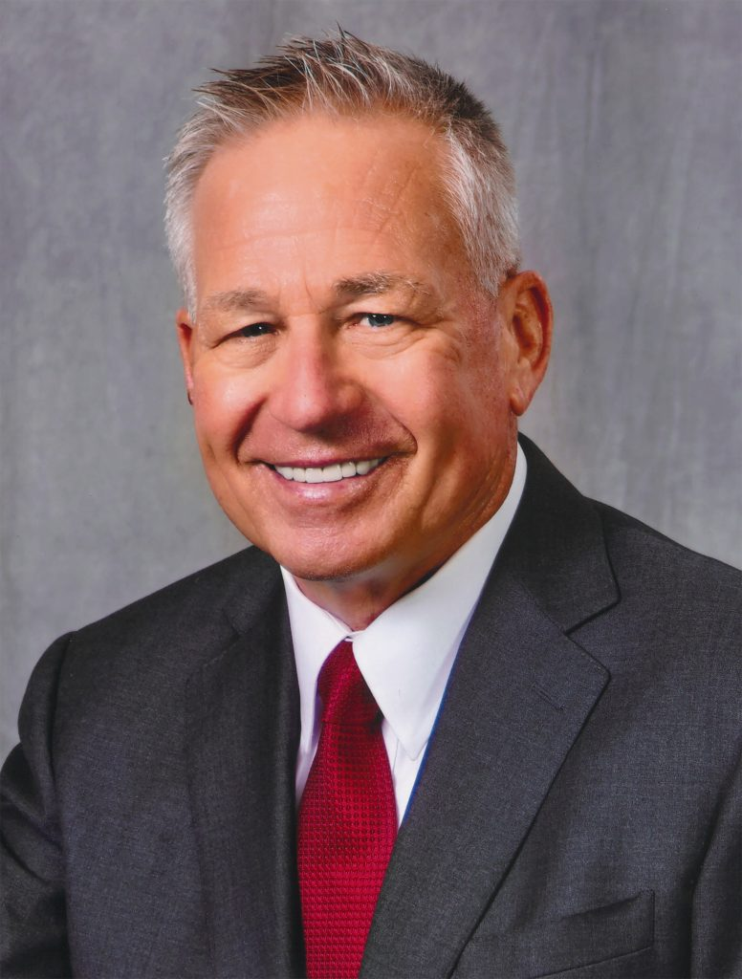

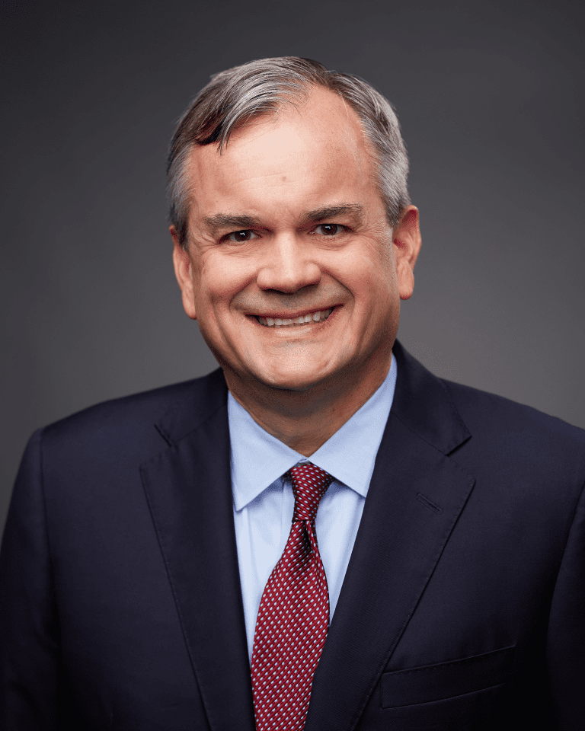
Current state regents & chancellor
Top Row (L to R): Courtney Warmington (Edmond), Chair; P. Mitchell “Mitch” Adwon (Tulsa), Vice Chair; Steven W. Taylor, Secretary (McAlester); P. Ken Levit, (Tulsa), Assistant Secretary; Brian Beller (Goldby)
Bottom Row (L to R):; Dennis Casey (Morrison); Trevor S. Pemberton, (Norman); Jack Sherry (Holdenville): Michael C. Turpen (Oklahoma City); Sean Burrage, Chancellor

Slide 7
Coordinating vs governing
  Coordinating (OSRHE)
  Determine functions of institutions
  Prescribe standards of education
  Grant degrees
  Recommend funding and allocate lump sum
  Allocate revolving funds
  Determine student fees
  Coordination, research and planning
  Governing
  Management of institution
  Personnel, salaries,
  Contract for services
  Recommend degrees
  Acquire and hold title to property
  Academic, student, and budget administration
  Purchasing
  Capital construction
  Auxiliary services

Slide 8
Advisory councils to the state regents
Oklahoma Student Advisory Council
Council on Instruction
Council on Student Affairs
Council of Presidents
Communicators Council
Innovation Council
Faculty Advisory Council
Council of Business Officers
Career Council
Council on Information Technology
Economic Development Council

Slide 9
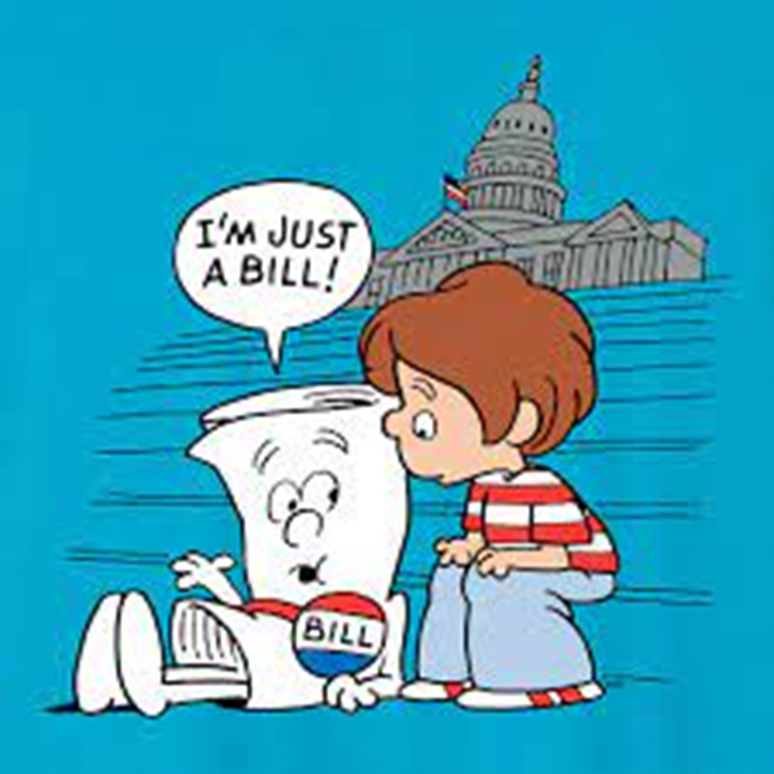
How is policy developed at osrhe
Internally
Legislatively
State Regents Staff
Council on Instruction Committees
Council on Instruction
Council of Presidents
State Regents

Slide 10
Internal Policy development examples and process example
Repeat and reprieve policy
New program proposal requirements
Undergraduate academic courseload
COI
Posting
Approval
COP
Posting
Approval
SR
Posting
Approval
September
October
November
December
January
February

Slide 11
Legislative Policy development examples
Oklahoma’s Promise O.S. § 2601 et seq.
In-state student status for uniformed service members 38 U.S.C, Section 3679(c) and 70, O.S., § 3247
Limits on credit awarded for Advanced Placement 70 O.S. § 3207.1
Instructor English Proficiency
Policy legislatively mandated does not require State Regents’ approval

Slide 12
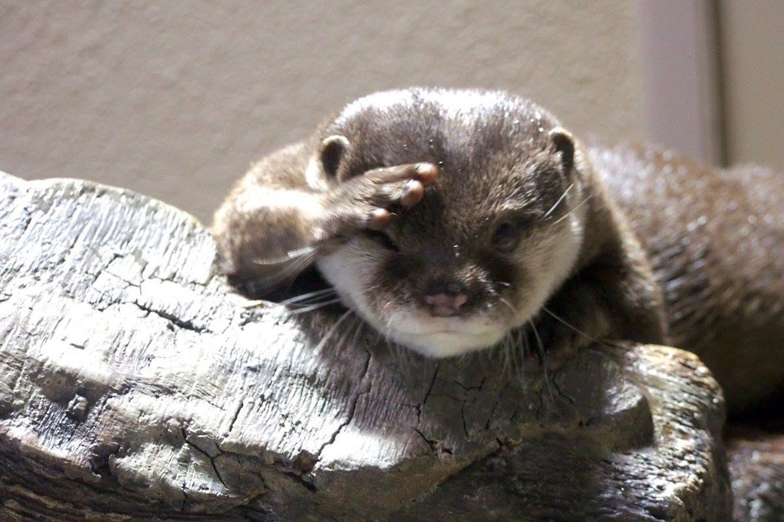
Where is chapter 3

Slide 13

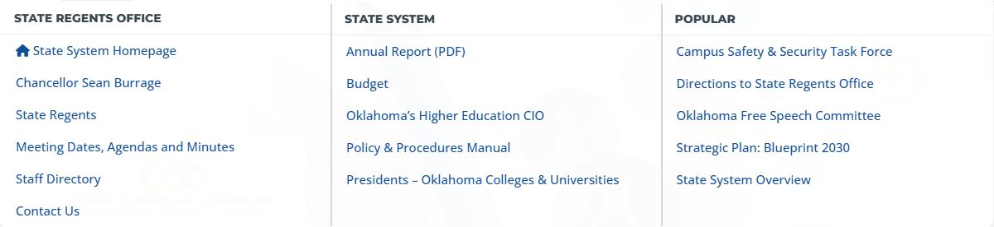
Okhighered.org

Slide 14
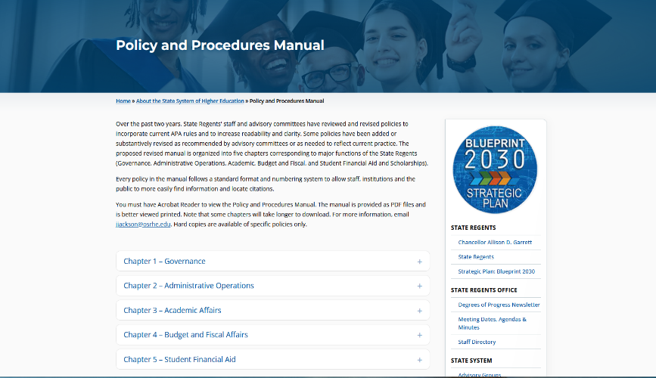
Where is chapter 3

Slide 15
osrhe policy manuals
Chapter 1 - Governance
General guidance on the function of the State Regents
Chapter 2 – Administrative Operations
Rules of operation for the State Regents
Delegation of authority to the Chancellor
Establishes State Regents committees and advisory boards
Chapter 3 – Academic Affairs
Chapter 4 – Budget and Fiscal Affairs
Chapter 5 – Student Financial Aid
Program approval process
Admission and retention criteria
Undergraduate degree requirements
Procedural guide for budgeting, allocating, accounting, and reporting
References legal responsibilities to the State Regents
Addresses policy relating to financial aid and scholarships under the oversight of the State Regents

Slide 16
SARA POLICY – INSTITUTIONAL RENEWAL

Slide 17
SARA POLICY WORKSHOP
Save the Date!
Tuesday, December 1, 2026
9:00am to 11:30 pm (preliminary)
Zoom
We won’t be able to record
Recommended to attend: anyone who has anything to do with SARA at your institution
Welcome to attend: anyone else
For all Oklahoma SARA institutions, public and private

Slide 18
SARA OKLAHOMA POLICY WORKSHOP – preliminary agenda
Preliminary Agenda
SARA
  Brief History
  NC-SARA vs SARA
  Compacts, States, Institutions
SARA Policy
  Modification Process
  PMPs Approved this Year
  Anticipated Going Forward
OSRHE SARA Policy
  Policy
  Procedures
  Annual Renewal Process
Regulatory Compliance
  The Triad
  Federal State Authorization Regulations
  Current State of Neg Reg
  Resources
Topic suggestions or questions you’d like me to address, let me know: Ms. Elizabeth Walker.

Slide 19
RENEWALS FOR THIS SUMMER/FALL
My Schedule September and October
I am out of the office the following dates (conferences and annual):
  Fri, Sep 4 through Mon Sep 21, back Tues, Sep 22
  Fri, Oct 9 through Fri Oct 30, back Mon, Nov 2
Little over 2 weeks from Sep 22 to Oct 8 – in the office 16 days during these two months
I’ll respond to emails as I’m able but won’t be able to do in-depth work like review and approve your applications.

Slide 20
PLEASE HELP!
9 SARA institutions’ renewal dates fall between now and November 7.
SO HELPFUL to me if you could submit your applications by August 10, so I have time to get them done before my trips start.
Institution | Renewal Date | Date Renewal Window Opens
Southwestern Oklahoma State University | 10/3/2026 | 7/5/2026
Carl Albert State College | 10/7/2026 | 7/9/2026
Rogers State University | 10/7/2026 | 7/9/2026
East Central University | 10/9/2026 | 7/11/2026
OSUIT | 10/9/2026 | 7/11/2026
Cameron University | 10/10/2026 | 7/12/2026
Redlands Community College | 10/21/2026 | 7/23/2026
Tulsa Community College | 10/21/2026 | 7/23/2026
Northwestern Oklahoma State University | 11/7/2026 | 8/9/2026
Thank you!

Slide 21
ANNUAL RENEWAL
Topics Covered
1. End Date & the Renewal Cycle
2. Renewal Process
3. Complete the Application
4. Submit the Application
5. Review and Approval
6. SARA Fees
7. The Grace Period
8. Non-Compliant Applications
9. Payment By Check
10. PLD Resources
11. Fed Regs – Federal Resources
12. Fed Regs – Other Resources

Slide 22
End DATE & the renewal cycle
Your annual participation end date, aka expiration date, is the anniversary of the date your first application was approved. Always.
This date remains the same from year to year, regardless of your payment date on any given year.
So if your participation end date is August 3, you can pay for your renewal on May 10 every year, and your participation end date will stay August 3, every year.
This date, the date in the reminder email NC-SARA sends you, is the date your payment has to clear, NOT the deadline to submit your application to me.
After you submit your application, I have to review it, update your contacts, approve it in Salesforce, and your payment has to clear, before your participation date.

Slide 23
Renewal process
90 days before your participation end date, NC-SARA will send an email to the SARA contacts in Salesforce notifying you that your renewal period has opened.
The email will include your participation end date and a link to where you can find the current renewal application on NC-SARA | Applications and Approval Forms.
Download and complete the renewal application.
The SARA Quick Start Guide - Institutional Applications at NC-SARA | Resources | SARA Learning Station provides detailed instructions on how to complete the new application form.
Never re-use last year’s form. Always use the form found on NC-SARA | Applications and Approval Forms.
The signatory MUST be either the president (CEO) or the chief academic officer (CAO).
If your application is not approved in Salesforce 30 days after your first reminder (the 90-day reminder), NC-SARA will send another reminder at 60 days out, a third at 30 days out, and a final one at 14 days.
This is 14 days before your participation ends. Please don’t wait until then!

Slide 24
Complete the application
SARA Application Completion Guide
  SARA Quick Start Guide - Institutional Applications
Required Documentation
Oklahoma SARA Application Supplement
  Completed and signed by either the president (CEO) or the chief academic officer (CAO).
Domiciled in Oklahoma
  Public institutions use this PDF: PDF of 70 O.S. § 3201 Institutions Comprising the Oklahoma State System of Higher Education
  Here is the link to it in Oklahoma Statues Citationized for your own reference: 70 O.S. § 3201 Institutions Comprising the Oklahoma State System of Higher Education
Accreditation Status
Most recent action letter from institution’s primary accrediting agency (or equivalent that specifies current accreditation status).

Slide 25
SUBMIT the application
Email all to me: Ms. Elizabeth Walker.
Email each document as an individual item;
  the SARA Renewal application is a PDF,
  the Oklahoma SARA Application Supplement is another PDF,
  the accreditation verification is a 3rd PDF,
  etc.
Please DO NOT submit a scanned image
  The links provided in the application MUST. BE. CLICKABLE.
  I have let this slide in the past bc we’re all friends, but I cannot do that any longer.
  If you send me a scanned image, I will have email you back to send me a PDF, not an image.
  To send me a PDF through Adobe sign is GREAT!

Slide 26
Review and approval
I review the application and required documentation.
If all in compliance, I update the Salesforce portal with changes to:
  Institutional contacts
  Branch campuses
  Institutional FTE
And approve the application.
The institution will receive an email from NC-SARA notifying you of the approval and providing a link to the invoice and an opportunity to pay online.
When your payment clears, NC-SARA will send you a notification email.
I am cc’d on all emails from NC-SARA.

Slide 27
SARA FEES
SARA bases its fees on institutional FTE as reported to IPEDS.
IPEDS number reported in the application: I have to go with the number found here: IPEDS Data Center. Please still enter a number, so the application will be complete, but be aware if your number is different from the IPEDS number, I have to use IPEDS, EVEN if it is in a higher fee bracket than the number you submit.
Current Fees:
  FTE of less than 2,500 $2,200
  FTE of 2,500 – 9,999 $4,400
  FTE of 10,000 – 29,999 $6,600
  FTE of 30,000 or more $8,800
The NC-SARA board considers fee increases every other year. Fees were last increased in 2023 and effective July 1, 2024; the next fee increase will be considered in 2027. If an increase is approved, it would be effective July 1, 2028.

Slide 28
The Grace Period
There is no grace period for the renewal process.
If your application payment is not cleared by your participation end date, you’re out.
Institutions whose participation expires must wait 180 days before re-applying.
You do get five “late” days to get the payment in. But policy says NC-SARA will charge you a late fee.
I can request an extension of a renewal period for 30 days if the end date is missed, but this requires WORK for me, SREB, NC-SARA, and you, and carries a late fee.

Slide 29
Non-Compliant applications
If some part of your application is not in compliance, I will email you with notice of the non-compliance and what you must do to fix it.
The application will not be approved in Salesforce until the issues of non-compliance are fixed and/or a corrected application or documentation are submitted.
Please understand that this process takes time, especially when I have a lot of applications to review and deadlines related to other duties, and please submit your application before your 60-day reminder.

Slide 30
payment by check
If you send a paper check, PLEASE put it in the post at least 30 days before your due date. Why?
  NC-SARA office is in Boulder, Colorado.
  NC-SARA staff are all over the country: Massachusetts, Minnesota, Kentucky, California, Florida, and those are just the ones I know of. Just a very few actually live in and around Boulder.
  They do not go into the office every day.
  If your check gets there when the office is closed, and that day is the day of your expiration, you will get an email telling you your participation is ended.
  Then you, NC-SARA staff, and I all get involved in a flurry of emails to establish that you did send a check, they aren’t in the office this week, yes, they’ll accept your efforts as good faith and not kick you out or charge you a late fee.

Slide 31


PLD Resources
Regulations
PPA Certification: 34 CFR § 668.14 (b)(32)
Public Disclosures: 34 § 668.43(a)(5)(v)
Individual Direct Disclosure: 34 CFR § 668.43(c)
Sub-regulatory Guidance
USDE Certification Procedures – Questions and Answers
  This page has guidance for GE Program Hours, Licensure Disclosure Requirements, and Transcript Withholding.
Source
All these links are from the HELP presentation and can also be found there.
Professional Licensure: Should We Still Care? Presentation at Oklahoma SARA State Meeting, June 4, 2026. You can share the link and download the presentation.
You should contact Kris Maul at HELP with questions. He is a professional consultant so some services will carry a fee, but I’m sure he’ll be as helpful as possible.
SAN Professional Licensure Webpage

Slide 32



Fed Regs – Federal resources
How to Find the Final Rules
Federal Register
Where the Department publishes everything from Intent to Establish Neg Reg Committees to the final rules. Access information specific to USDE neg reg activity through the USDE Neg Reg links provided below.
Negotiated Rulemaking for Higher Education 2025
Negotiated Rulemaking for Higher Education 2026
On either page, click the link “Federal Register Notices and Fact Sheets” and scroll down looking for links named “Final Rule - …” to go to the final rule for each Committee in the Federal Register.
As of July 20, 2026, the 2026 page had only the Intent to Establish a Neg Reg Committee for the AIM Committee; the final rule had yet to be published.
Code of Federal Regulations
The entire eCFR.
Title 34 / Subtitle B / Chapter VI / Part 600, Institutional Eligibility Under the Higher Education Act of 1965, as Amended
All the regulations regarding institutional eligibility for Title IV aid.
USDE Homeroom Blog
White House Executive Orders
USDE Newsroom

Slide 33


Fed regs – other resources
WCET Frontiers Blog
WCET experts publish posts about everything affecting distance education and state authorization and more (AI, accessibility, the Canvas attack, more!). Sign up to get notifications in your inbox.
SAN Federal Regulations and SAN Compliance Management
Both excellent resources for foundational and background information on federal regulations and managing institutional compliance. A lot of info under Compliance Management is members-only, but a lot is free and available to the public.
WCET & SAN Policy Tracker | Policy Tracker
An unbelievably useful site. May just replace everything else I’ve just given you. Covers federal statutes, regulations, and guidance, judicial actions and executive orders. Free and available to the public!
TC Regucation Blog
In addition to information blog posts about higher education law and regulations, they also announce upcoming webinars and other events here. Sign up to get notifications in your inbox.
TC YouTube Channel
Videos of all their webinar presentations.
Federal Regulatory Updates Presentation
Presentation by Aaron Lacey at Oklahoma SARA State Meeting on June 2, 2026. You can share the link and download the presentation. Please remember! Some things will have changed since June 2.

Slide 34
INNOVATION COUNCIL

Slide 35

2.30 Innovation council
OKInnovationCouncil.org
2.30.1 Purpose
  The purpose of the Innovation Council (IC) is to advance educational innovation across Oklahoma’s higher education institutions by fostering collaboration, supporting evidence-based practices, and promoting student success and institutional excellence.
Standing Committees:
  AI Impact Committee
    The AI Impact Committee serves to establish best practices for ethical and responsible use of Artificial Intelligence in academia.
  Online Learning Committee
    The Online Learning Committee serves to establish and promote shared standards and evidence-based practices for online course design, delivery, accessibility, and continuous improvement. This committee will make recommendations on quality assurance metrics and convenings.
  Open Educational Resources Committee
    The Open Educational Resources Committee (OER) serves to provide best practices in OER adoption, creation, and affordability projects that expand access and reduce costs.
  Accessibility Committee
    The Accessibility Committee will provide best practices and shared standards of course design and accessibility support.

Slide 36
TEACHER EDUCATION

Slide 37
3.21 teacher education
3.21.1 Purpose
  Improve teacher education quality
  Set admission and program standards
  Guide transfer coursework
  Define curriculum expectations
  Set faculty preparation expectations
3.21.2 Criteria for Admission
  2.75 or higher in all general education courses
  22 ACT (w/writing)
  1120 SAT (5 Reading & Writing; 4 Analysis)
  PRAXIS Core Academic Skills for Educators
  Baccalaureate Degree

Slide 38
3.21 teacher education (con’t.)
3.21.3 Degree Requirements
  Completion of the 4X12 degree requirements, the foreign language requirement, reading instruction, and assessment.
  Training and instruction on substance abuse, mental illness, classroom management and safety, technology and trauma.
  Meet one of two criteria addressing foreign language or Emergent Bilingual / English Learning in P-12 schools.
  Study the philosophy, overarching framework, components, and implementation of multi-tiered systems of support (MTSS) designed to address the core academic and non-academic needs of all students.
Other Requirements
  Oklahoma Subject Area Test (OSAT)
  Clinical Field Experience – Minimum 60 hours/12-week student teaching internship / Paid Student Teaching
  Numerous evaluations and assessments
  Teacher competencies, dispositions, state and national standards
  Foundations of Reading Test (FORT) – Strong Readers Act (70 O.S. 1210.508F)
  Assessment of Professional Knowledge (APK)

Slide 39
3.21 teacher education (con’t.)
3.21.4 Guidelines for Educator Preparation Faculty
  Teach regularly scheduled classes in a state accredited P-12 school(s) and/or perform a professionally appropriate role at a school site(s), which involves direct contact with students. A minimum of 10 clock hours per school year.
  Faculty members are expected to incorporate their varied common school classroom experiences into their teacher preparation program.
  Empowering students with teaching skills and strategies for diverse classrooms.
3.21.5 Guidelines for Participation on Induction Committees
  An induction committee may consist of a mentor teacher(s), principal / assistant principal(s), other administrator(s), or a higher education faculty member inside or outside the teacher education unit.
  Teacher education faculty members participating on induction committees are expected to have expertise and experience in the teaching field of the teacher inductee

Slide 40
3.22 Oklahoma teacher connection
Recruitment, retention and placement of teachers in the public schools of the State of Oklahoma.
Funding of state sponsored grants for campus-based recruitment, retention, and placement programs.
  OTC Collegiate Grant Program
Establishment and development of recruiting programs for potential teachers – including pre-collegiate curricular courses.
  Teach Oklahoma
  Lead Oklahoma
  Educators Rising

Slide 41
CONTRACTUAL ARRANGEMENTS BETWEEN HIGHER EDUCATION INSTITUTIONS AND OTHER ENTITIES
UNDERGRADUATE TRANSFER AND ARTICULATION
COURSE EQUIVALENCY PROJECT
CREDIT FOR PRIOR LEARNING

Slide 42
3.6 Cooperative agreements
3.6.1 Purpose
  Ensures compliance with State Regents’ standards when awarding academic credit through cooperative agreements between higher education institutions and external entities.
3.6.2.A-E Requirements of a Cooperative Agreement
  Executed by the institutional president/designee and entity counterpart
  Defines responsibilities of each party
  Courses must align with institution’s mission
  Courses must be clearly identified on transcripts
  Agreements should be sent to OSHRE Staff for record keeping
3.6.3.A-C Approved Methods
  Contractual Arrangements
  Articulation Agreements
  Statewide Agreements

Slide 43
3.11 Undergraduate transfer and articulation or courses
3.11.1 Purpose
  Supports seamless student transfers among career tech centers, community colleges, and universities to maximize credit transfer and improve degree completion.
3.11.2A-G Transfer of Courses Within the State System from Degree-granting Institutions
  Gen Ed courses transfer when content is reasonably equivalent
  Accreditation requirements may require additional Gen Ed coursework
  Institutions should advise students on prerequisite coursework
  AA/AS degrees satisfy lower-division Gen Ed requirements
  Introductory courses apply to degree requirements and CEP transfer
  Community Colleges may offer approved lower division courses from 4-year institutions
  Receiving institutions determine transferability of non-transfer degrees and certificates

Slide 44
3.11 Undergraduate transfer and articulation or courses (con’t)
3.11.2H-L Transfer of Courses Within the State System from Degree-granting Institutions
  Associate degree requirements must be published and maintained, including prerequisites and admission criteria, while honoring catalog-year requirements for continuously enrolled students
  Baccalaureate degree requirements must be published and maintained, including lower-division prerequisites, while honoring catalog-year requirements for continuously enrolled students
  Transfer guides must be published and maintained, including archived copies, course equivalency evaluation procedures, appeals processes, and a link to the statewide course equivalency matrix
  Prior learning credit transfers on the same basis as credit earned through regular coursework at the awarding institution
  Course Equivalency Project Matrix establishes statewide course equivalencies recognized by participating institutions

Slide 45
3.11 Undergraduate transfer and articulation or courses (con’t)
3.11.3 Transfer of Courses from Non-State System, Degree-granting Institutions
  HLC-Accredited institutions may transfer credits if students meet admission, good standing and academic progress requirements
  Other USDE-recognized accredited institutions may transfer credit through institutional review and course-by-course evaluation
  Non-USDE-recognized institutions may transfer credits when validated by receiving institution and supported by successful academic performance
  Non-native English speakers must meet applicable transfer admission and English language proficiency requirements
3.11.4 Credit from Oklahoma Technology centers may transfer through a Cooperative Agreement

Slide 46
3.16 Credit for prior learning
3.16.1 Purpose
  Credit for prior learning establishes standard for awarding credit earned through life experience and non-credit learning outside higher education institutions.
3.16.2.A-D CPL Standards
  Student must be enrolled for eligible to re-enroll to receive credit for prior learning
  Prior learning credit must be validated through successful completion od coursework before being transcripted.
  Prior learning must be evaluated using approved assessments, examinations, portfolios, military, training, and other recognized methods.
  ACT and SAT scores cannot be used to award prior learning credit.

Slide 47
3.16 Credit for prior learning (Con’t)
3.16.2.E-K CPL Standards
  Prior learning credit may be applied toward degree program requirements.
  Prior learning credit must comply with HLC standards and ACE recommendations.
  Assessment scores must meet established standard before prior learning credit is awarded.
  Prior learning evaluations must be objective and consistently applied.
  Prior learning credit may only be awarded in State Regents-approved programs.
  Prior learning credit must be clearly identified on transcripts and evaluation fees are limited to actual costs.
  Prior learning credit transfers on the same basis as traditionally earned college credit.

Slide 48
3.16 Credit for prior learning (Con’t)
3.16.3 Credit for Military Service
  Internal approval processes are required for awarding military credit.
  Designated staff must manage military credit submissions
  Military credit articulations must be reviewed periodically
3.16.4 Oversight and Evaluation
  Advanced placed credit requires institutions to award credit for AP exam scores of 3 of higher and regularly review and publish AP credit policies
  CLEP Credit Standards use ACE recommended minimum scores unless a higher score is justified for success in advanced coursework
  CLEP Policy Transparency requires institutions to post CLEP credit policies on their websites
  Prior learning reporting requires institutions to report all credit for prior learning through the unitized data system

Slide 49
Break for lunch
WE WILL RETURN AT 12:30 PM

Slide 50
CONCURRENT ENROLLMENT
STUDENT ASSESSMENT \

Slide 51
3.10 Concurrent enrollment
3.10.1 Purpose
  Allows eligible high school juniors and seniors to earn college credit, supporting the State System’s goals to expand access, improve student outcomes, and increase educational efficiency.
  This policy outlines:
    Eligibility, admission, placement, and retention criteria
    Standards for course delivery and learning environments
    Annual reporting requirements for instructions

Slide 52
3.10 Concurrent enrollment
3.10.2 Guiding Principles
  Provides meaningful college course experiences​
  Supports college and career goal development​
  Improves access and success in college​
  May reduce cost and time to degree​
  Strengthens alignment between K 12 and higher education
3.10.3 Dual Credit
  Pursuant to 70 O.S. §628.13, when a student earns college credit through concurrent enrollment, school districts shall provide academic credit for any concurrently enrolled higher education courses that are correlated with the academic credit awarded by the institution of higher education. Academic credit shall only be transcripted as elective credit if there is no correlation between the concurrent enrollment higher education course and a course provided by the school district.

Slide 53
3.10 Concurrent enrollment
3.10.4 Program and Curriculum Standards
  Institutional Standards
    Designate staff responsible for coordinating concurrent enrollment​
    Offer cataloged courses approved through the regular course approval process​
    Use the same course prefix and number as the equivalent on campus course​
    Maintain timely communication with partner high schools
  Course Quality Standards
    Courses must match equivalent on campus courses in content, requirements, assignments, grading criteria, design, quality, rigor, and evaluation​
    Regular, full-time faculty must approve syllabus, textbooks, teaching methods, and student assessments​
    Early alert systems are encouraged to support students who struggle academically​
    OER and no cost material options are encouraged

Slide 54
3.10 Concurrent enrollment
3.10.5 Student Eligibility and Support
  Who may be admitted
    High school juniors and seniors may be admitted provisionally.
    Students from accredited high schools are eligible with minimum GPA or satisfactory standardized test score
    Home schooled and unaccredited high school students must meet equivalent coursework and test standards.
  Eligibility Options
    Qualify by Minimum Test Scores
      Community College: ACT 19 | SAT 990
      Regional Universities: ACT 20 | SAT 1030
      Research Universities: ACT 24 | SAT 1160
    Qualify by GPA
      Students may qualify with an overall minimum GPA of 3.0 on a 4.0 scale.

Slide 55
3.10 Concurrent enrollment
3.10.5 Student Eligibility and Support (cont.)
  Agreement Requirement
    All students must provide a signed Concurrent Enrollment Agreement. The agreement includes classification, semester, high school course load, and acknowledgement or financial responsibility.
  Course Placement and Support
    Concurrent students may not enroll in co requisite courses or supplemental instruction​
    Students may enroll in college-level courses as determined by the institution’s assessment plan.
    Access to student services and academic support comparable to campus students
  Workload and Continuation
    Combined workload may not exceed 19 credit hours in a regular term; 9 credit hours in summer.​
    One half high school unit equals three college credit hours for workload calculation​
    Continuation requires high school approval and meeting retention standards​
    Concurrent students follow the higher education institution academic calendar

Slide 56
3.10 Concurrent enrollment
3.10.6 Policy Exceptions
  Exception Authority
    Policy exception requests apply to students who do not meet standard admission criteria​
    Requests must be approved by the Chancellor​
    The policy allows the president or designee role in exception requests
  Grade-Level Eligibility
    Juniors and seniors may be considered with supporting documentation and rationale for success​
    Freshmen and sophomores may be considered if they meet or exceed the standards established for juniors and seniors​
    All exception requests must be supported by documentation

Slide 57
3.10 Concurrent enrollment
3.10.7 Faculty or Instructor Qualifications and Support
  Instructor Qualifications
    All instructors shall meet Higher Learning Commission qualification expectations​
    Qualifications may include academic credentials, progress toward credentials, equivalent experience, or a combination​
    High school faculty may be used as graduate assistants or teaching assistants if allowed by institutional hiring practices and HLC Assumed Practices
  Instructor Support and Evaluation
    All concurrent instructors, including GAs and TAs, must participate in orientation and training​
    Institutions shall provide professional development opportunities​
    Concurrent enrollment faculty shall be evaluated regularly under institutional policies and procedures
3.10.8 Transferability of Credit
  Institutions must ensure students and parents/guardians understand how the course applies toward degree requirements and the transferability of any earned credit.

Slide 58
3.10 Concurrent enrollment
3.10.9 Memorandum of Understanding
  Institutions must execute an MOU with a high school when offering concurrent enrollment coursework to a defined group or cohort of students.
  MOUs are not required for individually enrolled students or online courses.
3.10.10 Off-Campus Geographic Service Areas
  Institutions have first priority for concurrent enrollment services within approved service areas​
  Shared geographic service area provisions determine tuition waiver reimbursement expectations​
  A school district may invite a preferred institution, with funding responsibilities addressed by policy​
  Geographic service areas do not apply to online courses

Slide 59
3.10 Concurrent enrollment
3.10.11 Early College Programs
  Program Purpose
    Designed to serve traditionally underserved students and students who may not already aspire to continue their education.
    Must lead to a meaningful academic credential earned alongside a high school diploma.
  Program Requirements
    Must include student support services and readiness tools to promote student success.
    Students may not be charged tuition to participate.
  Approval & Oversight
    Requires State Regents authorization and a signed MOU.
    Approval is required for new programs, substantial program changes, and renewals.

Slide 60
3.10 Concurrent enrollment
3.10.12 Accountability, Compliance, and Data Reporting
  Institutions offering concurrent enrollment must adhere to NACEP standards.
  Institutions with approved Early College High School (ECHS) programs must provide program information and outcomes to the State Regents as required.
  Concurrent enrollment data is collected and reported annually through the Unitized Data System (UDS).
  Institutions offering off-campus concurrent enrollment must annually submit:
    Signed MOUs
    Faculty qualifications and course assignment information

Slide 61
3.20 Student assessment
3.20.1 Purpose
  Ensures student learning is assessed, and programs are continuously improved to support all students, including those needing additional support in English, mathematics, reading, and science.
  Provides guidance for supporting underprepared students within the State System.
3.20.2 Standards
  A. Improvement of Teaching and Learning
    Institutions must assess student learning using criteria aligned with institutional mission and academic programs.
    Assessment must align with HLC accreditation requirements and State Regents' Academic Program Review policy.
  B. Accountability and Institutional Effectiveness
    Assessments should be compared to external benchmarks when possible.
    Assessment data must be included in Academic Program Reviews.
    Assessments should support the improvement of teaching and learning.
    Institutions should evaluate the validity and reliability of assessment measures.
    Assessment should consider institutional characteristics and the needs of special populations.

Slide 62
3.20 Student assessment
3.20.2 Standards (cont.)
  C. Supplemental and Co-Requisite Instruction
    Students assessed as underprepared in foundational disciplines must receive appropriate academic support, such as co-requisite instruction, supplemental instruction, or comparable interventions.
      Placement criteria for support courses must be outlined in the institution's assessment plan.
    Students who demonstrate competency may have curricular deficiencies waived.
    Institutions may offer single-tier, 0-level remediation courses for designated populations, such as English language learners or adult students who voluntarily enroll.

Slide 63
3.20 Student assessment
3.20.2 Standards (cont.)
  D. Course Placement Evaluation
    Past academic performance should inform placement and advising.
    Assessment results should be used for placement and advisement.
    Institutions should evaluate the effectiveness of their assessment programs.
    Assessment data should support instructional improvement and student achievement.
  E. General Education Assessment
    General education assessment must be used to improve the institution's general education program.
    Assessment should measure student learning in areas such as:
      Communication
      Critical Thinking
      Mathematics
      Reading
      Writing

Slide 64
3.20 Student assessment
3.20.2 Standards (cont.)
  F. Student Engagement and Satisfaction
    Institutions may assess student perceptions of academic and campus programs and services.
    Assessment results should be used to improve the quality of programs and services.
  G. Planning and Reporting
    Institutions must maintain a current assessment plan.
    Assessment plans must include the assessments required by policy.
    Assessment plans must be posted on the institution's website.

Slide 65
Academic Program Approval
Intensive English Program
Academic Program Review
Changes in Academic Structure and Nomenclature
Academic Calendars

Slide 66
3.4 Academic Program approval
Purpose
  Recognizes the primary role of institutional faculty, administrators, and governing boards in initiating and recommending needed changes in educational programs.
State Regents Responsibility
  Evaluate statewide need and system impact.
  Ensure consistency across the State System.

Slide 67
3.4 Academic Program approval
Levels of Academic Programs
  Level I
    Degree Level
    Associate, Bachelor, Master, Doctorate
  Level II
    Degree Designation
    AA, AS, BA, BS, M.Ed., Ph.D., etc.
  Level III
    Degree Program/Major
    English, Biology, Cybersecurity, etc
  Level IV
    Options or emphases
    Finance, Management, Literature

Slide 68
3.4 Academic Program approval
Approval Required
  New Program Proposals
  Program Deletions
  Certificate Deletions
  Total Credit Hour Changes (for overall program)
Notification Only
  New Certificate Additions
  Program Suspensions
  Program Reinstatements
  Option Additions/Deletions
  Electronic Delivery Requests
  Program/Option Name Changes
  Degree Designation Changes
  Location Changes
  CIP Code Changes
  Program Requirement Changes (excluding total credit hour changes)
    Course Additions/Deletions

Slide 69
3.4 Academic Program approval
New Program Proposals (NPP)
  Minors, Micro-credentials, and Certificates not included
  2 to 3 month approval process
Proposal Steps
  Letter of Intent (LOI) Submission
  NPP Submission
  State Regents Agenda

Slide 70
3.4 Academic Program approval
LOI and NPP Timeline
  LOI submitted by institution
  LOI sent to Presidents and CAOs
    7 days to ask questions and raise concerns (no protesting)
  If no LOI concerns are received, automated email with NPP link is sent
  NPP submitted by institution
  NPP sent to Presidents and CAOs
    21 days to protest
    Protest Reasons
      Unnecessary Duplication
      Workforce Demand
      Student Needs in the State
  If no NPP protests are received, agenda item is prepared for State Regents meeting

Slide 71
3.4 Academic Program approval
Deletions
  Governing board approval needed
  Importance of student headcount
  Teach out plan
  Funds for reallocation

Slide 72
3.4 Academic Program approval
Certificates
  Notification only = auto approved
  Importance of IPEDS information
    “ALL” designation = website recognition
  Review and Assessment
    Embedded → mirrors host program review schedule
    Stand alone → 5-year program review cycle (no post audit review)

Slide 73
3.5 Intensive English program
Purpose
  Non-native speakers of English must present evidence of proficiency in the English language prior to admission. Students who score below the regular admission requirements to be admitted following the successful completion of a minimum of 12 weeks of instruction at the advanced level.
IEP programs must be accredited by the CEA or the ACCET.
Institutions must provide timely communication in regards to all changes to accreditation status.

Slide 74
3.7 Academic program review
Purpose
  Systemic review of academic programs and determination of extent to which these programs are achieving intended outcomes.
Types of Reviews
  Post Audit
  5-Year Academic Program Review
  Low Productivity Programs

Slide 75
3.7 Academic program review
Post Audit Reviews
  Only for programs under provisional approval
  Required even if a specialty accreditation has been completed
  Criteria to be met:
    Productivity numbers from NPP that were approved by the State Regents
  List of programs to be reviewed sent in spring.
  Post Audit Reports due in September
  Numbers reported are for specific fall and specific academic year that is provided in the approval follow up letter.

Slide 76
3.7 Academic program review
Post Audit Requirements Met
  Both enrollment and graduation criteria are met
  Program receives final approval
  Program moves to 5-year program review cycle
  Productivity requirements moving forward reflect policy minimums

Slide 77
3.7 Academic program review
Post Audit Requirements Not Met
  Only one or neither criteria not met
  Institutions can request:
    Deletion of program
      Requires Governing Board and State Regents’ approval
      Must submit Deletion Request Form
    Suspension of program
      Requires Governing Board approval and State Regents’ notification
      Must fill out Program Modification Form
    Extension of the post audit review period
      3-year maximum extension
      Detailed summary on future plans for the program

Slide 78
3.7 Academic program review
Academic Program Reviews
  Oklahoma State Statute 70 O.S. § 3253 requires all active programs with final approval to complete a program review every 5 years.
  Embedded certificates will be reviewed along with the main program
  Stand alone certificates will be reviewed independently
  Programs in post audit are not required to have a 5-year program review
  External accreditations can no longer be used in lieu of a 5-year program review
  Institutions must complete the OSRHE Program Review Form
  Program reviews are due by November 1st each year

Slide 79
3.7 Academic program review
Academic Program Review Criteria
  Updated Program Review Form is coming!
  Review Criteria:
    Program Objectives and Goals
    Quality Indicators
      Faculty credentials
      Achievement of graduates
      Programmatic accreditation or industry standards
      Student achievement
      Academic Resources
    Minimum Productivity Indicators
    Quantitative Measures

Slide 80
3.7 Academic program review
Low Productivity Programs
  Oklahoma State Statute 70 O.S. § 3253 has changed the LoPro process
  Programs that do not meet minimum productivity criteria
  Programs excluded from LoPro reporting:
    Programs in Post-Audit
    Suspended programs
  LoPro lists sent to CAOs in Spring
  LoPro reports are due in September each year

Slide 81
3.7 Academic program review
5-Year Average
Degrees Conferred
  AA/AS = 5
  AAS = 5
  Bachelor’s = 5
  Master’s = 3
  Doctorate = 2
Majors Enrolled
  AA/AS = 25
  AAS = 17
  Bachelor’s = 12
  Master’s = 6
  Doctorate = 4

Slide 82
3.7 Academic program review
Low Productivity Reports
  Institutions request approval for a plan of action
    Delete
    Suspend
    Request exception for continuation
  Continuation conditions:
    No Cost
    Shared Cost
    Restructure Program
    Collaborative Program
    Grow the Program

Slide 83
3.7 Academic program review
Low Productivity Reports Continued
  OSRHE staff will review reports and submit recommendations to State Regents for action of denial or approval.
  If approved, program goes on probationary status for 3 years.
  Plan of Improvement now required
  After 3 years, failure to meet or demonstrate progress…
    What happens?
  After 3 years, progress demonstrated but minimums not met…
    What happens?
  No more than 2 exemptions allowed in a consecutive 10-year period

Slide 84
3.8 changes in academic structure and nomenclature
Purpose
  Notification of changes made to academic structure and nomenclature at State System institutions.
Notification Only
Changes Include
  Creation of new institutional unit where none existed (department, school, college, etc.)
  Division of a single department or instructional unit into two or more parts
  Upgrading an instructional unit to a higher level or status (department to school)
  Change in name of instructional unit (maintain status level)
  Move of instructional unit from one college/school to another

Slide 85
3.19 Academic calendars
Purpose
  Uniform academic calendar for the State System.
Dates
  Due December 1st every year
  Updated and available online by January
Reminders
  Only submit Fall, Spring, and Summer course schedules.
    Disregard short/intersession courses
  Review dates carefully!
  Notify OSRHE of any updates as soon as possible

Slide 86
3.19 Academic calendars
Spring Break
  House Bill No. 2727, Section 22, expressed legislative intent that public schools, area vocational technical schools and higher education institutions coordinate spring break dates.
The week that includes the 3rd Wednesday of March each year
  Through 2031, these dates are:
    2027 March 15-19
    2028 March 14-18
    2029 March 12-16
    2030 March 11-15
    2031 March 17-21

Slide 87
Institutional Accreditation and State Authorization
Functions of Public Institutions
Function of Research in the State System
Institutional Admission and Retention
Grading
Undergraduate Academic Course Load

Slide 88
3.1 institutional accreditation and state authorization
Grounded in Oklahoma statute and sets minimum requirements for institutions operating in Oklahoma
  All private and out-of-state public degree-granting institutions shall be accredited by a USDE recognized accreditor
OSRHE responsibilities
  Establish and collect authorization fees
  Require payment to the Tuition Recovery Fund
  Deny, not renew, or revoke authorization when in violation of Oklahoma statute or OSRHE standards
Exemptions
  Private institutions participating in OTEG
  Institutions operating only within approved reciprocity agreements
  Certain religious degrees operating solely for religious purposes within a religious organization

Slide 89
3.1 institutional accreditation and state authorization
State-system institutions must:
  Maintain accreditation with the Higher Learning Commission
  Provide OSRHE with copies of assurance arguments/reviews, and final evaluation reports
  Notify OSRHE of any impending action (i.e. sanction, notice, show cause)
  Provide closure plans, teach-out plans, and student records disposition plans
Private and out-of-state public institutions:
  Must be approved annually
  Must be accredited by USDE-recognized agency and legally authorized to offer degree-related instruction in home state, or applicable federal/tribal entity

Slide 90
3.1 institutional accreditation and state authorization
Activities requiring authorization
Offering degree programs or degree-related instruction in any modality
Operating instructional or non-instructional locations
Awarding degrees to recipients in Oklahoma
Offering dual/concurrent enrollment courses for college credit
Activities not requiring authorization
Overnight field trips
Sports games or events
Social gatherings of students or alumni
Students participating in professional conferences, organizations, or similar events
Participation in college fairs
Placement of students into supervised field experiences (including but not limited to: student teaching or practia, clinical rotations, internships, externships)

Slide 91
3.1 institutional accreditation and state authorization
Standard for operation
  Comply with applicable laws and designate an Oklahoma location director.
  Maintain disaster recovery and student records disposition plans.
  Accurately disclose accreditation; avoid misleading marketing and unauthorized OSRHE endorsement claims.
  Provide complaint procedures, appeal processes, catalog/equivalent information, and enrollment agreements before payment
Revocation of authorization
  Accreditor recognition is withdrawn, accreditation is withdrawn, or sanction/show cause/provisional/teach-out actions occur.
  Home state, tribal, or federal operating authority is lost or at risk of denial/withdrawal.
  Institution fails to disclose required information, comply with OSRHE policy, or maintain Title IV eligibility.

Slide 92
3.1 institutional accreditation and state authorization
Reporting
  Substantive changes
  Leadership changes
  Required degree-related supervised field experiences for Oklahoma students.
Marketing restrictions
  No misleading, deceptive, or inaccurate statements.
  No help-wanted classified ads for marketing.
  Salary references require recent graduate wage data or an appropriate external source.
  No guaranteed-employment claims during or after training.
Student complaints
  Institutions must provide written complaint procedures independent of Title IX and student-conduct complaint procedures.
  Students must have an appeal procedure, and information about filing complaints with the State Regents is available on the State Regents website. (SARA Complaints) (Oklahoma Student Complaints)

Slide 93
3.2 functions of public institutions
OSRHE has constitutional authority to determine functions and courses of study
3.2 outlines the functions of the State System
Common functions
  Economic and community development
  Provide general education
  Offer concurrent enrollment
  Award micro-credentials, certificates, and degrees
  Research

Slide 94
3.2 functions of public institutions
3 Tiers
  Research Universities
    OU, OSU
  4-Year/Regional Universities
    CU, ECU, LU*, NSU, NWOSU, OPSU, RSU, SEOSU, SWOSU, UCO, USAO*
  Community Colleges
    CASC, CSC, EOSC, MSC, NEOAMC, NOC, OCCC, RCC, RSC, SSC
Constituent Agencies
  OU
    OUHC, OU-Law, OU Geological Survey, OU-Tulsa
  OSU
    OSUCVM, OSUCOM, OSU Agricultural Experiment Station, OSU Agricultural Extension Division, OSUCHS, OSU- OKC, OSUIT
    *Has statewide function

Slide 95
3.2 functions of public institutions
Branch Campuses
  CASC – Sallisaw
  CSC – Muskogee
  CU – Duncan
  EOSC – McAlester
  LU – Tulsa
  MSC – Ardmore
  NOC – Enid
  NSU – Broken Arrow
  NWOSU – Enid
  NWOSU – Woodward
  OSU – Tulsa
  RSU – Bartlesville
  RSU – Pryor
  SEOSU – McCurtain County
  SWOSU – Sayre
  OU – College of Medicine-Tulsa

Slide 96
3.2 functions of public institutions
Institutions must offer degree programs within their function
  Research Universities
    Lower/Upper division leading to bachelor’s degree
    Graduate course work leading to master’s, doctorate, or first professional
  4-Year/Regional Universities
    Lower/Upper division leading to bachelor’s degree
    Graduate course work leading to master’s
    Course work leading to first professional or doctorate when appropriate
  Community Colleges
    Lower division leading to associate degree

Slide 97
3.2 functions of public institutions
Function Exceptions
  Considered for unique and specific purposes
  Allowed ONE function exception
Change of Function
  Statute 70 O.S. § 3208 – requires approval or order of the State Regents

Slide 98
3.3 function of research in the state system
Provides guidance State System institutions on function of research
  Research must be appropriate to institutional mission and function
State Regents
  Related to the coordination and planning of goals, functions, and objectives for State System
Provides policy and procedures for external grants
  Federal funds follow Uniform Guidance / 2 CFR 200

Slide 99
3.9 institutional admission and retention
Purpose
  Outlines high school requirements for college admissions
    Performance requirements
    Curricular requirements
  Provides guidance on:
    International student admission
    Admission of transfer students
    Retention standards
  State Regents’ policy are considered minimum

Slide 100
3.9 institutional admission and retention
Outlines high school requirements for college admissions
  4 English
  3 Lab Science
  3 Math 3 History and Citizenship Skills
  2 Additional units
Students with curricular deficiencies must be admitted using alternative admission category
  Students must satisfy deficiencies within 24 college credit hours attempted
  Standardized tests are not required by State Regents’ policy for admission

Slide 101
3.9 institutional admission and retention
Special Admission Categories
  Non-degree seeking students
  Alternative admission
  Adult admission
  Home-study or non-recognized accredited or unaccredited high schools
  Opportunity admission
  Bridge program

Slide 102
3.9 institutional admission and retention
Retention Standards
  Students must maintain a 2.0 overall GPA
    Freshman with fewer than 30 hours with 1.7 - 2.0 – placed on Academic Notice
    Remain on Academic Notice until overall GPA is 2.0 or has earned more than 29 credit hours
    Students with more than 29 credit hours – place on Academic Probation
      Continue enrollment while on Academic Probation if semester GPA is 2.0 or higher
      Suspended in semester GPA is below 2.9
    Concurrent enrollment students must maintain a 2.0 to continue participation
    Seniors may continue in up to 15 credit hours to attempt to raise GPA
    Institutions may establish academic suspension appeals
    Suspended students may not enroll at for one regular semester
    Second suspension students cannot return to suspending institution until GPA is 2.0

Slide 103
3.12 grading
Establishes uniform grading system for all State System institutions
  Letter grades: A, B,C, etc.
  Other symbols: I, W, S-U/P-NP, etc.
Provides guidance on academic forgiveness provisions
  Repeated courses
  Academic reprieve
  Academic renewal

Slide 104
3.12 grading
Repeated Courses
  Students may repeat any course up to 4 attempts (including initial attempt)
  Only highest grade used in GPA calculation
  Attempts after the first 4 will be used in calculation
Academic Reprieve
  Disregard up to 2 consecutive semesters
  Must have 2.0 with no grade lower than C in subsequent semesters – minimum 12 credit hours
  Courses with passing grade may be used to demonstrate competency – but cannot be used for credit hours

Slide 105
3.12 grading
Academic Renewal
  Provides student with a fresh start
  3 years must have elapsed between semester being renewed and the request
  Must have 2.0 or higher GPA and no grade lower than a C is subsequent semesters – minimum 12 credit hours
  Request is for ALL courses before the date indicated in the request
  Courses cannot be used to demonstrate competency or for credit hours

Slide 106
3.13 undergraduate academic courseload
Outlines policy for maximum workload for students
  Limited to the number of semester credit hours that is 50 percent greater than that total number of weeks in the academic term (i.e. 16 weeks = no more than 24 credit hours)
  Institutions can limit student academic course load based on program or performance

Slide 107
Break for lunch
WE WILL RETURN AT 2:15 PM

Slide 108
Granting of Degrees
Undergraduate Degree Requirements
Distance Education AND Traditional Off-Campus Courses AND Programs
In-State/Out-of-State Status of Enrolled Students
Instructors’ English Proficiency
Professional Programs

Slide 109
3.14 granting of degrees and other awards
Outlines OSRHE’s authorization to confer degrees and guidance on diploma format
Provides policy on reporting of degrees
Includes guidance on degree revocation
  Requires institutions to have established procedures
Authorizes institutions to grant honorary and posthumous degrees with limitations
Requires sample diploma to be submitted to State Regents by December 1

Slide 110
3.15 undergraduate degree requirements
Establishes guidelines, criteria, and standards for associate and baccalaureate degree programs
Prescribes minimum general education, upper-division, and course residency requirements
Types of associate degrees
  Associate in Arts, Associate in Science, Associate in Applied Science
Types of baccalaureate degrees
  Bachelor of Arts, Bachelor of Science, Bachelor of (Specialty)
  Sub-120 Bachelor’s Degree

Slide 111
3.15 undergraduate degree requirements
General Education
  Associate in Arts/Science
    6 hours English Composition
    6 hours U.S. History and U.S. Government
    6 hours Science (must include one lab science)
    6 hours Humanities (non-performance)
    3 hours Mathematics
    3 hours Guided Elective
    Additional liberal arts and sciences courses to total 37 credit hours
  Associate in Applied Science
    6 hours English Composition
    6 hours U.S. History and U.S. Government
    6 hours Guided Elective

Slide 112
3.15 undergraduate degree requirements
General Education
  Bachelor Degrees
    6 hours English Composition
    6 hours U.S. History and U.S. Government
    6 hours Science (must include one lab science)
    6 hours Humanities (non-performance)
    3 hours Mathematics
    3 hours Guided Elective
    Additional liberal arts and sciences courses to total 40 credit hours
  Sub-120 Bachelor’s Degree
    6 hours English Composition
    6 hours U.S. History and U.S. Government
    6 hours Science (must include one lab science)
    6 hours Humanities (non-performance)
    3 hours Mathematics
    3 hours Guided Elective

Slide 113
3.15 undergraduate degree requirements
Minimum Standards for Baccalaureate Degrees
 | Number of Hours Required
 | BA | BS | Specialty | Sub-120
Total semester credit hours required | 120 | 120 | 120 | 90
General education | 40 | 40 | 40 | 30
Liberal arts and sciences course work | 80 | 55 | 40 | 30
Credit in residence at the awarding institution (15 of the final 30 hours or 50 percent of the major also required in residence) | 30 | 30 | 30 | 22
Credit from a baccalaureate degree-granting institution (40 hours must be upper-division) | 60 | 60 | 60 | 45
Area of specialization (50 percent must be upper-division) | 30 | 30 | 30 | 40

Slide 114
3.15 distance education and traditional off-campus courses and programs
Establishes standards for offering distance education courses to ensure quality and rigor and for the operation of designated learning sights.
Online and blended courses must be intentionally designed, supported, assessed and improved – not simply moved online
Program Design
Teaching Support
Learner Support
Learner Success
Course Standards
Accessibility
Technology expectations
Other expectations
Faculty training
Copyright/fair use policy
Use learner feedback
Library resources
Academic services
Technical support
Regular and substantive interaction

Slide 115
3.15 distance education and traditional off-campus courses and programs
Institutions are responsible for following authorization and compliance requirements where activity or students are located.
Institutions adding online modality to existing program must report this to the State Regents
Geographic service areas
  Each institution has first priority for offering programs/courses within their service area consistent with its mission

Slide 116
3.18 in-state/out-of-state status of enrolled students
Provides guidance on student residency status
  Burden of proof to establish residency lies with student
  Ultimate responsibility for residency determination rests with institutions
Provisions for special student groups
  Documented foreign nationals
  Students impacted by war
  Foreign service officers and members of the intelligence community
  Uniformed services and other military service/training
  Full-time professional practitioner or worker
  Citizen of freely associated states

Slide 117
3.23 instructors’ English proficiency
3.24 professional programs
3.23
  Statutorily requires instructors, including graduate teaching assistants to be proficient in the English language
  Provides guidance for reporting requirements and complaints
3.24
  Requires professional programs to align with national programmatic accreditation standards (i.e. LCME, CAPTE, ABET)

Slide 118
Questions?

