Slide 1
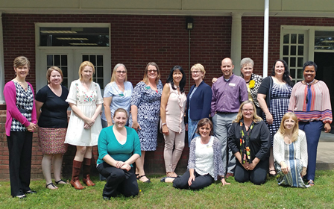



















Join the CGR Team
CouncilonGrants&Research
for Oklahoma Universities
To Join CGR, Visit:
www.okhighered.org/grant-opps/cgr/
Like Us On Facebook
Notes:
To change this brochure, replace our sample content with your own. Or, if you'd rather start from a clean slate, press the New Slide button on the Home tab to insert a new page. Now enter your text and pictures in the empty placeholders. If you need more placeholders for titles, subtitles or body text, copy any of the existing placeholders, then drag the new one into place.

Slide 2
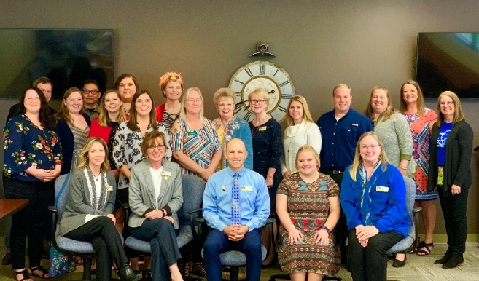

Membership
Membership is distinguished into full and affiliate membership. Full membership is open to all sponsored program officers at the regional universities in the state of Oklahoma. Full membership members have voting rights and the right to hold office. Affiliate membership is open to sponsored program officers at Oklahoma public/independent universities and community colleges as well as to emeritus members of the Council on Grantsmanship and Research and the Coordinator for Grantsmanship at the State Regents. Though affiliate members do not have voting rights and cannot hold office, they will benefit from the sharing of grant-related information in terms of policies and resources.
Mission
Vision
The mission of the Council on Grants and Research (CGR) is to offer support and resources to facilitate grant proposal writing and program review across institutions of higher education in the state of Oklahoma.
In the service of grantsmanship and research across the State of Oklahoma, the CGR vision includes:
* creating a forum for the exchange of ideas and relevant policies among sponsored program officers
* promoting continuous improvement and a commitment to grantsmanship
* providing opportunities and resources to facilitate grantsmanship in support research endeavors
* serving as an advocate of grantsmanship by providing relevant resources
Meetings
History
The Council on Grants and Research (CGR) is a group of sponsored program officers and grant writers from Oklahoma’s regional universities. The council was formed as an outcome of the Oklahoma universities and colleges grant administrators’ meeting hosted by the Oklahoma State Regents for Higher Education in July 2004. The organization focuses on the importance of using external funding as a means to drive intellectual capital on campuses and as a means to support high-quality learning experiences for students. It encourages the successful pursuit of funding opportunities through collaboration and provides a network of support to advance grantsmanship and research activities among Oklahoma’s institutions of higher education.
CGR meets on a regular basis throughout the academic year to discuss grant proposal writing and share resources to facilitate this activity at institutions of higher education across the state.
Goals
Contact Us
1. Enhance Visibility of Grantsmanship Opportunities and Resources
2. Expand Grantsmanship Opportunities and Resources
3. Sustain Involvement in the council on Grantsmanship and Research
www.okhighered.org/grant-opps/cgr/
CouncilonGrants&Research
for Oklahoma Universities

