Slide 1


Cheryl Dowd
Director,
WCET/State Authorization Network (SAN)
cdowd@wiche.edu

Slide 2
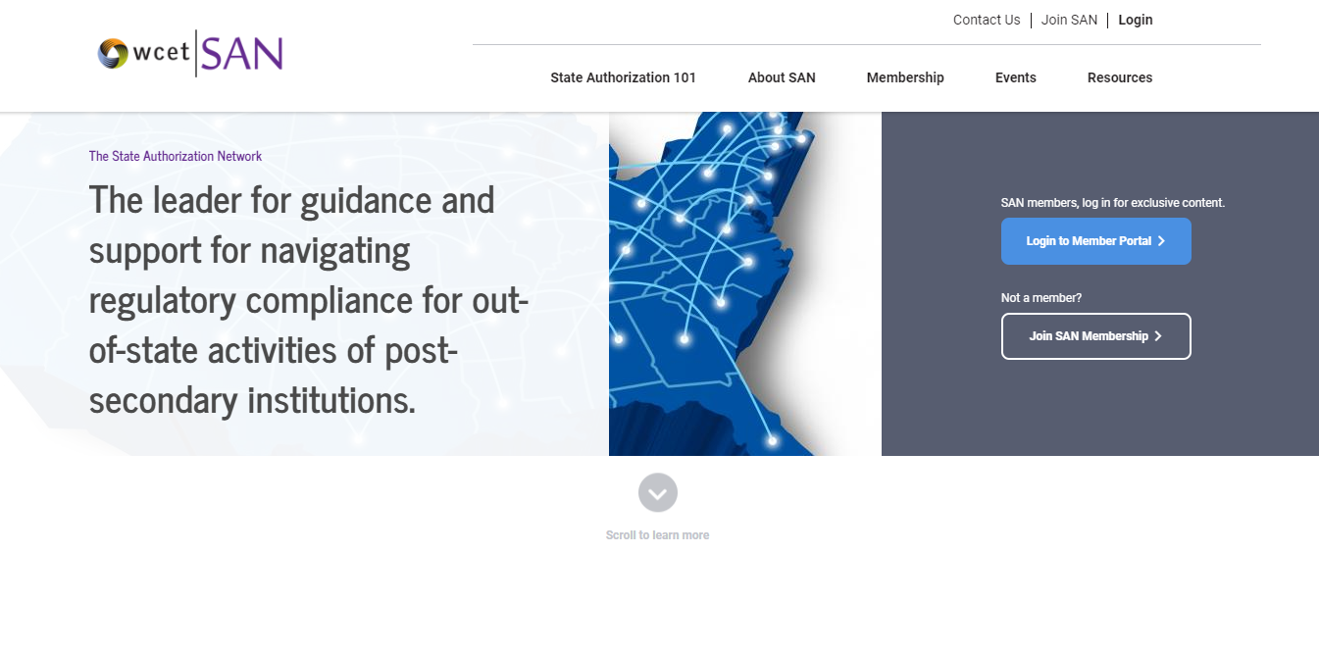

Who is SAN?

Slide 3
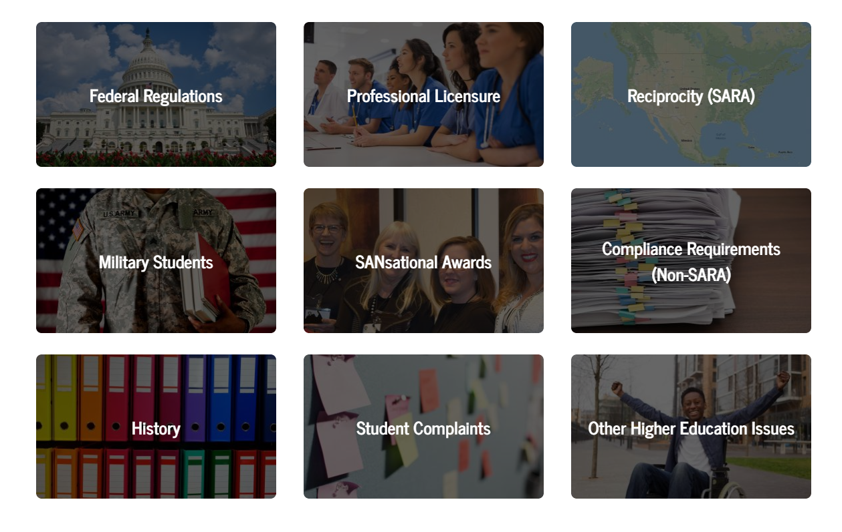
Resources Available Through SAN
Website: https://wcetSAN.wiche.edu
Also very helpful:
WCET Frontiers https://wcetfrontiers.org

Slide 4
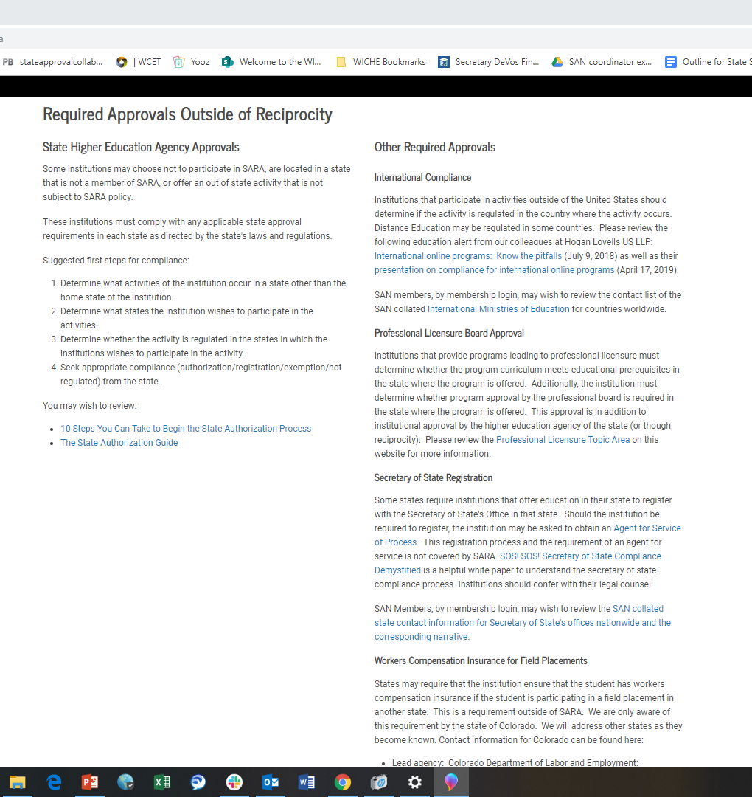
Required Approvals Outside of Reciprocity
International
Secretary of State
Workers Comp Ins.

Slide 5



Fundamentals of State Compliance
State authorization…
if you are crossing a state line to perform ANY activity you should check to see if it is regulated by that state.
(State compliance)

Slide 6

Options for State Compliance
State by State Compliance:
Varied Oversight by State
Varied Applications
Varied Definitions
Varied Reporting
Varied Costs
Reciprocity:
Interstate agreement
Consistent Oversight
Uniform Process
Voluntary for States to join
Institutions apply to their state.
SARA Manual

Slide 7
Federal Compliance
Federal Regulations: tying State compliance to participation in Title IV HEA programs.
10 years in the making:
2009 – A negotiated rulemaking committee discussed the issue of state authorization.
2010 – Final regulations for State Authorization- includes distance ed. (600.9(c)).
2011-2012 – Federal Courts struck 600.9(c) on procedural grounds.
2014 – A negotiated rulemaking committee- no consensus.
2016 – Final regulation released for state authorization of distance ed (w/disclosures).
2018, July - USED Delays regulations for review and revision.

Slide 8
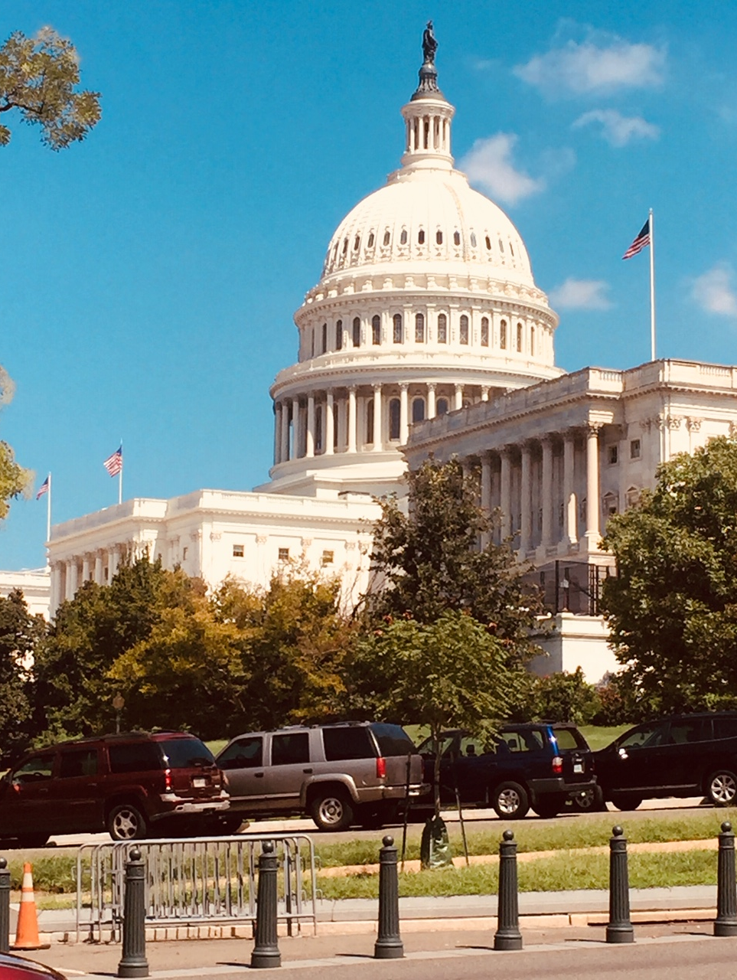
Negotiated Rulemaking Accreditation and Innovation
Purpose: Define or revise regulations.
Long list of issues identified.
Three subcommittees named.
If the main committee doesn’t reach “consensus,” the Department writes the rules.

Slide 9

Consensus Reached! (April 3, 2019)
Bucket #1 – Accreditation, Definition of Credit Hour and Byrd Scholarship
Bucket #2 – TEACH Grant and Religious Freedom
Bucket #3 – Distance Education, State Authorization for Distance Education, and Competency Based Education

Slide 10

Timeline for Packages of Regulations
After Consensus, USED indicated proposed regulations will be
released in multiple packages (not necessarily corresponding to the buckets).
Timeline:
June 12, 2019: Package #1 released for public comment.
By Nov 1, 2019: Package #1 Final regs released.
July 1, 2020: New Regulations of Package #1 go into effect*.
AFTER Nov 1, 2019: Package #2 & #3 to be released. Earliest effective date would be July 1, 2021*.
* Final Regulations can be subject to early implementation as designated by USED.

Slide 11
Federal Lawsuit
NEA, California Teachers Assoc. et al., v. Betsy DeVos, USED, et al.
April 26, 2019 Ruling
Vacatur of the Delayed 2016 Federal Regulations.
Court indicates USED improper process to delay the regulations.
Ruling Stayed for 30 days.
May 26, 2019 – 2016 Federal Regulations effective.
No guidance from the Department until July 22, 2019.
Institutions were not sure what to do.

Slide 12
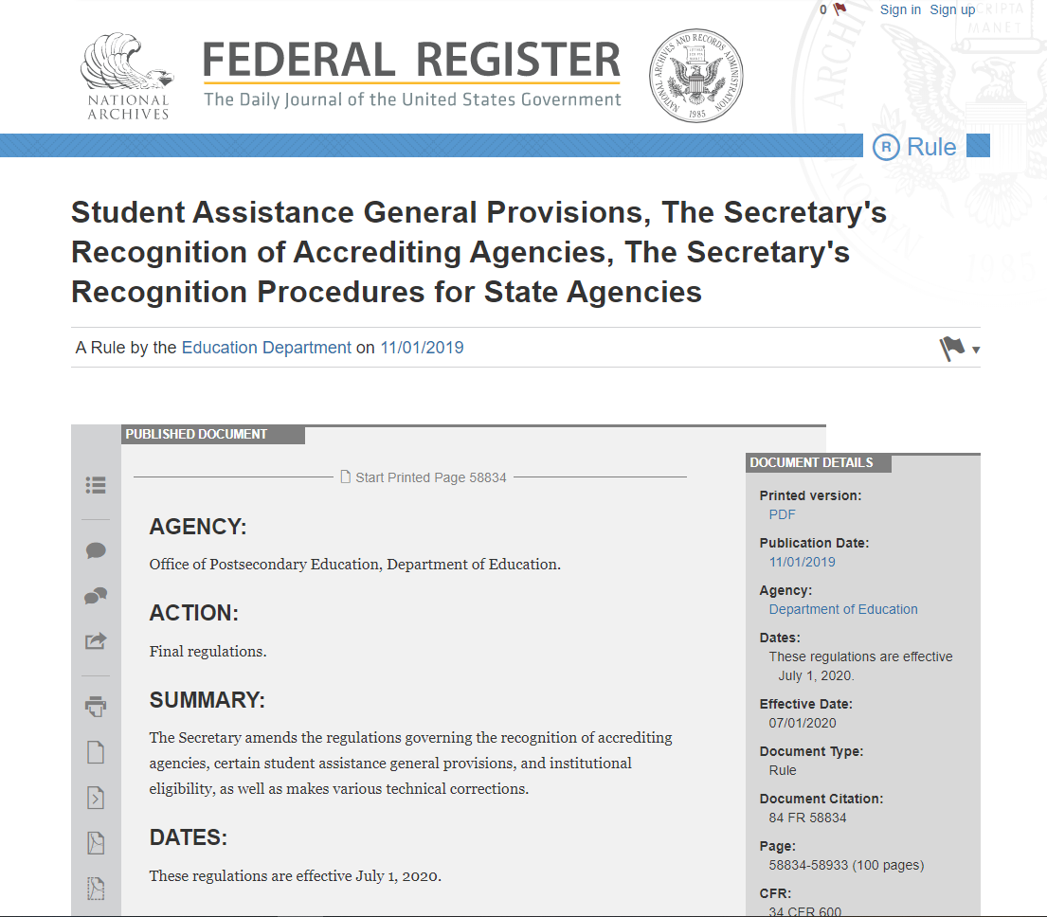
2019 Federal Regulations

Slide 13

State Authorization Reciprocity Agreement 34 CFR 600.2
Agreement between 2 or more states that allows institutions to provide educational activities in other states as directed by the agreement.
States that volunteered to participate are to follow reciprocity agreement processes for distance education authorization.
State may enforce its own general purpose laws that would apply to any business.

Slide 14
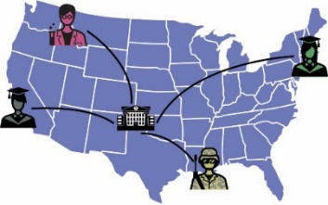
State Authorization 34 CFR 600.9(c)
Tied to Aid– Eligibility to disburse aid tied to the institution having approvals demonstrated by:
Direct approval by the state.
Through a state authorization reciprocity agreement.
Student Location
Defensible Process
At enrollment or Formal receipt of information from the student that the location has changed.

Slide 15

Disclosures & Professional Licensure Disclosures 34 CFR 668.50;34 CFR 668.43(a)(5)(v) and 34 CFR 668.43(c)
Distance Education Disclosures removed to eliminate redundancy as most were required elsewhere.
2019 Proposed Federal Regulations disclosure requirements for professional licensure/certification for all modalities. (Face to face!)
General and Direct Disclosures.

Slide 16
2016 Distance Ed Disclosures removed- 668.50
Public Disclosures for educational programs offered solely through distance education:
Authorization by the state or reciprocity.
Complaint process where the institution’s main campus is located.
Complaint process where the student resides.
Adverse Actions initiated by State entities.
Adverse Actions initiated by accrediting agencies.
Refund Policies required by a State
Professional Licensure
NOW General Disclosures all modalities: 668.43
34 CFR 668.43 (a)(6)
34 CFR 668.43 (b)
Not provided
34 CFR 668.43 (a)(20)*
34 CFR 668.43 (a)(19)*
34 CFR 668.43 (a) (2)
34 CFR 668.43(a)(5)(v) & 34 CFR 668.43(c)

Slide 17

General Disclosures – Professional Licensure CFR 668.43(a)(5)(v)
A list of states for which the institution has determined that the curriculum meets licensure requirements.
A list of states for which the institution has determined that the curriculum does not meet licensure requirements.
A list of states for which the institution has not made a determination whether the curriculum meets licensure requirements.

Slide 18
Direct Disclosures 34 CFR 668.43(c)
If the institution indicates that it does not meet or has not made a determination where the prospective student is located; notice to that student must take place prior to the student’s enrollment in the program.
If the institution makes the determination that the program does not meet requirements in a state where an enrolled student is currently located, the institution must provide that notice within 14 days of making that determination.
Disclosures are to be directly to the student in writing. – email is sufficient.
Changes to location will be upon formal receipt of information from the student that the student has changed to another state.

Slide 19

Early Implementation
Authority exercised by the Secretary of the USED.
Designate certain regulations for early implementation.
At the discretion of the institution.
2016 Fed Regs now.
Implement new 2019 Fed Regs for 7/1/20.
Implement new 2019 Fed Regs now.
Not a choice: Do nothing until July 1, 2020

Slide 20

Compliance Strategies - Processes
Develop Institutional Processes
Collaboration with Key Stakeholders
Provosts, VP’s
General Counsel
Financial Aid Staff
Academic Departments
Admissions & Registration Staff
Academic Advisors
IT & Institutional Research
Others??

Slide 21
Compliance Strategies - Document
Document Institutional Processes & Implementation
Institutional Processes should be documented for staff to implement.
Implementation of the processes should be documented to show consistent practices at the institution.
Documentation showing consistent practices may then be available to show evidence of State/Reciprocity or Federal compliance.

Slide 22
Resources
SAN Website: https://wcetSAN.wiche.edu
WCET Frontiers: https://wcetfrontiers.org
Final Federal Regulations for State Authorization Released, WCET Frontiers
Final Regulations published Nov 1, 2019; Federal Register
Considerations for Early Implementation of State Authorization Federal Regulations, WCET Frontiers
SAN Basics Workshop – Boulder, CO; June 3-4, 2020. Information is Here!
NASASPS Conference with coordination by SAN – New Orleans, LA; April 26-29, 2020 Information is Here!
Notes:
Navigate around SAN website.

