Slide 1
Summer Academies
2023
Technical Assistance Meeting
Friday, August 19, 2022

Slide 2
Summer Academy Team
Dr. Colbi Beam - Coordinator for Academic Affairs and
K-12 & Postsecondary Student Success Initiatives
Dr. Kyle Foster – Assistant Vice Chancellor for Academic Affairs
Annette Long - Director of Student Preparation for College Readiness
Sabrina Wood - Coordinator of Student Preparation for College Readiness

Slide 3
The 1989 Oklahoma Legislature in Senate Bill No. 269 appropriated funds to the Oklahoma State Regents for Higher Education for Summer Academies.

Slide 4
Basic Requirements
Accredited Oklahoma degree-granting institutions of higher education
Must serve only Oklahoma students, rising 8th -12th grade; must be open to ALL students in these grades
Maximum two week Academies

Slide 5
General Guidelines
Not traditional classroom experience
Hands-on activities
Student exploration, experimentation, career motivation
MINIMUM or NO Lecture!
NO funds from students/parents

Slide 6
Absolute Priorities
Make success in college an expected and logical outcome for ALL student participants with particular emphasis on those young people from subgroups most likely to be underserved in the fields of mathematics, science, technology and engineering.

Slide 7
Absolute Priorities continued
Provide stimulating learning opportunities
Combine learning and fun
Help develop early awareness about need to plan for college
Fully expose students to college campus experience
Build in young people a sense of accomplishment
Develop and promote career and educational aspirations
*Seek partnerships toward relevant work experiences for students
Notes:
*We definitely encourage partnerships with local industry, but our focus is that this is engaging students in math and science in a fun way, exposing them to content and rigor and the benefits of a degree in this area.

Slide 8
We encourage you to actively recruit underserved students
Reach out to schools, tribes, community centers, counselors, science/math teachers, churches, other civic/community organizations that serve the students that are most likely to be underserved in the STEM fields. The TRIO programs on your campuses are an excellent place to start
To the extent that you can, be intentional to create a student group that is diverse in education, family education, SES, ethnicity, geography, etc. as you choose your students
Recognize and accommodate barriers related to underserved students
Notes:
Should be clear criteria for your applicants

Slide 9
STUDENT Application stumbling blocks
Requiring a high GPA or high ACT score
Having an extensive application process
Lengthy forms/lengthy essays
Requiring letter of reference from principal
Asking for ONLY school references
Requiring administrator’s signature
Please ensure easy access to the application
Notes:
You should have clear criteria and apply it across all applicants

Slide 10
Residential or commuter
If you have the ability we STRONGLY encourage you to host a residential academy
If you have a commuter academy please consider:
An academy schedule 9:00 am – 4:00 pm may create a barrier
we encourage you to schedule for longer than a work day and consider holding the drop off and pick up times outside of the regular work day
consider providing transportation
Notes:
It will open your academy up to more students from diverse backgrounds. There are many things you need to consider in your planning, but it may help with the low participation that many commuter academies had this year.
Many families cannot take their child to an academy that starts an 9 and ends at 4 for a week.

Slide 11
Honor Statement for Application Form
Several hundred Oklahoma students are applying for State Regents Summer Academies. Students attending more than one State Regents Summer Academy may prevent many other students from having this opportunity. Although some Academies do not have waiting lists, others have very long waiting lists.
So that more students may attend a State Regents Summer Academy, I will notify Academy Directors if I am accepted for more than one 2022 Academy.
Applicant signature______________________________
Notes:
We’d like to encourage you to include this in your application. We may require it and include it in the FY 24 RFP.

Slide 12
TO Submit a proposal
RFP can be found at https://www.okhighered.org/grant-coordination/osrhe-grants.shtml#sa
Fill out this online application: https://www.surveymonkey.com/r/Q3WWP76
Within the online application, you will upload the following:
Professional Staff Brief Vitae
Letter of Institutional Support (Sample in RFP)
Your Proposal Narrative
Student Participant Application Questions and Requirements-NEW
FY23 Summer Academies Budget (XLSX, 13k)
FY23 Summer Academies Statement of Assurances (PDF, 69k)
FY23 Recipient Commitment Form (PDF, 93k)

Slide 14
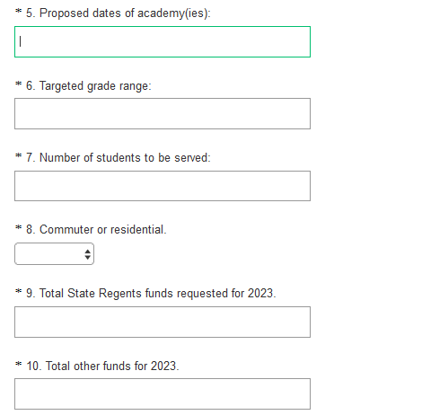

Slide 15
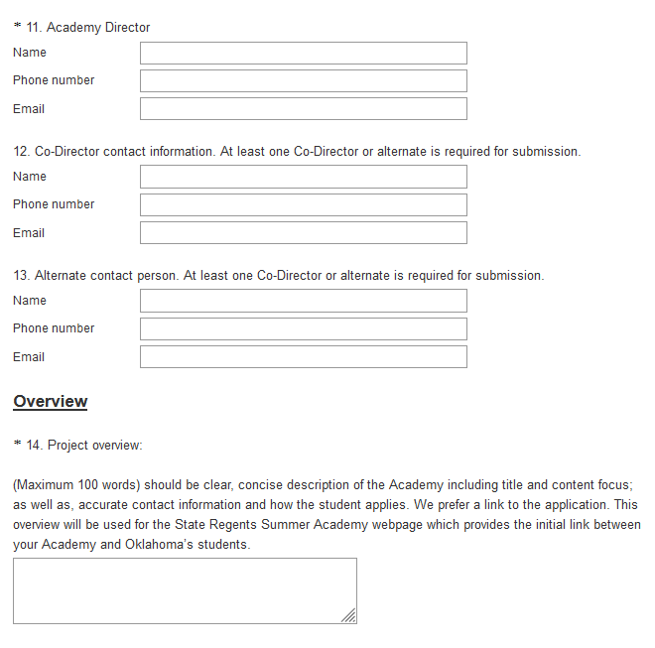

Slide 16
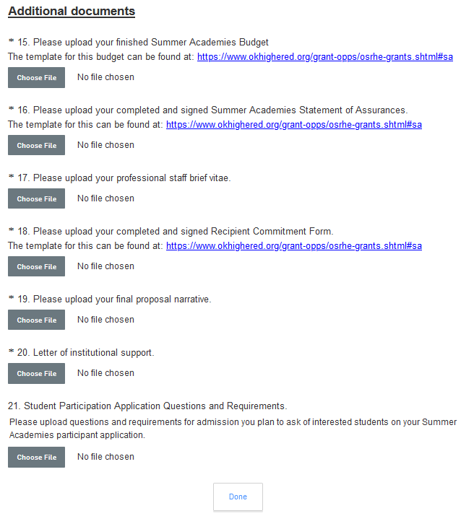

Slide 17
Some Changes in the FY23 RFP
New budget forms! And new Funding formula
All students who apply on or before the April 1, 2023 selection date must be treated equally.
Dissemination Plan
Proposals must contain a dissemination plan that includes strategies to inform local and state communities about the outcomes and success stories of the Summer Academy. It is strongly encouraged that Summer Academy directors and their affiliated institutions submit press releases after the Summer Academy to local and state media outlets. Other recommended strategies include setting time aside near the end of programs for students to write letters to their elected officials or local newspaper about their experience. Creativity in this area is encouraged.
Past performance may impact future funding
In reviewing Summer Academy proposal applications, the State Regents may consider previous Summer Academy program performance, including but not limited to conformance to applicable Summer Academy Guidelines and Procedures, timeliness of compliance with applicable reporting requirements and funding expenditures, and site visit evaluations.
Short online survey (provided by the State Regents) at the end of the Summer Academy to acquire student feedback.
Submit an electronic copy of your student application with your proposal.

Slide 18
Funding
Residential - $200 per FTE per day
Commuter - $175 per FTE per day
50% funds will be disbursed on April 30, 2023
Remaining funds disbursed on June 30, 2023
Notes:
Student incentives are allowed

Slide 19
For Awarded proposals
After the December Regents meeting your president will receive an email with an attached agreement, you will be CC’d. It is your responsibility to make sure we get the signed agreement back by the deadline.
Awardees may start distributing information after Directors’ orientation meeting in January
OSRHE Communication Department will have a design to add to your website

Slide 20
Timeline RFP page 3
September 30, 2022 Proposal submission due
December 8, 2022 Notification of Awards at Regent’s Meeting
January 20, 2023 Orientation meeting for Directors of funded Summer Academies
February 1, 2023 Final Overview edits due (including URLs & application information)
March 1, 2023 Student application goes live on Okcollegestart website
April 1, 2023 Student selection may begin
April 30, 2023 First 50% of payment sent out
June 30, 2023 Second 50% of payment sent out
September 15, 2023 Final reports due

Slide 21
Contact Information:
summeracademies@osrhe.edu
Annette Long/Director of Student Preparation for College Readiness
E-mail: along@osrhe.edu
Phone: 405.225.9156
Colbi Beam/Coordinator for Academic Affairs and K-12 & Postsecondary Student Success Initiatives
Email: cbeam@osrhe.edu
Phone: 405.225.9308

